Slide 1
國立屏東大學 資工系研究所專題講座
緯創資通
技術發展部門 CTO 辦公室
Emma S.Y. Chao
2021.11.22

Slide 2
Agenda
Introduction
What is ?
AI
AI Trend
AI Applications
How to ?
Where to start ?
on the right track
Women in Tech.
Plan action items

Slide 3
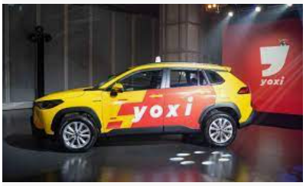
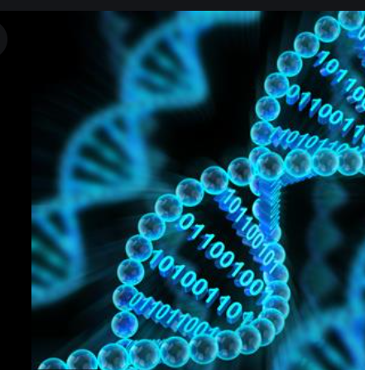
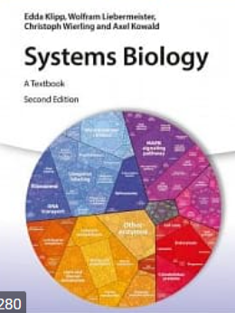
Introduction
Assistant Professor in CSIE Dept.
校務研究中心副執行長
Machine Learning
Department Head.
數據總監
AI/ML
Department Head
資深經理
工程師 / 講師
CSIE PhD Degree
Certificated
MCSE
Bioinformatics
教學 , 研究 , 行政
校務研究中心
大數據
Hadoop生態系
客戶 360 度標籤
數位行銷
價格預測
訂購量/安全庫存預測
AOI/聲音瑕疵檢測
Predictive Maintenance
Tactile Sensor
AR/MR Applications

Slide 4
What is AI ?

Slide 5
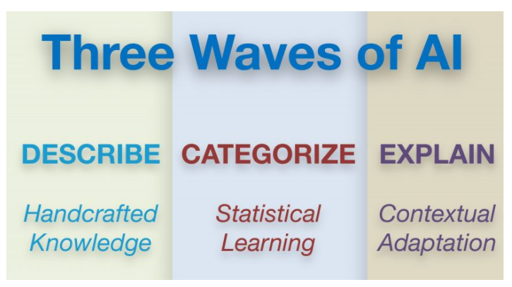
AI trends
DARPA (Defense Advanced Research Project Agency) 美國國防高等研究計畫署 , 2017
1970s – 1990s | 2000s -- 2019 | 2020s – 2030s
Good at reasoning, but no ability to learn or to generalize | Good at learning and perceiving, but minimal ability to reason or generalize | Excellent at perceiving, learning and reasoning, and able to generalize
Symbolic, heuristic, rule based Handcrafted knowledge, expert systems 僅限於幾個嚴格定義的問題，且沒有學習能力，不能處理不確定性問題 | Statistical learning, Deep NN, CNN Advanced text, speech language and vision processing 大數據/Hadoop related Recognition 為主 無特徵建模需求開始增加 (un-supervised learning) | Contextual adaption(情境適應), able to explain decisions. Can converse in natural language Requires far fewer data samples for training Able to learn and function with minimal supervision

Slide 6
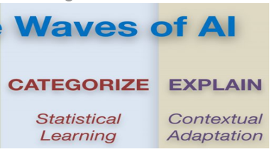
Perceive 感知能力 – rich, complex and subtle information
Learn 學習能力 – within an environment (?)
Abstract 抽象能力 – to create new meanings
Reason 推理能力– to plan and to decide
Complex signal
資料源多樣性 , 資料源組合性 , 間接推斷
Context – Aware
Able to perceive at the same level as a human does
Detect Signals
訊號偵測
震動感測器 , Radar,
壓力感測器
Requires far fewer data samples for training. (for new task)
Few-shot learning
需要 prior knowledge (prior data or prior model)
Defect Recognition
Use Case
OCR 光學字元辨識
(受限環境下表現優)
Intelligent QA 問答系統
先理解再組合(生成答案)
Generation
生成資料(訊)
(不是訓練資料)
SOP Recognition
Use Case
Action Recognition
Use Case
Speech Recognition
NLU
語意理解
(大)數據強烈相關
Face Recognition
(身分確認)
生物辨識
(聲音 , 虹膜 , 指紋)
對話機器人
(特定領域 , 腳本規範)

Slide 7
AI Applications
In Heath Care, smart Medical
Protein-Protein interaction
Drug resistant
Sleep Apnea
In E-Commerce
Customer 360 v.s Digital Marketing
Blueprint v.s. online Community v.s. Chatbot
In smart Manufacture
more examples

Slide 8
How to

Slide 9
Where to START ?
Data Type
Image, Numerical, Text, Acoustic
Where is the passion would be ?
Technology skills
基本功
資料結構
演算法
作業系統
資料庫
系統分析與設計
實作才是真理

Slide 10
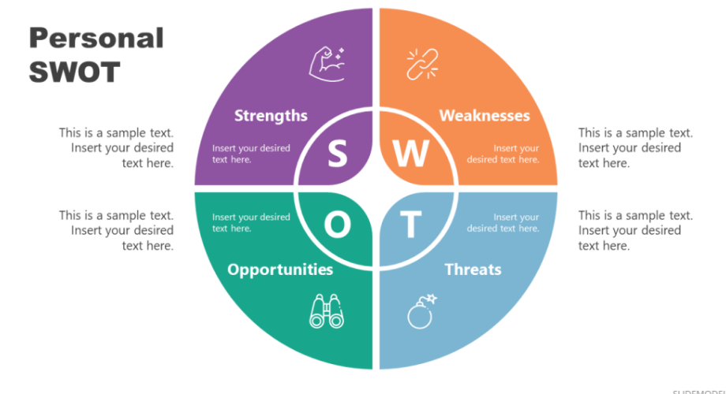
On the right TRACK
104 JD
Interviewers’ Questions
PPT
Code Review
Have questions proactively
Personal SWOT
Compete with yourself first

Slide 11
Women in Tech.
Differences ?
I think the differences are getting fewer.
It is all about your personality and attitude.
Never stop Learning, increase Professionalism constantly
Observation
https://women-in-tech.org/
http://www.twepress.net/ 女科技人電子報

Slide 12
Plan action items
原子習慣
Short-tern Plans
3-24 months
Learn something new or improve skills
Long-tern Plans
3-5 years career path
Get promoted ?
Distinct industry ? (跨領域)
完成 6 個國家旅行
Changes with environment and situations

Slide 13
Q and A

Slide 14
同場加映

