Slide 1
Ray-tracing Algorithm and Hardware
Reporter: 邱敬捷 博士候選人
Department of Computer Science
National Chiao Tung University
Taiwan, R.O.C.
2017/10/24

Slide 2
這個…被顯卡邊緣的圖學技術是怎麼來的?

Slide 3
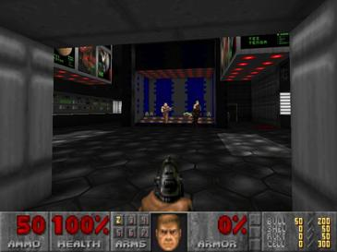
故事是這樣的…
很久很久以前…大約30年前
那時的三維遊戲畫面長這樣
乾那賽…

Slide 4
然後有兩位大大跳了出來…
在計算機圖學界
我覺得影像就是要逼真！要漂亮！
我覺得影像能接受就好了，重點是能即時畫出來
小R (Reality)
小A (Approximation)

Slide 5
然後有兩位大大跳了出來…
我要模擬光的各種物理現象，創造一種跟真實世界極為類似的一種演算法
我只要用各種平行技術與近似技術，還要把硬體升級，讓速度更快
小R
小A
此後兩位分道揚鑣…

Slide 6
然後…各自發展新技術
看這片森林，光線灑落在每片葉子上，連葉脈都清清楚楚
森林喔，直接用照片貼一貼就好了啦，這樣才不用每顆都畫
小R
小A
Ray Casting技術
Texture 技術

Slide 7
影像比較
小R
小A
vs

Slide 8
然後…
看這影子，超真實的，雖然畫了我一小時
影子，不就圓圓一坨就好了嗎，快就對了
小R
小A
Shadow Ray技術
Shadow技術?

Slide 9
影像比較
小R
小A
vs

Slide 10
然後…
看，我可以反射出鏡子中的成像，還可以折射水中的筷子，雖然要多畫上一個小時
…不需要這種東西，直接不畫，這樣更快
小R
小A
Ray Trace技術
???

Slide 11
影像比較
小R
小A
筷子在水中被折射了
(對不起 太難畫了)
vs
啊就不想做麻

Slide 12
到了推廣的時後
大家看，我的畫出來的影像超逼真的，雖然要花點時間
大家看，雖然畫的有點假，但可以即時互動喔！
小R
小A
欸…玩遊戲轉個身要三小時，怎麼受的了，還是快一點的好了
遊戲市場

Slide 13


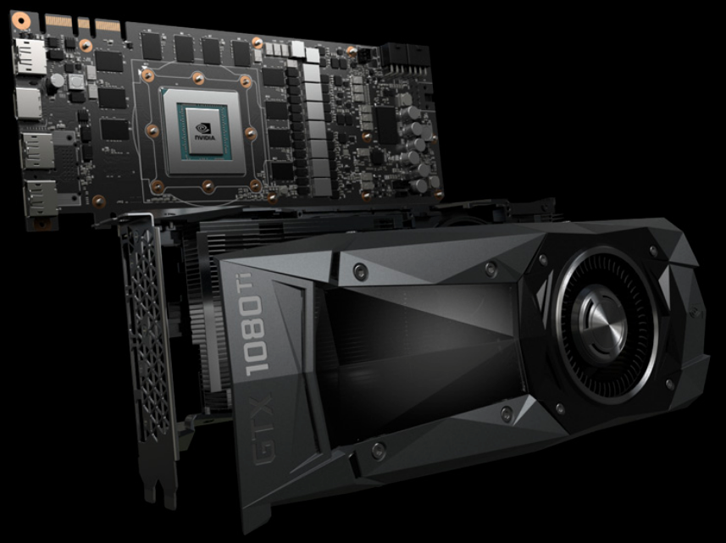
之後…
Ray Tracing
http://www.disney.com.tw/cars/
https://www.geforce.com.tw/graphics-cards/geforce/pascal/tw/gtx-1080-ti/
小R
小A
小A受遊戲市場歡迎，廠商與玩家大量投入，小R變成邊緣人，改往電影界發展

Slide 14
Outline
Introduction
Ray-casting Algorithm
Ray-tracing Algorithm
Traversal Tree Algorithm
Ray-tracing Hardware
Traversal Tree and Build Tree Hardware
Conclusion

Slide 15
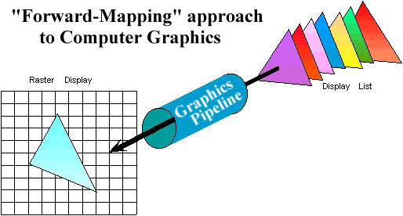
Graphics Pipeline Review
Properties of the Graphics Pipeline
  Primitives are transformed and projected (not depending on display resolution)
  Primitives are processed one at a time.
  Forward-mapping from geometrical space to image space

Slide 16
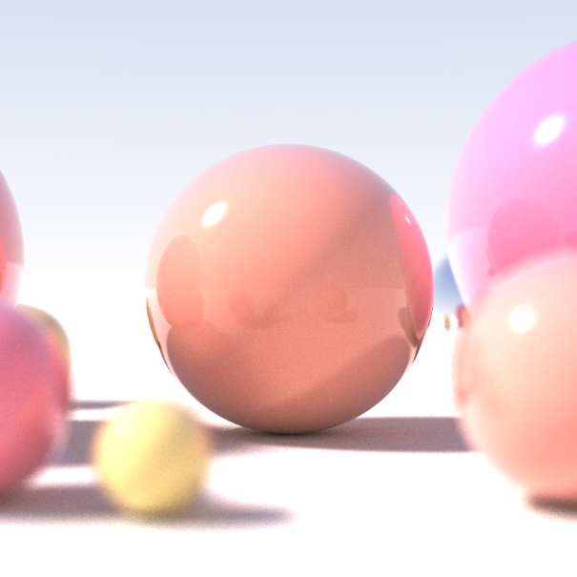
Realistic Images synthesis
Global illumination
  Radiosity (Finite elements)
  Ray tracing (Point sampling)
  Photon mapping (Point sampling)
https://upload.wikimedia.org/wikipedia/commons/3/32/Recursive_raytrace_of_a_sphere.png

Slide 17
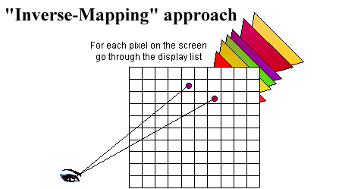
Ray Casting (1/2)
Ray-casting searches along lines of sight, or rays, to determine the primitive that is visible along it.
Properties of ray-casting:
  Go through all primitives at each pixel
  Image space sample first
  Analytic processing afterwards

Slide 18
Ray Casting (2/2)
For every pixel shoot a ray from the eye through the pixel.
For every object in the scene
  Find the point of intersection with the ray closest to (and in front of) the eye
  Compute normal at point of intersection
Compute color for pixel based on point and normal at intersection closest to the eye (e.g. by Phong illumination model).
t₀

Slide 19
Ray-tracing (1/4)
Cast rays from the eye point the same way as ray casting
  Builds the image pixel by pixel, one at a time
Cast additional rays from the hit point to determine the pixel color
  Shoot rays toward each light. If they hit something, then the object is shadowed from that light, otherwise use “standard” model for the light
  Reflection rays for mirror surfaces, to see what should be reflected in the mirror
  Refraction rays to see what can be seen through transparent objects
  Sum all the contributions to get the pixel color

Slide 20
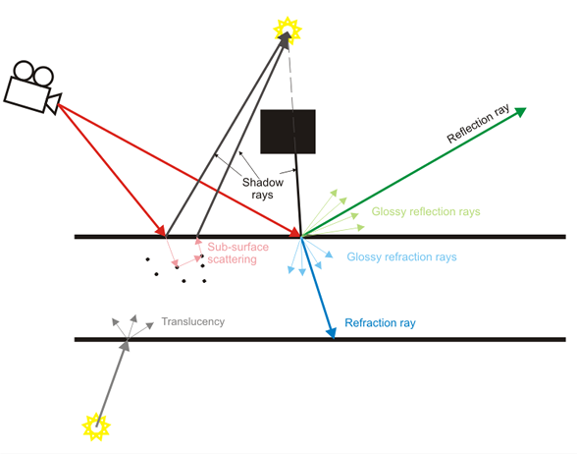
Ray-tracing (2/4)
http://help.chaosgroup.com/vray/help/rhino/150R1/basic.htm
Notes:
Ray tracing is a technique for generating an image by tracing paths of light from the camera through pixels in an image plane and simulating the effects of its encounters with virtual objects. To create different effects different rays are traced. The above diagram shows how the basic effects are generated. Primary rays (Red) are always traced from the camera into the scene in order to determine what will be visible in the final image. To create the direct illumination and shadows "Shadow rays "(Black) are traced from each rendered point to each light in the scene. If the rays "hit" a light the point is illuminated based on the light's settings. If they hit an object the point is shaded. Reflection rays (Green) are traced in the direction of the reflection vector which depends on the type of reflection - fresnel or normal and the index of refraction of the material. The direction of the Refraction rays(Blue) depends only on the index of refraction of the material. For clear reflections and refractions only a single ray is traced. To create glossy reflections or refractions many rays are traced in a cone - the spread of the cone depends on the glossiness amount.
Subsurface scattering and translucensy effects are generated by tracing rays inside the geometry.

Slide 21
Ray-tracing (3/4)
Primary rays (Red) are always traced from the camera into the scene in order to determine what will be visible in the final image.
To create the direct illumination and shadows "Shadow rays "(Black) are traced from each rendered point to each light in the scene.
  If the rays "hit" a light the point is illuminated based on the light's settings.
  If they hit an object the point is shaded.
Reflection rays (Green) are traced in the direction of the reflection vector which depends on the type of reflection - fresnel or normal and the index of refraction of the material.
The direction of the Refraction rays/Transmitted rays (Blue) depends only on the index of refraction of the material.
http://help.chaosgroup.com/vray/help/rhino/150R1/basic.htm
Notes:
Ray tracing is a technique for generating an image by tracing paths of light from the camera through pixels in an image plane and simulating the effects of its encounters with virtual objects. To create different effects different rays are traced. The above diagram shows how the basic effects are generated. Primary rays (Red) are always traced from the camera into the scene in order to determine what will be visible in the final image. To create the direct illumination and shadows "Shadow rays "(Black) are traced from each rendered point to each light in the scene. If the rays "hit" a light the point is illuminated based on the light's settings. If they hit an object the point is shaded. Reflection rays (Green) are traced in the direction of the reflection vector which depends on the type of reflection - fresnel or normal and the index of refraction of the material. The direction of the Refraction rays(Blue) depends only on the index of refraction of the material. For clear reflections and refractions only a single ray is traced. To create glossy reflections or refractions many rays are traced in a cone - the spread of the cone depends on the glossiness amount.
Subsurface scattering and translucensy effects are generated by tracing rays inside the geometry.
Transmitted rays: Rays from a point on a transparent surface through the surface

Slide 22
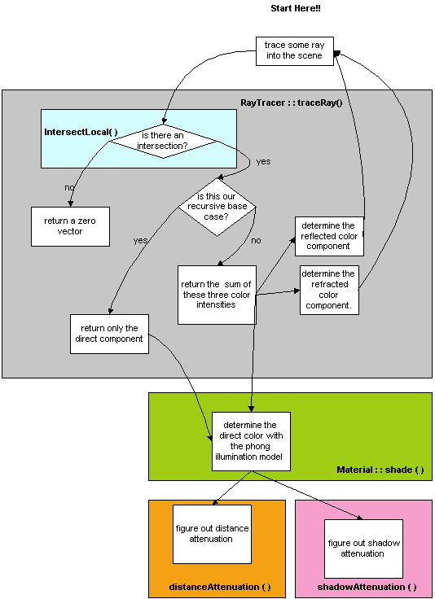
Ray-tracing (4/4)
https://courses.cs.washington.edu/courses/cse457/15au/src/trace/trace.php

Slide 23
Recursive Ray-tracing
Recursive Ray Tracing
Viewpoint
N₃
T₃
R₂
N₂
T₁
R₃
L₁
R₁
L₂
R₁
T₁
N₁
L₃
L₁
L₂
L₃
N_{i} surface normal
R_{i} reflected ray
L_{i} shadow ray
T_{i} transmitted (refracted) ray
Eye
R₂
R₃
T₃

Slide 24
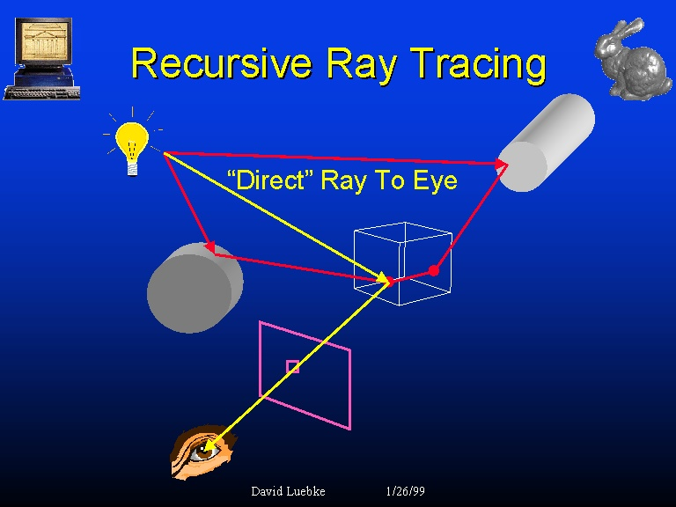
Recursive Ray-tracing
How to detect other tracing paths in red color?
http://www.cs.virginia.edu/~gfx/Courses/1999/advanced.spring99.html/lecture2/sld005.htm

Slide 25
Recursive Ray-tracing
Ray Tracing Illumination

Slide 26
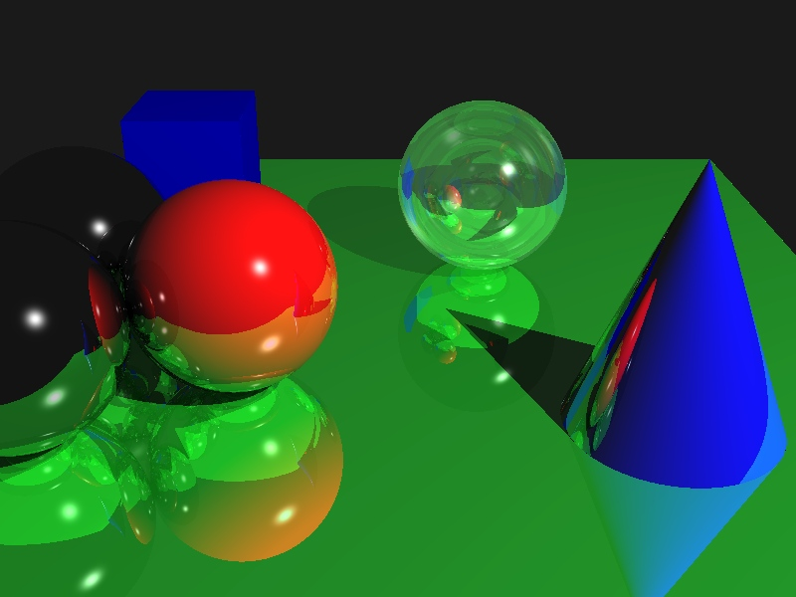
Ray-tracing Results

Slide 27
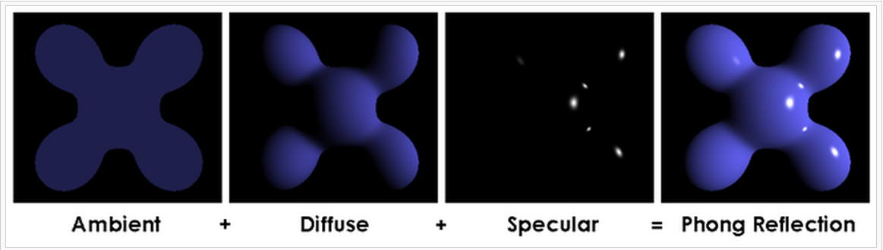
Phone Reflection Model
Visual illustration of the Phong equation: here the light is white, the ambient and diffuse colors are both blue, and the specular color is white, reflecting a small part of the light hitting the surface, but only in very narrow highlights. The intensity of the diffuse component varies with the direction of the surface, and the ambient component is uniform (independent of direction).
https://en.wikipedia.org/wiki/Phong_reflection_model
Notes:
Phong reflection model
From Wikipedia, the free encyclopedia
Not to be confused with Phong shading.
The Phong reflection model (also called Phong illumination or Phong lighting) is an empirical model of the local illumination of points on a surface. In 3D computer graphics, it is sometimes ambiguously referred to as "Phong shading", in particular if the model is used in combination with the interpolation method of the same name and in the context of pixel shaders or other places where a lighting calculation can be referred to as “shading”.
For each material in the scene, the following parameters are defined:
{\displaystyle k_{\text{s}}}, which is a specular reflection constant, the ratio of reflection of the specular term of incoming light,{\displaystyle k_{\text{d}}}, which is a diffuse reflection constant, the ratio of reflection of the diffuse term of incoming light (Lambertian reflectance),{\displaystyle k_{\text{a}}}, which is an ambient reflection constant, the ratio of reflection of the ambient term present in all points in the scene rendered, and{\displaystyle \alpha }, which is a shininess constant for this material, which is larger for surfaces that are smoother and more mirror-like. When this constant is large the specular highlight is small.
Vectors for calculating Phong and Blinn–Phong shading
Furthermore, we have
{\displaystyle {\text{lights}}}, which is the set of all light sources,{\displaystyle {\hat {L}}_{m}}, which is the direction vector from the point on the surface toward each light source ({\displaystyle m} specifies the light source),{\displaystyle {\hat {N}}}, which is the normal at this point on the surface,{\displaystyle {\hat {R}}_{m}}, which is the direction that a perfectly reflected ray of light would take from this point on the surface, and{\displaystyle {\hat {V}}}, which is the direction pointing towards the viewer (such as a virtual camera).Then the Phong reflection model provides an equation for computing the illumination of each surface point {\displaystyle I_{\text{p}}}:
{\displaystyle I_{\text{p}}=k_{\text{a}}i_{\text{a}}+\sum _{m\;\in \;{\text{lights}}}(k_{\text{d}}({\hat {L}}_{m}\cdot {\hat {N}})i_{m,{\text{d}}}+k_{\text{s}}({\hat {R}}_{m}\cdot {\hat {V}})^{\alpha }i_{m,{\text{s}}}).}where the direction vector {\displaystyle {\hat {R}}_{m}} is calculated as the reflection of {\displaystyle {\hat {L}}_{m}} on the surface characterized by the surface normal {\displaystyle {\hat {N}}} using
{\displaystyle {\hat {R}}_{m}=2({\hat {L}}_{m}\cdot {\hat {N}}){\hat {N}}-{\hat {L}}_{m}}and the hats indicate that the vectors are normalized. The diffuse term is not affected by the viewer direction ({\displaystyle {\hat {V}}}). The specular term is large only when the viewer direction ({\displaystyle {\hat {V}}}) is aligned with the reflection direction {\displaystyle {\hat {R}}_{m}}. Their alignment is measured by the {\displaystyle \alpha } power of the cosine of the angle between them. The cosine of the angle between the normalized vectors {\displaystyle {\hat {R}}_{m}} and {\displaystyle {\hat {V}}} is equal to their dot product. When {\displaystyle \alpha } is large, in the case of a nearly mirror-like reflection, the specular highlight will be small, because any viewpoint not aligned with the reflection will have a cosine less than one which rapidly approaches zero when raised to a high power.
Although the above formulation is the common way of presenting the Phong reflection model, each term should only be included if the term's dot product is positive. (Additionally, the specular term should only be included if the dot product of the diffuse term is positive.)
When the color is represented as RGB values, as often is the case in computer graphics, this equation is typically modeled separately for R, G and B intensities, allowing different reflections constants {\displaystyle k_{\text{a}},} {\displaystyle k_{\text{d}}} and {\displaystyle k_{\text{s}}} for the different color channels.

Slide 28
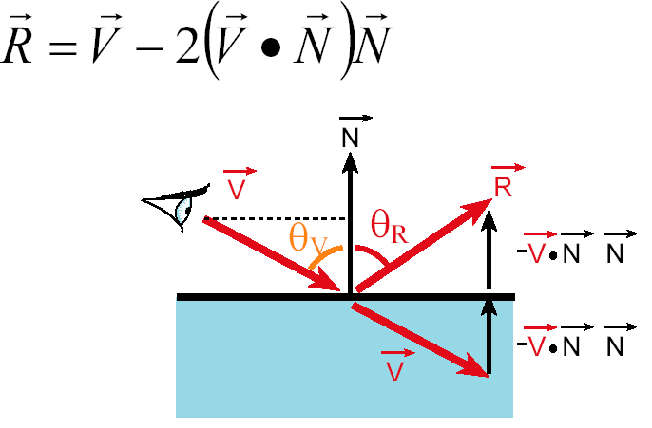
Reflection Ray

Slide 29
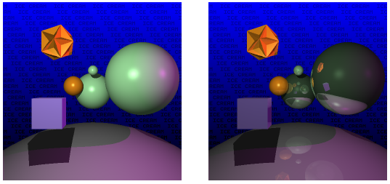
Reflection Ray Results

Slide 30
Refraction Ray
Snell’s Law
Note that I is the negative of the incoming ray
Total internal reflection when the square root is imaginary

Slide 31
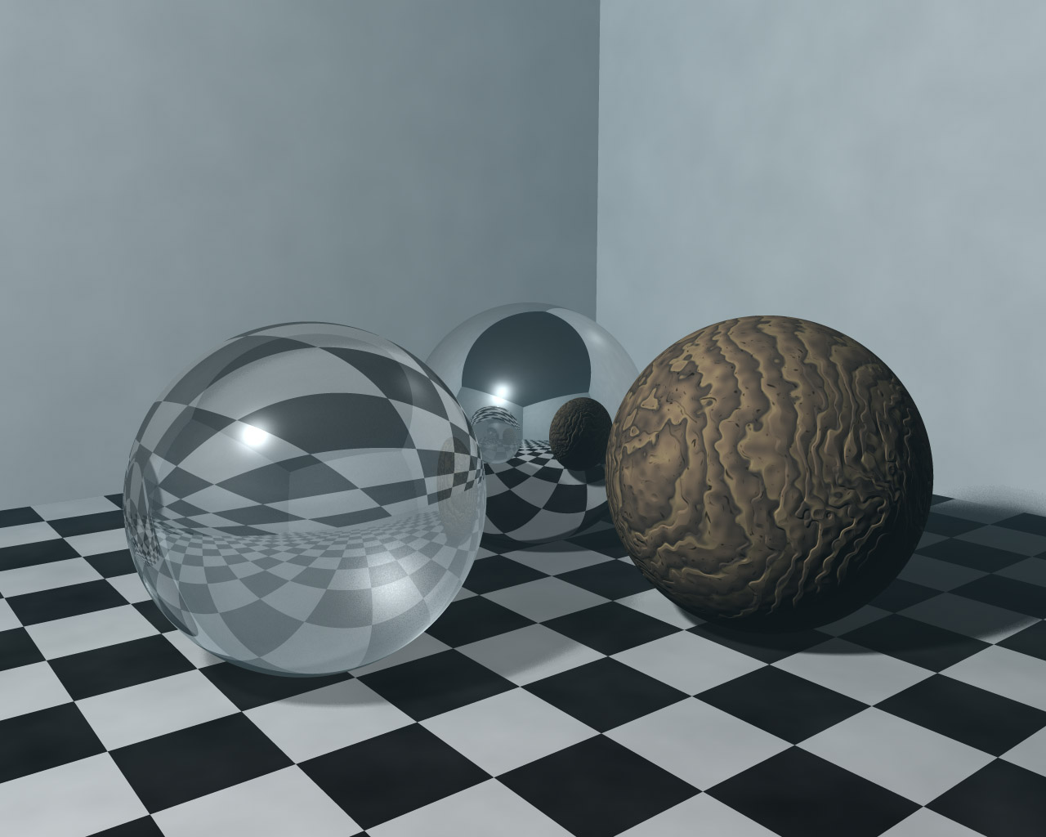
Refraction Ray Results

Slide 32
Shadow Ray
Shoot a ray to the light and try to get the distance to the nearest intersection point .
If the distance > the distance to the light,
add the lighting effect
Space partition will speed up its computation.

Slide 33
Shadow Ray
light
pixel
d_L
d_hit
eye
p
d_L < d_hit , visibility = 1

Slide 34
Shadow Ray
light
d_L
eye
d_hit
d_L > d_hit , visibility = 0

Slide 35
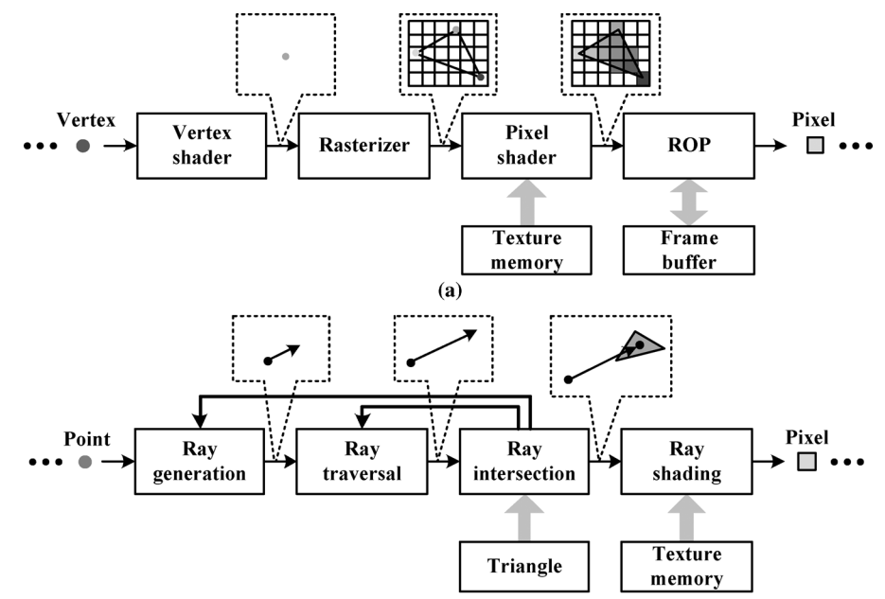
Computational Flow
H. Y. Kim, Y. J. Kim, L. S. Kim, MRTP: Mobile Ray Tracing Processor with Reconfigurable Stream Multi-Processors for High Datapth Utilization, IEEE JSSC, Feb. 2012.

Slide 36
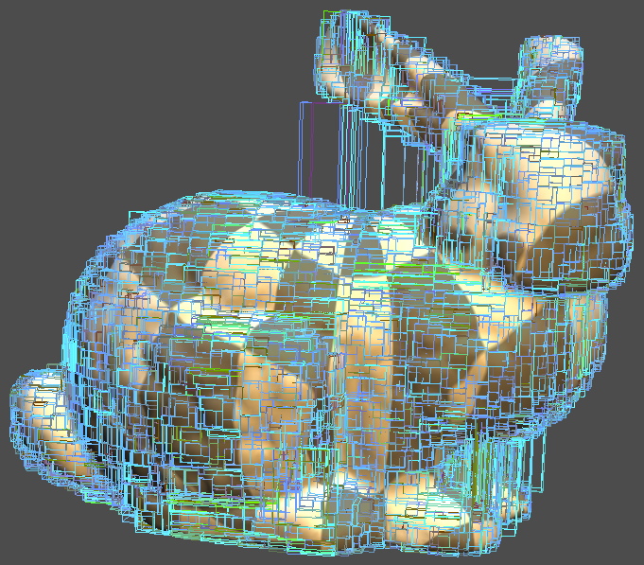
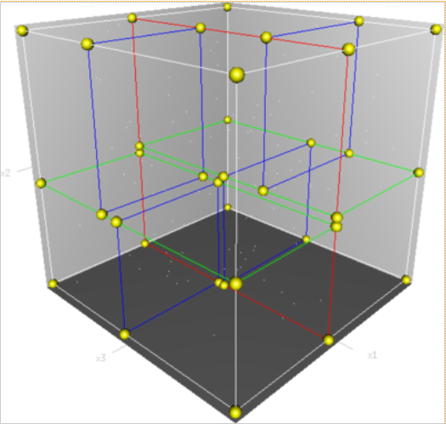
KD Tree Structure and Results
http://zh.wikipedia.org/wiki/K-d%E6%A0%91
http://cybertron.cg.tu-berlin.de/rapid_prototyping_11ws/slicer/

Slide 37
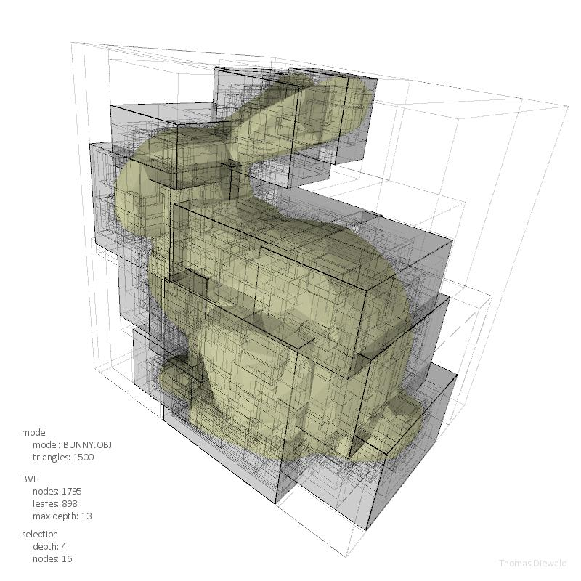
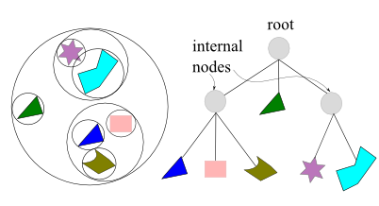
BVH Tree Structure and Results
Bounding Volume Hierarchy
http://www.bogotobogo.com/Games/spatialdatastructure.php
http://thomasdiewald.com/blog/?p=1488

Slide 38
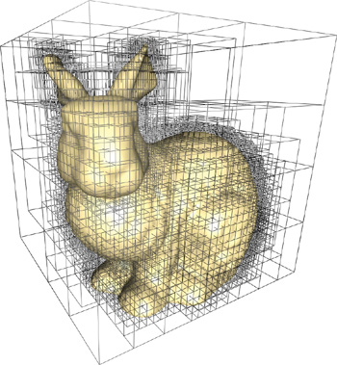
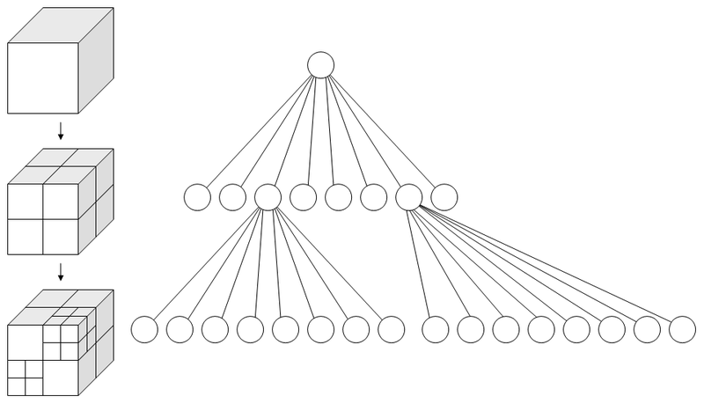
Octree Structure and Results
http://http.developer.nvidia.com/GPUGems2/gpugems2_chapter37.html
http://en.wikipedia.org/wiki/Octree

Slide 39
RT Sphere Intersection
Ray:
Sphere:

Slide 40
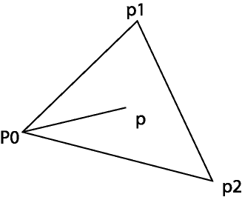
RT Triangle Intersection
Barycentric Coordinates
This can be used for checking if P is
In the triangle. It is also useful when
Computing the texture coordinates and
Other linear interpolations (normal).
P is inside the triangle if c₁ > 0, c₂ >0, and
c₁+c₂ < 1
CS 535

Slide 41
Ray-tracing Hardware
Perspective:
Heterogeneous computation architecture (skip here)
Commercial GPU (skip here)
  CUDA
  OpenCL
Specialized hardware for ray-tracing

Slide 42
Specialized Hardware - Ray Tracing
Acceleration Structure
Tracing
General Computation

Slide 43
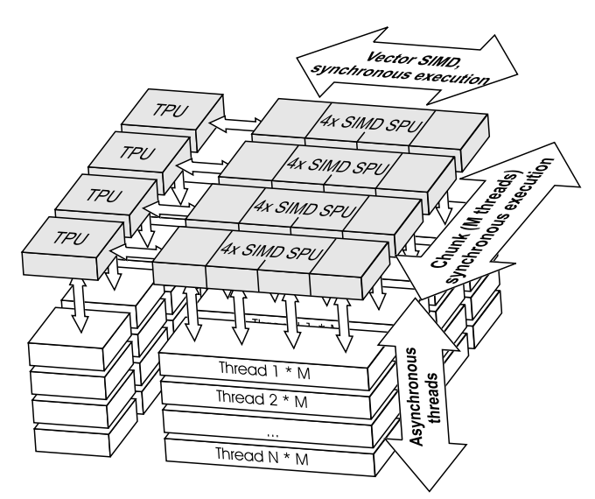
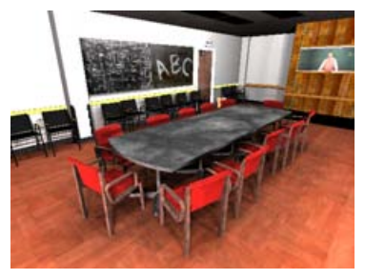
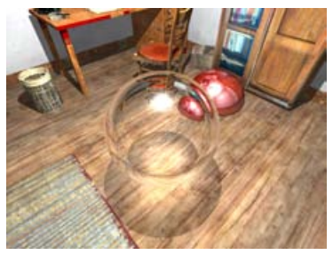
Ray Processing Unit (RPU)
5.5fps
4.5fps
SIGGRAPH '05 ACM SIGGRAPH 2005 Papers, Pages 434-444
Notes:
Shader Processing Unit (SPU): geometry intersection and shading computations
Traversal Processing Units (TPUs)

Slide 44
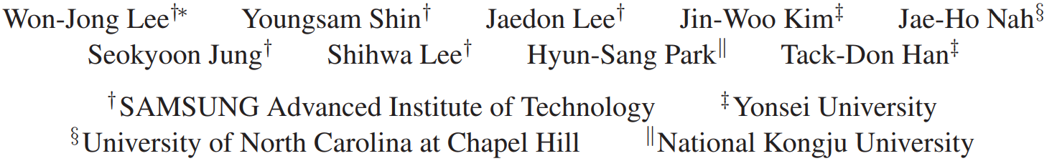
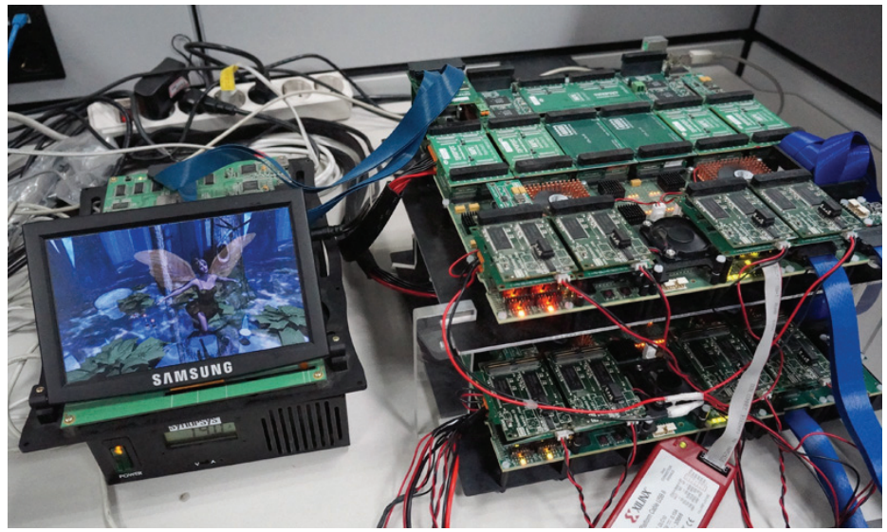
Samsung Reconfigurable GPU based on Ray Tracing (SGRT)
Fairy scene, 34 fps at 4 SGRT cores (500 MHz T&I unit and 1 GHz SRP

Slide 45
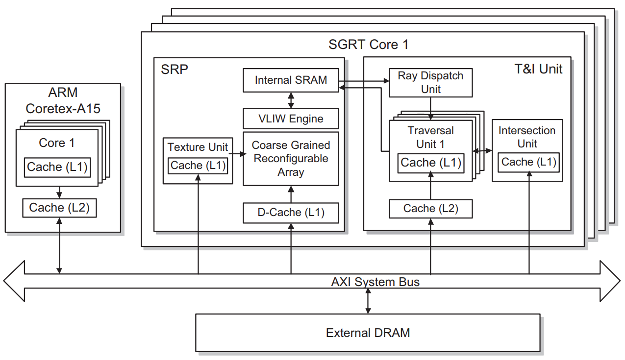
Samsung Reconfigurable GPU based on Ray Tracing (SGRT)
Combine the advantages of Rasterization & RayTracing
HPG '13 Proceedings of the 5th High-Performance Graphics Conference
Pages 109-119

Slide 46
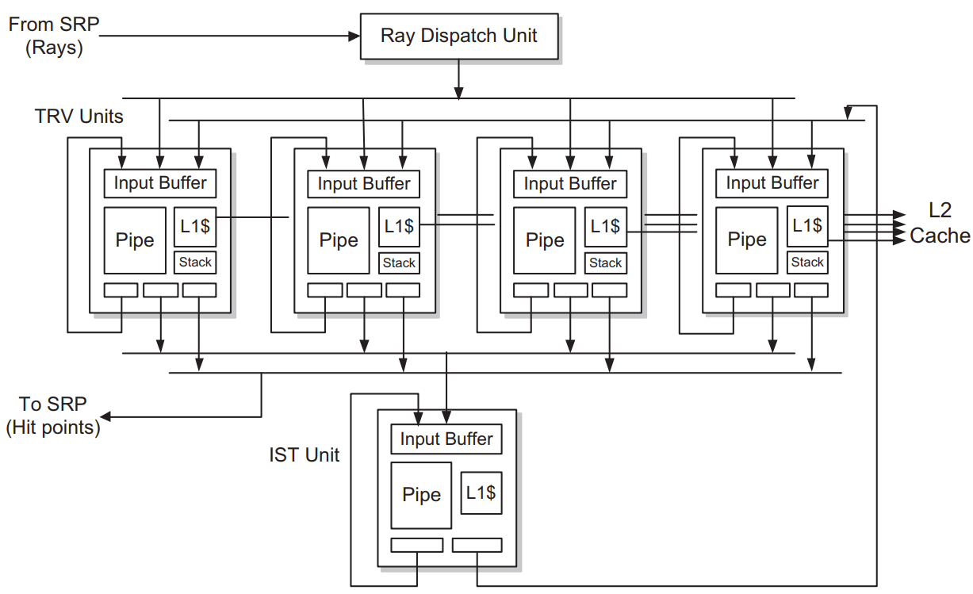
Internal Architecture of the
T&I Unit
Node
Leaf Node
HPG '13 Proceedings of the 5th High-Performance Graphics Conference
Pages 109-119

Slide 47
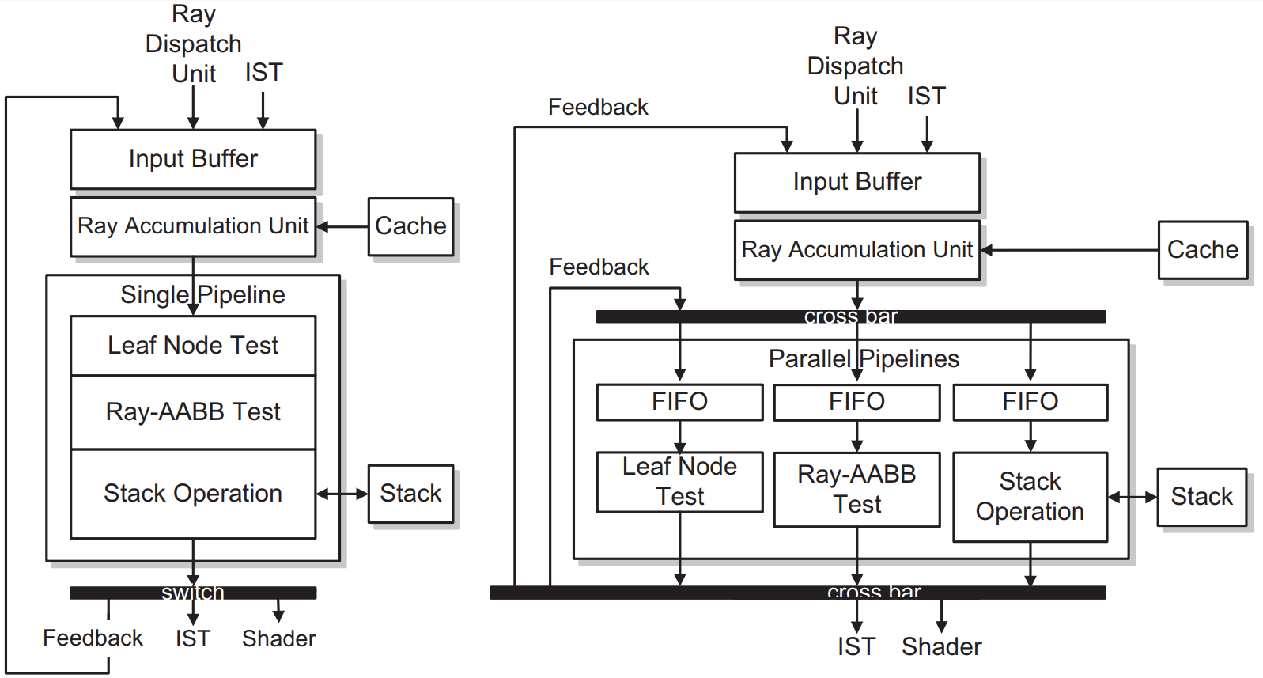
Traversal Unit
Single Pipeline
Parallel Pipeline

Slide 48
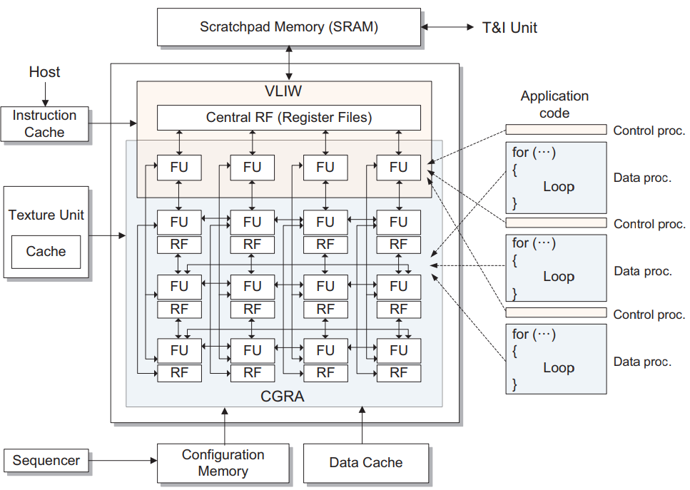
Programmable Shader

Slide 49
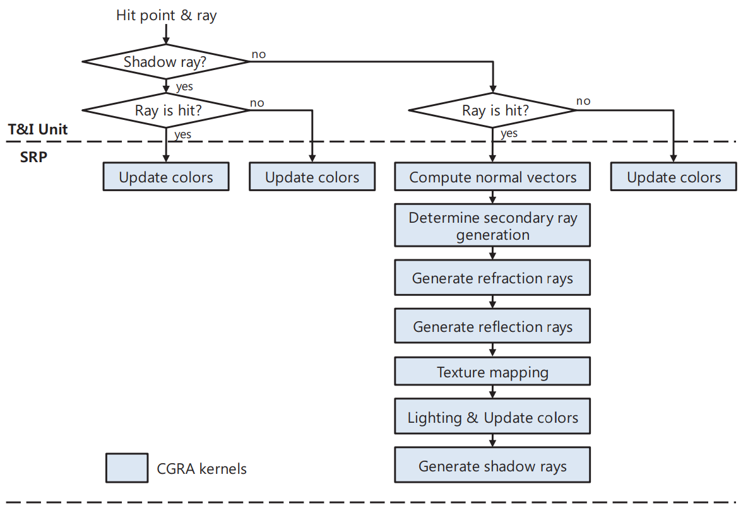
Execution Flow

Slide 50
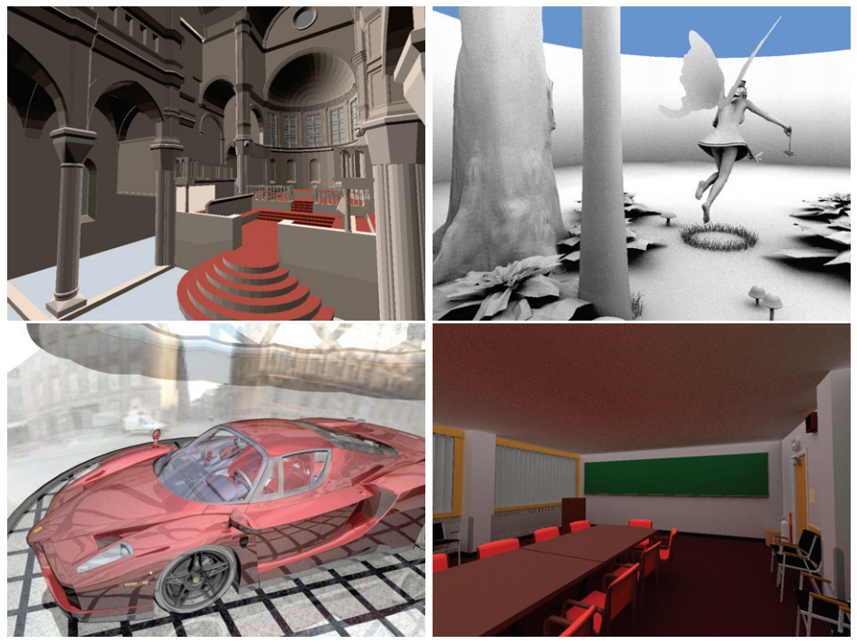
RT Results

Slide 51
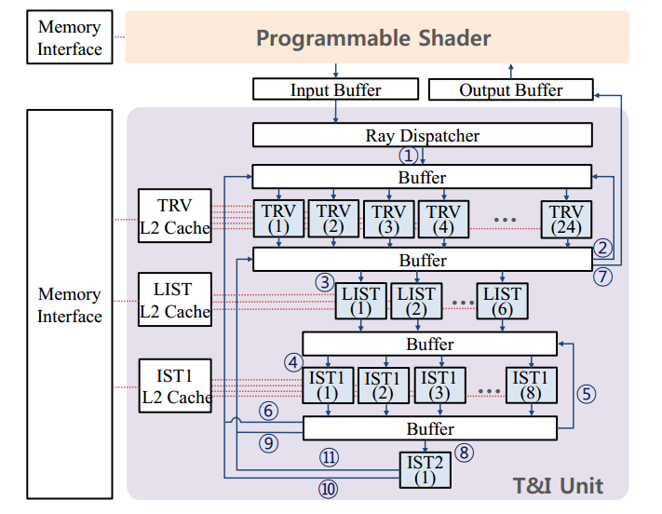
T&I Engine
http://dl.acm.org/citation.cfm?id=2024194; T&I Engine: Traversal and Intersection Engine for Hardware Accelerated Ray Tracing

Slide 52
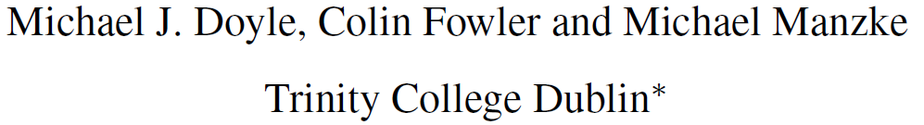
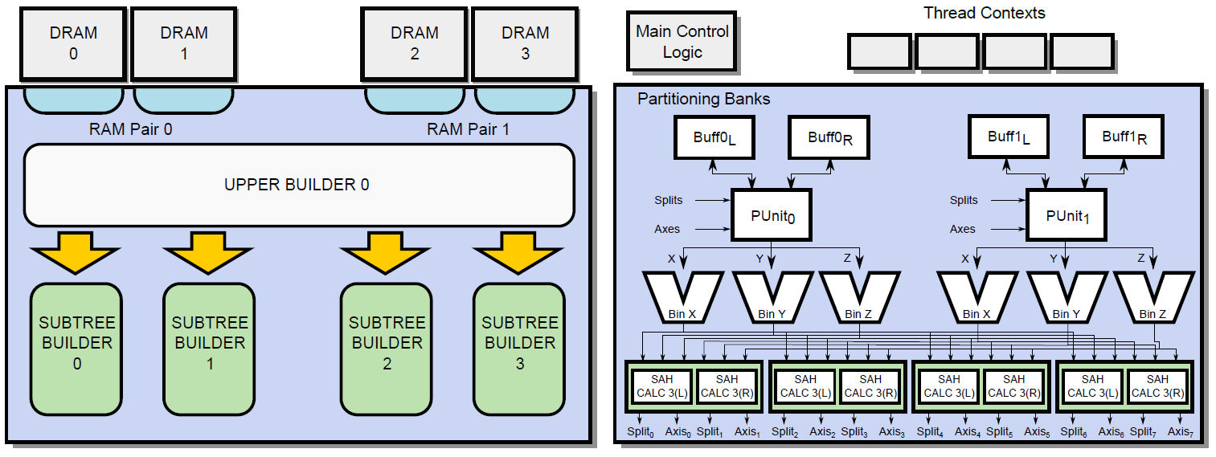
A Hardware Unit for Fast SAH-optimised BVH Construction
ACM Transactions on Graphics, Vol. 32, No. 4, Article 139, Publication Date: July 2013

Slide 53
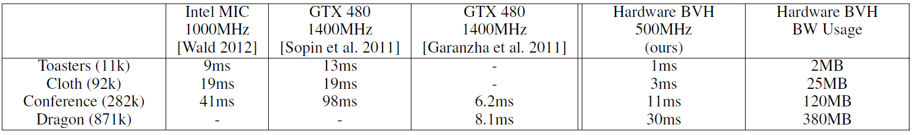
Build Times
Real-time rendering: 30fps
One flame: 33ms

Slide 54
Conclusion
Pon:
  Global illumination can be achieved.
  The computational independence of each ray makes ray tracing
amenable to parallelization.
Con:
  Sacrifice performance to improve image quality
  Divergence of second rays reduce parallelism
  If the traditional ray tracing is not realistic enough, additional techniques (photon mapping, path tracing) can be considered to show more accurate simulation of real-world lighting

