Slide 1

Algorithmic Aspects of b-Disjunctive Total Domination in Graphs
MOST 106-2221-E-259-005
彭勝龍博士
Department of Computer Science and Information Engineering
National Dong Hwa University, Hualien 974, Taiwan

Slide 2
Prelude
S.-L. Peng, The disjunctive total domination problem on some subclasses of chordal graphs, Proceedings of the World Conference on Smart Trends in Systems, Security and Sustainability (WS4 2017), London, February 15-16, 2017.
C.-F. Lin, S.-L. Peng, Algorithmic aspects of disjunctive total domination in graphs. Proceedings of the 10th International Conference on Combinatorial Optimization and Applications (COCOA 2016), LNCS 10043 (2016) 285–293.
C.-F. Lin, S.-L. Peng, and H.-D. Yang, Disjunctive Total Domination Numbers of Grid Graphs, Proceedings of the International Computer Symposium (ICS 2016), 80-83, December 15-17, 2016.

Slide 3

Outline
Introduction
Hardness Results
Disjunctive total domination on grid graphs
Disjunctive total domination on tori
Conclusion

Slide 4
Outline
Introduction
Hardness Results
Disjunctive total domination on grid graphs
Disjunctive total domination on tori
Conclusion

Slide 5
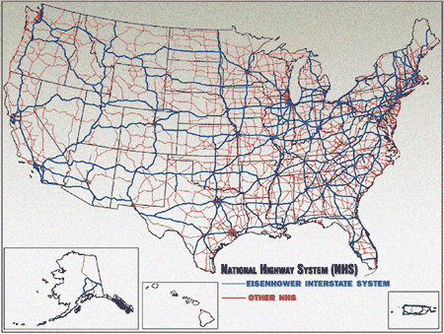
Introduction

Slide 6
Introduction
A dominating set is a subset D of G such that every vertex not in D is adjacent to at least one member of D.
Notes:
a set X of at most k vertices such that every vertex of G is either in X or adjacent to a vertex in X
圖G中的一個集合，能夠dominate圖G中所有不屬於它的一般點

Slide 7
Introduction
A dominating set is a subset D of G such that every vertex not in D is adjacent to at least one member of D.
Notes:
a set X of at most k vertices such that every vertex of G is either in X or adjacent to a vertex in X
圖G中的一個集合，能夠dominate圖G中所有不屬於它的一般點

Slide 8
Introduction
A total dominating set is a set of G such that every vertex in G have a neighbor in the dominating set.
Notes:
除了一般點以外 dominating set的黑點也需要被dominate 即圖G中所有的點都需要至少與一個黑點連接

Slide 9
Introduction
A disjunctive dominating set D is a vertex set such that every vertex in V \ D is adjacent to a vertex of D or there are at least two vertices of D at distance 2 from it.
Notes:
與total dominating set一樣 但多了一個條件 除了與一個dominating set的黑點連接 在距離為2的地方找到兩個屬於dominating set的黑點也符合條件

Slide 10
Introduction
A disjunctive total dominating set D is a set that every vertex in G is adjacent to a vertex of D or there are at least two vertices of D at distance 2 from it.

Slide 11

Introduction
The disjunctive total domination number of a graph G denoted by $γ_{t}^{d}\left(G\right)$, is the minimum size of a disjunctive total dominating set of G.

Slide 12
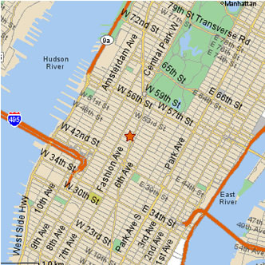

Introduction
Let $G_{m,n}$ be a grid graph, which is the Cartesian product of two paths $P_{m} and P_{n}$, denoted by $P_{m}×P_{n}.$

Slide 13
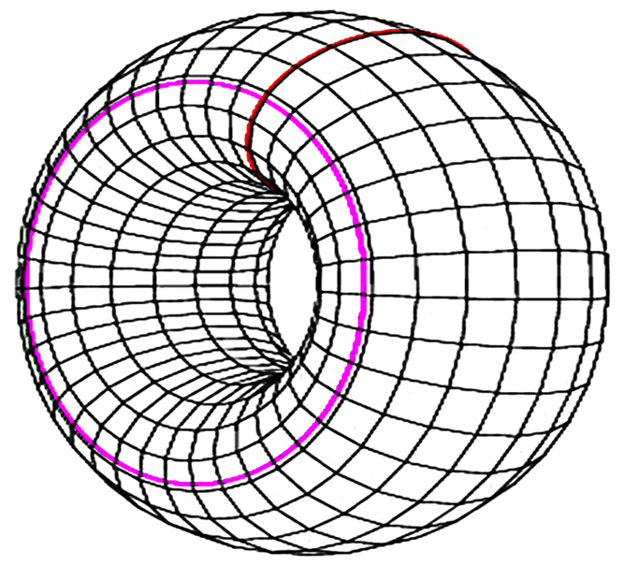

Introduction
Let $T_{m,n}$ be a torus, which is the Cartesian product of two cycles $C_{m}, C_{n}$, denoted by $C_{m}×C_{n}.$

Slide 14
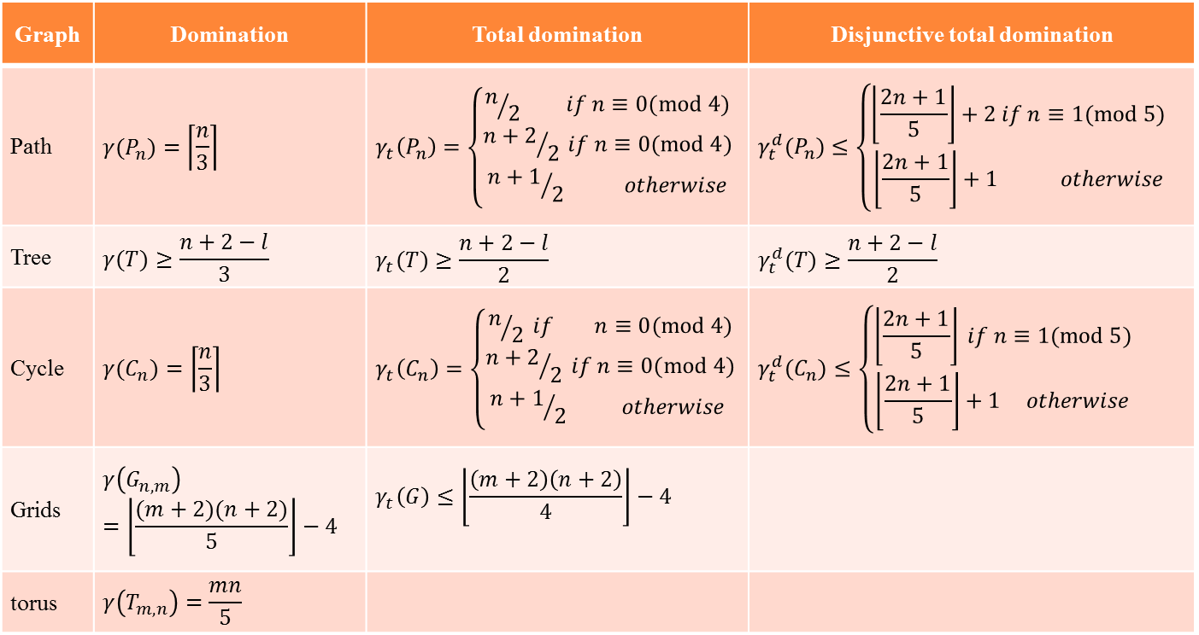
Previous results
Graph | Domination | Total domination | Disjunctive total domination
Path | $$γ(P_{n})=\left\lceil \frac{n}{3}\right\rceil$$ | $$γ_{t}\left(P_{n}\right)=\left\{\begin{aligned}n/2 if n≡0(mod 4) \\ {n+2}/2 if n≡0(mod 4) \\ {n+1}/2 otherwise\end{aligned}\right.$$ | $$γ_{t}^{d}(P_{n})≤\left\{\begin{aligned}\left\lfloor \frac{2n+1}{5}\right\rfloor +2 if n≡1(mod 5) \\ \left\lfloor \frac{2n+1}{5}\right\rfloor +1 otherwise\end{aligned}\right.$$
Tree | $$γ(T)≥\frac{n+2−l}{3}$$ | $$γ_{t}(T)≥\frac{n+2−l}{2}$$ | $$γ_{t}^{d}(T)≥\frac{n+2−l}{2}$$
Cycle | $$γ(C_{n})=\left\lceil \frac{n}{3}\right\rceil$$ | $$γ_{t}\left(C_{n}\right)=\left\{\begin{aligned}n/2 if n≡0(mod 4) \\ {n+2}/2 if n≡0(mod 4) \\ {n+1}/2 otherwise \end{aligned}\right.$$ | $$γ_{t}^{d}(C_{n})≤\left\{\begin{aligned}\left\lfloor \frac{2n+1}{5}\right\rfloor if n≡1(mod 5) \\ \left\lfloor \frac{2n+1}{5}\right\rfloor +1 otherwise\end{aligned}\right.$$
Grids | $$γ\left(G_{n,m}\right)=\left\lfloor \frac{(m+2)(n+2)}{5}\right\rfloor −4$$ | $$γ_{t}\left(G\right)≤\left\lfloor \frac{\left(m+2\right)\left(n+2\right)}{4}\right\rfloor −4$$
torus | $$γ\left(T_{m,n}\right)=\frac{mn}{5}$$
This talk
This talk

Slide 15
Outline
Introduction
Hardness Results
Disjunctive total domination on grid graphs
Disjunctive total domination on tori
Conclusion

Slide 16
b-Tuple Total Domination Problem
Given a graph G = (V, E), the b-tuple total domination problem (b-TDP for short) on G is to find a vertex subset D of the minimum cardinality such that every vertex of V is dominated by at least b vertices of D.
b-TDP is NP-hard on general graphs with minimum degree b.

Slide 17
Reduction
b-tuple total domination problem reduces to the b-disjuntive total domination problem
b-TDP ≤ b-DTDP

Slide 18
Total Domination Problem
Given a graph G = (V, E), the total domination problem (TDP for short) on G is to find a total dominating set of the minimum cardinality.
TDP is NP-hard on bipartite graphs and planar graphs.

Slide 19
Reduction
Total domination problem reduces to the b-disjuntive total domination problem
TDP ≤ b-DTDP
b−1
b

Slide 20
Outline
Introduction
Hardness Results
Disjunctive total domination on grid graphs
Disjunctive total domination on tori
Conclusion

Slide 21

Disjunctive total domination on grid graphs
For $n≥6$, the disjunctive total domination number of a path P_{n}.

Slide 22

Disjunctive total domination on grid graphs
For $n≥6$, the disjunctive total domination number of a $2×n$ grid graph.

Slide 23

Disjunctive total domination on grid graphs
For $n≥6$, the disjunctive total domination number of a $3×n$ grid graph.

Slide 24

Disjunctive total domination on grid graphs
For $n≥6$, the disjunctive total domination number of a $4×n$ grid graph.

Slide 25

Disjunctive total domination on grid graphs
For $n≥5$, the disjunctive total domination number of a $5×n$ grid graph.

Slide 26

Disjunctive total domination on grid graphs
For $n≥6$, the disjunctive total domination number of a $6×n$ grid graph.

Slide 27



Disjunctive total domination on grid graphs
For $m≥7$ and $n≥7$, we propose two approaches to bound $γ_{t}^{d}(G_{m,n})$ by using the following patterns.
$$P_{4×4}$$
$$P_{5×5}$$

Slide 28


Disjunctive total domination on grid graphs
Tiling by $P_{4×4}$:
$$P_{4×4}$$

Slide 29
Disjunctive total domination on grid graphs
Tiling by $P_{4×4}$:

Slide 30
Disjunctive total domination on grid graphs
Tiling by $P_{4×4}$:

Slide 31
Disjunctive total domination on grid graphs
Tiling by $P_{4×4}$:

Slide 32
Disjunctive total domination on grid graphs
Tiling by $P_{4×4}$:

Slide 33
Disjunctive total domination on grid graphs
Tiling by $P_{4×4}$:

Slide 34
Disjunctive total domination on grid graphs
Tiling by $P_{4×4}$:

Slide 35
Disjunctive total domination on grid graphs
Tiling by $P_{4×4}$:

Slide 36


Disjunctive total domination on grid graphs
Tiling by $P_{5×5}$:
$$P_{5×5}$$

Slide 37

Disjunctive total domination on grid graphs
Tiling by $P_{5×5}$:

Slide 38
Disjunctive total domination on grid graphs
Tiling by $P_{5×5}$:

Slide 39
Disjunctive total domination on grid graphs
Tiling by $P_{5×5}$:

Slide 40
Disjunctive total domination on grid graphs
Tiling by $P_{5×5}$:

Slide 41
Disjunctive total domination on grid graphs
Tiling by $P_{5×5}$:

Slide 42
Disjunctive total domination on grid graphs
Tiling by $P_{5×5}$:

Slide 43


Disjunctive total domination on grid graphs
$$P_{5×5}$$
$$P_{4×4}$$

Slide 44
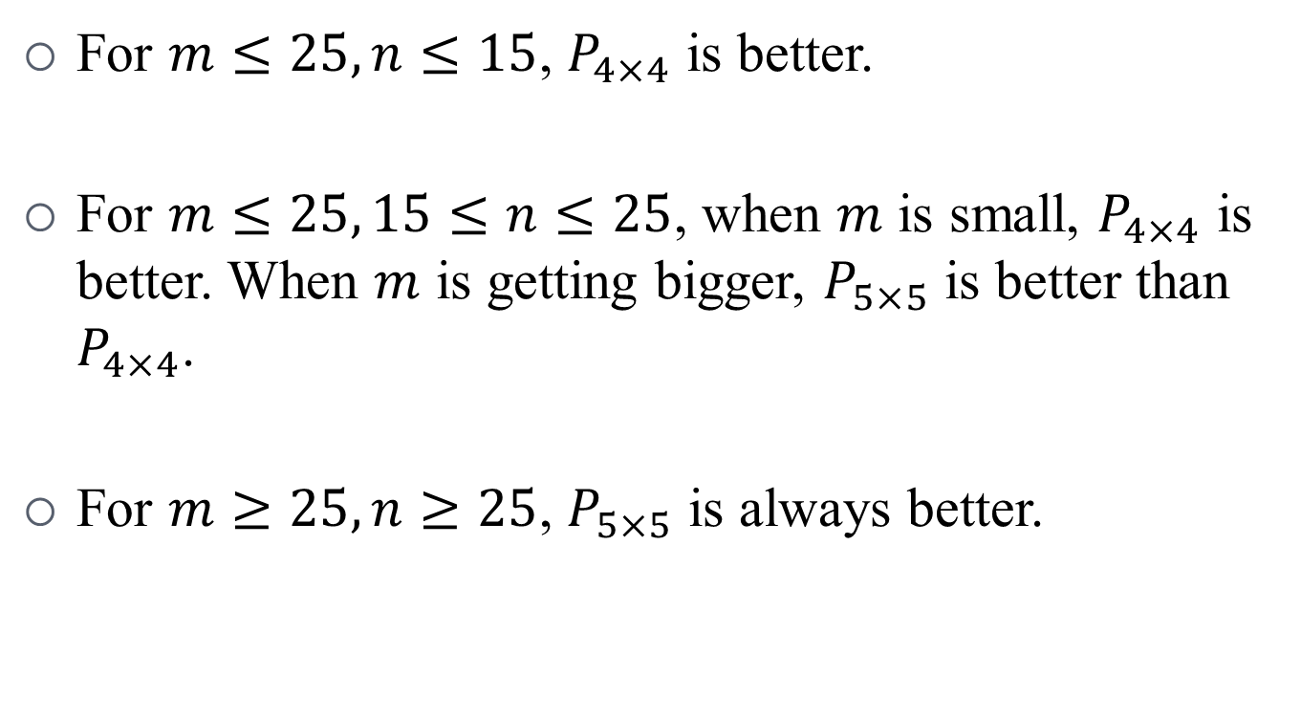
Disjunctive total domination on grid graphs
For $m≤25, n≤15$, $P_{4×4}$ is better.
For $m≤25, 15≤n≤25$, when $m$ is small, $P_{4×4}$ is better. When $m$ is getting bigger, $P_{5×5}$ is better than $P_{4×4}$.
For $m≥25,n≥25$, $P_{5×5}$ is always better.

Slide 45
Outline
Introduction
Hardness Results
Disjunctive total domination on grid graphs
Disjunctive total domination on tori
Conclusion

Slide 46

Disjunctive total domination on tori
We found that the result obtained by using $P_{5×5}$ as a base pattern is optimal, i.e., we can find $γ_{t}^{d}(T_{5,5})$.
$$P_{5×5}$$

Slide 47

Disjunctive total domination on tori
By using $P_{5×5}$ the following bound is tight.
$$P_{5×5}$$

Slide 48

Disjunctive total dominating on tori
When both $m$ and $n$ are multiples of 5,

Slide 49
Disjunctive total dominating on tori
When both $m$ and $n$ are multiples of 5,

Slide 50
Disjunctive total domination on tori

Slide 51
Disjunctive total domination on tori

Slide 52
Outline
Introduction
Hardness Results
Disjunctive total domination on grid graphs
Disjunctive total domination on tori
Conclusion

Slide 53
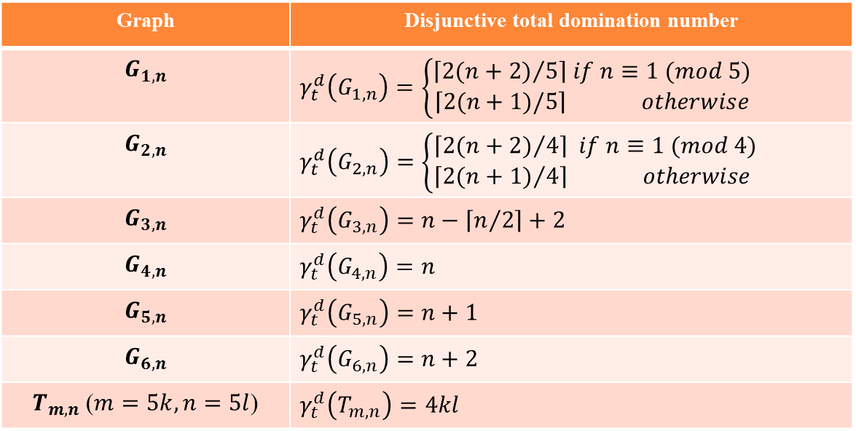
Conclusion
Graph | Disjunctive total domination number
$$G_{1,n}$$ | $$γ_{t}^{d}\left(G_{1,n}\right)=\left\{\begin{aligned}\left\lceil {2(n+2)}/5\right\rceil if n≡1 (mod 5) \\ \left\lceil 2(n+1)/5\right\rceil otherwise\end{aligned}\right.$$
$$G_{2,n}$$ | $$γ_{t}^{d}\left(G_{2,n}\right)=\left\{\begin{aligned}\left\lceil {2(n+2)}/4\right\rceil if n≡1 (mod 4) \\ \left\lceil {2(n+1)}/4\right\rceil otherwise \end{aligned}\right.$$
$$G_{3,n}$$ | $$γ_{t}^{d}\left(G_{3,n}\right)=n−\left\lceil n/2\right\rceil +2$$
$$G_{4,n}$$ | $$γ_{t}^{d}\left(G_{4,n}\right)=n$$
$$G_{5,n}$$ | $$γ_{t}^{d}\left(G_{5,n}\right)=n+1$$
$$G_{6,n}$$ | $$γ_{t}^{d}\left(G_{6,n}\right)=n+2$$
$T_{m,n}$ ($m=5k, n=5l$) | $$γ_{t}^{d}\left(T_{m,n}\right)=4kl$$

Slide 54

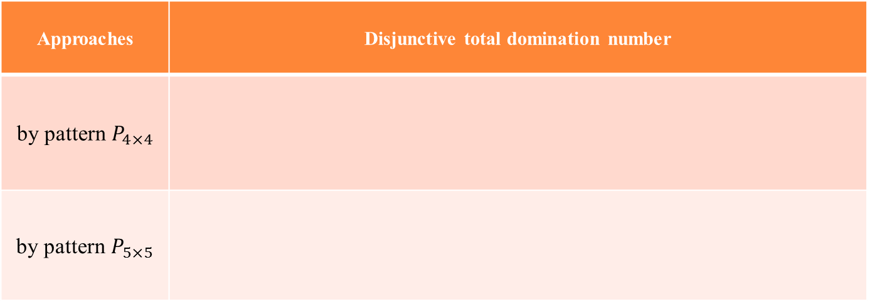
Conclusion
For $m≥7$ and $n≥7$,
Approaches | Disjunctive total domination number
by pattern $P_{4×4}$
by pattern $P_{5×5}$

Slide 55
Conclusion
Graphs | Disjunctive total domination number
Grid graphs
Tori

Slide 56


【新天地】
當腦海全部是妳，就忘了還有天地，當上蒼選擇哭泣，就把妳逐出記憶。
於是妳不再清晰，樂與憂也無意義，只有再從心喚起，讓天地有我有妳。

Slide 57
Thank You Very Much.

