Slide 1
Spatial Queries in Wireless Broadcast Environments
沈俊宏 助理教授
亞洲大學資訊傳播學系
台中市霧峰區
http://infocom.asia.edu.tw

Slide 2
大綱
無線資料廣播相關技術
結合無線廣播與空間查詢
Neighbor-Index Method
結論
Notes:
Here is my outline.

Slide 3
無線環境

Slide 4
無線系統的特性
傳輸的非對稱性
經常斷線
電力的限制
螢幕的尺寸
Notes:
Here are the features of wireless systems.
The communications between the server and the client are asymmetric.
Since the client often moves out, there are frequent disconnections.
Since the source of power is the battery, the active duration of the mobile unit is limited by power.
For saving power, the screen size of the mobile machine is small.

Slide 5
傳輸的非對稱性
Wireless information channels consist of two distinct sets of channels:
  uplink (upstream) channels:
• from clients to servers
  downlink (downstream) channels:
• from servers to clients
Notes:
There are two types of the wireless info. channels, uplink channels and downlink channels.
Uplink channels are from clients to servers and downlink channels are from servers to clients.

Slide 6
In the environment under consideration, the downstream communication capacity is relatively much greater than the upstream one.
In such an environment, the push-based data broadcast provides a good performance.
Notes:
In the wireless environment, the downlink communication capacity is relatively much greater than the uplink one.
Therefore, under such an environment, the push-based data broadcast provides a good perf.

Slide 7







Push-based Data Broadcast System
屏東大學
屏東孔廟
阿緱城門
孫立人將軍
行館
Wireless channel
Mobile devices
Server
Notes:
Let me use this example to explain the push-based data broadcast system.
When tourists come to Fukuoka for the first time, they may want to go sightseeing.
We can use the server to cyclically broadcast the info. about hot attractions in Fukuoka
on the broadcast channel.
The tourists can use the mobile devices, such as PDA equipped with the wireless facility,
to receive the desired info. from the channel.

Slide 8
為什麼要使用無線資料廣播
Scalability (可擴充性):
  The server only broadcasts data items on the channel which can be accessed by the clients, no matter the number of the clients.
  For example, the servicing cost of the server for 10 clients is the same as that for 100 ones.
Notes:
Wireless data broadcast has an advantage of scalability.
That is, the servicing cost of the server is the same no matter how many clients there are.

Slide 9
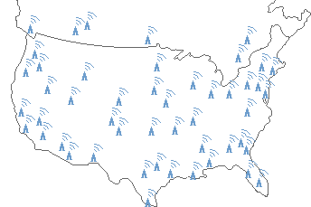
Microsoft® DirectBand™
A wide-area wireless data broadcast network built and operated by Microsoft.
Unused FM radio spectrum.

Slide 10

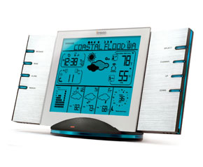
相關產品
Complete Regional Weather Station with MSN® Direct Weather Data Service
Photos courtesy of http://www.msndirect.com/

Slide 11



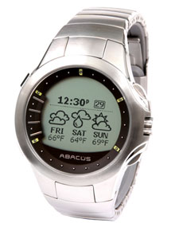



Smart Watches
News
Weather
Stocks
Sports
Lottery
Horoscopes
Photos courtesy of http://www.msndirect.com/

Slide 12
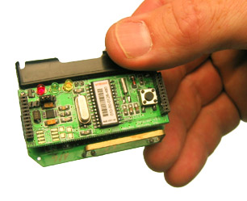
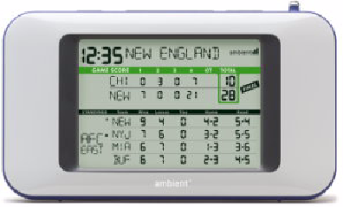
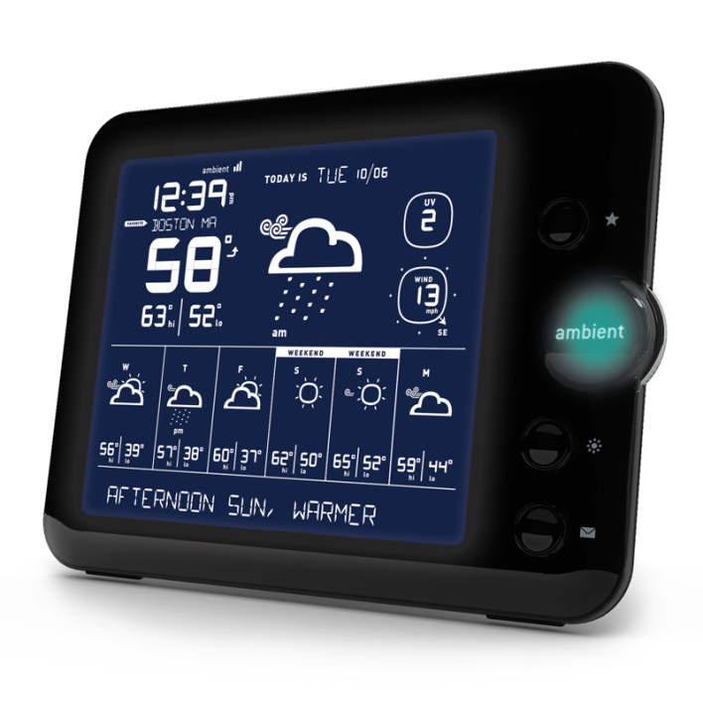
Ambient’s Products
Football SportsCast
7-Day Forecaster
Photos courtesy of http://www.ambientdevices.com/

Slide 13
無線系統的特性
傳輸的非對稱性
經常斷線
電力的限制
螢幕的尺寸
Notes:
Here are the features of wireless systems.
The communications between the server and the client are asymmetric.
Since the client often moves out, there are frequent disconnections.
Since the source of power is the battery, the active duration of the mobile unit is limited by power.
For saving power, the screen size of the mobile machine is small.

Slide 14
選擇性聽頻道技術
Active mode (耗電模式)
  More power consumption.
Doze mode (省電模式)
  Less power consumption.
Selective tuning is to remain the doze mode most of the time and go into the active mode only when the relevant information is present.
Notes:
The mobile devices have two modes, active mode and doze mode.
In active mode, the devices consume more power energy and can listen to the wireless channel.
On the other hand, in doze mode, the devices consume less power energy and cannot listen to the channel.
The technology of selective tuning is to keep the devices remaining the doze mode
most of the time and going into the active mode only when the relevant information is present.

Slide 15
Notes:
Let me use this figure to explain selective tuning.
The client first tunes in the channel to receive the index bucket. From this index bucket, the client will know when the desired data will arrive.
Then, the client can switch into the doze mode to save the power until the desired data arrives.

Slide 16
效能評比參數
Access Time (存取時間):
  The client waiting time for accessing the requested data.
Tuning Time (實際聽頻道時間):
  The amount of time spent by a client listening to the channel.
  This determines the client’s power consumption.
There is a trade-off between the access time and the tuning time.
Notes:
Two perf measures are concerned in this environment.

Slide 17
Time
T0 T1
T2 T3
T4 T5
T6 T7
: Access Time
: Tuning Time
Access Time = (T7 – T0)
Tuning Time = (T7 – T6) + (T5 – T4) + (T3 – T2) + (T1 – T0)
Notes:
This figure depicts the access time and tuning time.
If the client requests the data of interest at this point, and the data of interest is at this point.
The client has to wait for this duration to get the data of interest.
Therefore the duration from T7 to T0 is the access time.
In this case, the index is broadcast along with the data file,
so the client can be in the doze mode until the index or the data of interest is arrived.
Therefore, the summation of these four durations is the tuning time.

Slide 18
空間查詢
Location-Dependent Spatial Query (LDSQ) in the wireless environment is that mobile users query the spatial data items dependent on their current location.
  Nearest Neighbor Query
  k-Nearest Neighbors Query
  Window Query

Slide 19
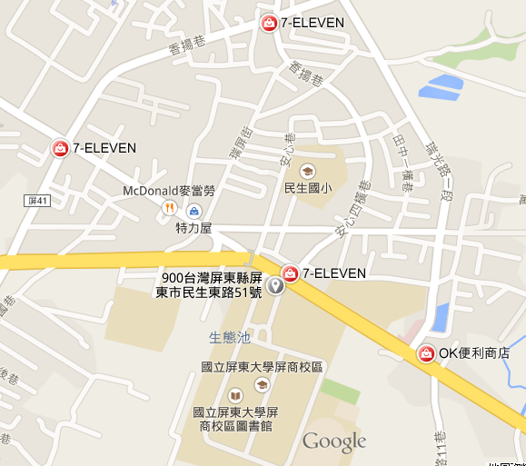
Nearest Neighbor Query
Show me the nearest convenient store.

Slide 20
k-Nearest Neighbors Query
Show me 2 nearest convenient stores.

Slide 21
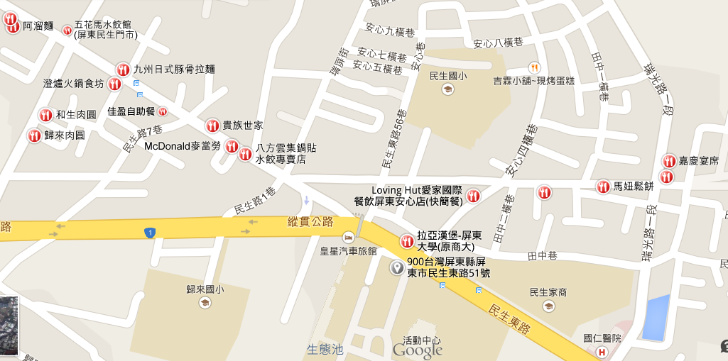
Window Query
Show me the restaurants around me.

Slide 22
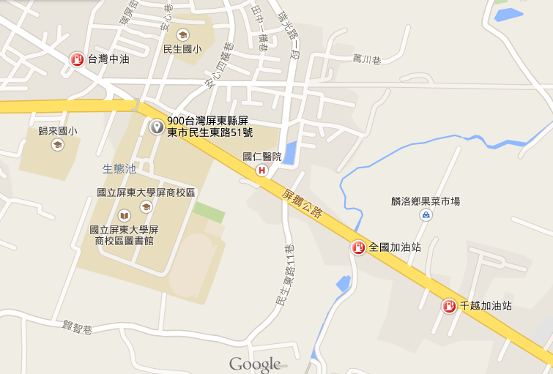
Continuous Window Query
Where are gas stations within this region along this segment?
Notes:
In this paper, we focus on continuous window queries.
In this figure, the user drives the car from here to here and wants to know glasses stores around him. This is the so-called continuous window query.

Slide 23
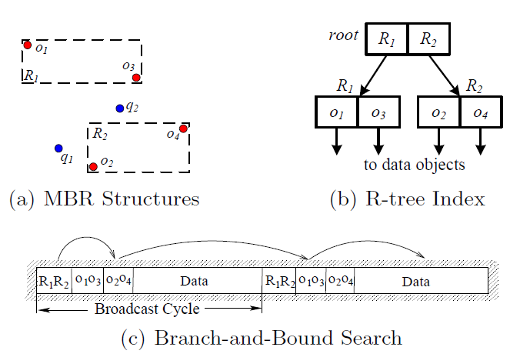
Linear Access on the Wireless Channel

Slide 24
Neighbor-Index Method
Jun-Hong Shen, Ching-Ta Lu and Ming-Shen Jian, "Neighbor-Index Method for Continuous Window Queries over Wireless," Applied Mechanics and Materials, Vol. 284-287, pp. 3295-3299, Jan. 2013. (EI)

Slide 25
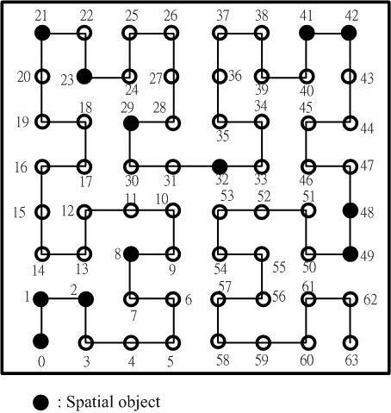
Motivation
For a continuous window query, answer spatial objects may be neighbors of each other.
Notes:
From our observation, we find out the answer spatial objects of a continuous window query may be neighbors of each other.
Therefore, in this paper, we propose NI to interleave neighbor information among spatial objects in a broadcast cycle to speed up the query processing and reduce the power consumption.

Slide 26
Therefore, we propose a neighbor-index method, NI, to efficiently support the continuous window queries over wireless data broadcast.

Slide 27
System Architecture

Slide 28
Neighbor-Index Method
Spatial objects are broadcast once in a cycle in the sequence of the Hilbert curve of order n.
The spatial objects covered by the same value of the Hilbert curve of order (n-1) are put in the same group.
An index bucket containing information about neighbors and the objects in this group is allocated before each group.

Slide 29
Hilbert Curve
Good locality
Notes:
The spatial objects are stored in the one-dimensional space in the order of the Hilbert curve.
The Hilbert curve is one kind of space-filling curves, which passes thru every point in a multidimensional space once to order these points linearly in the one-dimensional space. HC has good locality. That is, the points that are close in the multi-dimensional space are still close each other in the one-dimensional space.

Slide 30
Spatial Objects
Hilbert curve of order 3
Notes:
Let me use an example to go through our proposed method. Consider that we have these spatial objects in this space.
The black circle represents a spatial object.
The spatial objects are broadcast on the channel following the sequence of the Hilbert curve of order 3.

Slide 31
Grouping
The objects having the same Hilbert-curve value of order (n – 1) are allocated to the same group.
Hilbert curve of order 2
Notes:
The objects having the same Hilbert curve value of order 2 are allocated to the same group.
Then, an index bucket is allocated before each group.
The index bucket contains information about neighbors and the objects in the group.

Slide 32
Neighbor Index Construction
procedure NeighborIndexConstruction(h_{(n-1)}) current_h ←h_{(n-1)} /*current_h is the current processing block.*/ for i ← (n-1), 1 do Call procedure NeighborInformation(current_h) /* Calculate the Hilbert-curve value of the previous order. */ current_h ← end for Call procedure IndexEntryShrink Add the index entries pointing to those spatial objects in the same group to the index bucket for this group end procedure
Notes:
The neighbor index in an index bucket for a group contains information about the surrounding neighbors from the Hilbert curve of order 2 to that of order 1.

Slide 33
Neighbor Index
Hilbert curve of order 2
Hilbert curve of order 1
Notes:
Take this group for example. Its surrounding neighbors of the Hilbert curve of order 2 containing objects are these three.
And, its surrounding neighbors of the Hilbert curve of order 1 containing objects are these three.

Slide 34
Notes:
The corresponding neighbor indexes of order 2 and order 1 are put in index bucket NI2.

Slide 35
Index Entry Shrink
Notes:
The index entry with the wide range can provide more information about the following objects as compared to that with the short range.
These two index entries are pointing to index bucket NI5. Therefore, this entry is removed from NI2.

Slide 36
A Broadcast Cycle with Neighbor Indexes
Notes:
Here is the final broadcast cycle interleaved with neighbor indexes.
Note that each index bucket also has information about the objects in its corresponding group, not shown in this figure.

Slide 37
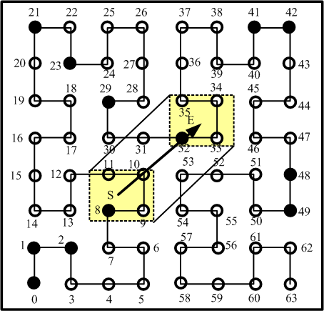
Continuous Window Query
Targeted segments
  (8, 11)
  (31, 35)
  (53, 53)
Notes:
Now consider that a client issues a continuous window query from S to E.
The spatial objects in this region should be found out. This region contains these three targeted segments.

Slide 38
After examining NI2
  (8, 11) -> (8, 8)
  (31, 35) -> (32, 35)
  (53, 53) -> ()
V = {o8, NI5} -> V = {NI5}
Notes:
Support the client tunes in the channel here and receives index bucket NI2.
After examining NI2, the client knows the arrival time of object 8.
The range of this segment is reduced to this one. And, this range of this doesn’t exist in the broadcast cycle.
The offsets to be visited are recorded in V.
After downloading object 8, NI5 will be visited.

Slide 39
After examining NI5
  (32, 35) -> (32, 32)
V = {o32} -> V = {}
Notes:
After examining NI5, the client gets the offset to object 32.
After object 32 is downloaded, the query processing is finished.

Slide 40
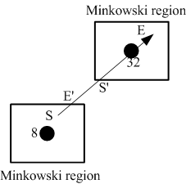
有效區間
The Minkowski region has the same size as the query window and centers at the answered object.
Notes:
For a continuous window query, the answered objects are only valid along part of the query line segments, that is validity segments.
The validity segment of an answered object is the intersection of the query line with its Minkowski region.
The Minkowski region has the same size as the query window and centers at the answered object.
Here shows the validity segments of objects 8 and 32.

Slide 41
效能模擬比較
We compare our proposed method, NI, with distributed spatial index (DSI).
B. Zheng, W.C. Lee, C.K. Lee, D.L. Lee, and M. Shao: A distributed spatial index for error-prone wireless data broadcast, The VLDB Journal, 18(4) (2009) 959-986.
Notes:
In our perf. evaluation, we compare our proposed algorithm with DSI via simulation.
DSI is also a Hilbert curve-based algorithm for continuous window queries in wireless data broadcast systems.

Slide 42

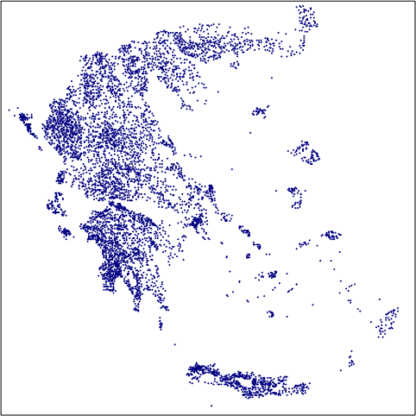
空間資料
There are two cases of the data distributions:
(a) uniform and (b) the real map (Greece).
(a)
(b)
42
Notes:
In our simulation, we use these two cases of data distributions, uniform and real.

Slide 43
Parameters
The simulation parameters
Parameter | Description
WinSideRatio | The ratio of the side length of a window query to that of the search space
QueryLengthRatio | The ratio of the length of a query line segment to the side length of the search space
43
Notes:
Here are the simulation parameters.
This one controls the size of a query window.
This one controls the length of a query line segment.

Slide 44
System Model
The start position of a continuous window query is randomly picked, and its corresponding moving direction is randomly picked between 0 and π/2.
In our simulation, 10,000 points are uniformly generated in a square Euclidean space (2⁸ × 2⁸).
In our simulation, 10,000 queries with a square of
⎡2⁸*WinSizeRatio⎤ × ⎡2⁸*WinSizeRatio⎤ are randomly issued.

Slide 45
存取時間
Uniform
Real
Notes:
In our simulation, we increase the values of these two perf. parameters at the same time.
As the values of these two perf. parameters increase, the average access time of both methods increases.
In this slide, we can observe that the avg access time of our proposed method is shorter than that of DSI in both uniform and real data sets.

Slide 46
實驗聽頻道時間
Uniform
Real
Notes:
Here shows the corresponding average tuning time of both methods.
Our proposed method still outperforms DSI on the avg tuning time.

Slide 47
耗電程度的比較
Uniform
Real
Notes:
This slide shows the perf on the avg power consumption.
The power consumption of our proposed method is less than that of DSI.

Slide 48
結論
To speed up the query processing and reduce power consumption of mobile devices, our proposed method interleaves neighbor information of spatial objects among a wireless broadcast cycle.
Experimental results show that our proposed method outperforms DSI on the average access time, tuning time and power consumption.

Slide 49
Thanks for your attention.

