Slide 1
頻譜偵測及共享機制探討
鍾偉和
副研究員.中央研究院

Slide 2
Outline
Introduction
  基本通訊原理介紹、頻譜競爭
偵測技術的基本原理及架構
  Binary Hypothesis test、Receiver Operating Curve
  MIMO Transceiver architecture and interference
Spectrum Sensing technologies
  Conventional detectors、Sequential detector、Cooperative detector
  Database assisted sensing
Channel Sharing Scheme
  Distributed Channel Sharing Scheme for Cognitive Radio
International Research/Standardization/Regulatory activities
  Licensed Shared Access/Authorized Shared Access
  LTE-U
  FCC, Ofcom, CEPT etc.
Q&A

Slide 3
Research Center for Information Technology Innovation, Academia Sinica-Overview
Formally Founded in 2007, Started Operation in Sept. 2008
The 31st youngest research unit in Academia Sinica
Faculty Member and Research Staff
  Tenure-track appointments(Research fellow): 15
  Research assistants and postdocs(including military substitute services): 220+
  Jointly appointed faculty:50+
Joint advisory with universities
Collaborations with industries

Slide 4
通訊系統的定義
通訊
  — (廣義) 資訊的處理、傳送及接收
  — (窄義) 資訊的傳送及接收
資訊包括語音、視訊及一般資料等。
研究領域包括語音及視訊壓縮處理、影像及語音辨識與處理、有線 (含光纖) 及無線 (電磁波輻射) 傳輸與接收、通訊網路、高頻 (微波) 電路及天線、安全 (保密) 通訊等。

Slide 5
通信系統範例
系統名稱 | 傳送端 | 傳輸通道 | 接收端
口耳相傳 | 說話者 (口) | 空氣 | 聽話者 (耳)
紙杯傳音 | 紙杯的一方 | 棉線 | 紙杯另一方
擊鼓吶喊 | 鼓 | 空氣 | 耳
烽火傳訊 | 烽火台 | 空間 | 眼
打旗語 | 旗 | 空間 | 眼

Slide 6
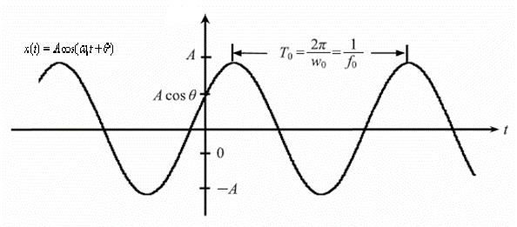
訊號介紹
通訊系統所使用的訊號中，最重要的是弦波(sinusoidal signal):
A: 振幅峰值(peak amplitude)
ω₀: 角頻率(radian frequency), ω₀ = 2πf₀
f₀ : 頻率(frequency), f₀= 1/ T₀ , T₀為週期
θ: 相位(phase)

Slide 7
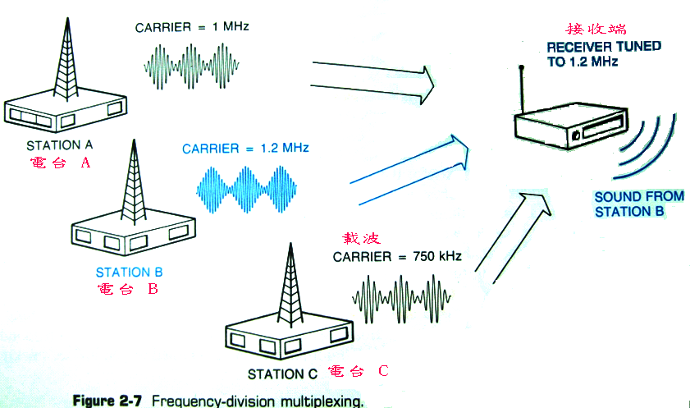
Introduction
Channelization by frequency (sinusoidal basis)
  Other options -- code, time.
  Carrier frequency range is limited

Slide 8
多重接取(Multiple Access)技術
一基地台同時接收多個使用者訊號，如何誰送了什麼訊號?
例如有三個人同時送出訊號，接收者收到三人訊號的總和，該如何知道誰送了什麼訊號?
  訊號模型R=S1+S2+S3
  R=3+5+8=16，可從16分出三人各送什麼嗎?
  如何設計一個系統幫助分辨誰送了什麼?

Slide 9
多重接取(Multiple Access)技術基本概念
利用正交基底
在空間中，三個方向的正交基底為(1,0,0);(0,1,0);(0,0,1)，把訊號載在基底上
  第一人用(1,0,0)，第二人用(0,1,0)，類推。
  載在基底上，如第一人用S1(1,0,0)，餘類推。
  收端用(1,0,0)和R做內積，即可得到S1
  (1,0,0)*R=(1,0,0)*(S1(1,0,0)+S2(0,1,0)+S3(1,1,0))=S1
此為訊號接收是簡例，可一般化成多點系統。

Slide 10
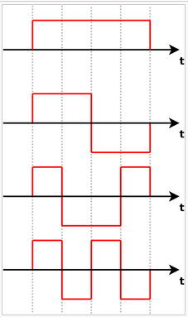
多重接取(Multiple Access)技術-以CDMA為例
4點接取系統
4個傳送端各用一個基底
  (1111);
  (11-1-1);
  (1-1-11);
  (1-11-1)

Slide 11
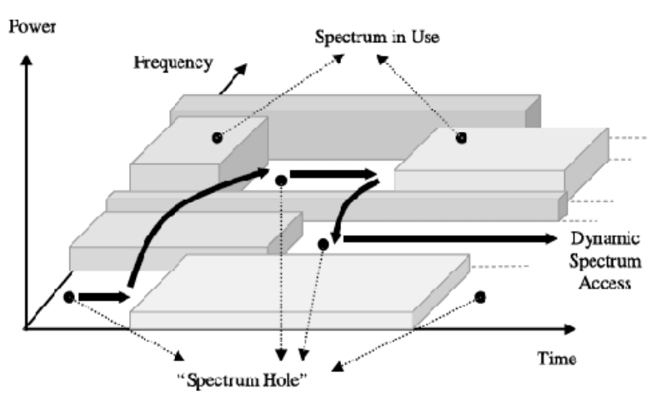
Introduction
Time-Frequency domain
Exploit spectrum holes

Slide 12
The democratisation of mobile broadband creates an unprecedented challenge for spectrum policy in Europe
12
Growth rate of mobile broadband traffic predicted to be more than 100% p.a.
The ITU predicts that by 2020 Europe will need to almost double the spectrum currently allocated to mobile
1,400
Thousands of TB/month
Large cost implications
1,200
Central & Eastern Europe
ILLUSTRATIVE
1,000
800
600
1.7 GHz of spectrum required (ITU)
400
Western Europe
200
0
2009
2010
2011
2012
2013
2014
Additional traffic in Europe to 2020
Spare capacity (inc. 800 MHz & 2.6 GHz)
New air interface technologies
Network densification
Future needs
(Also: smartphone sales will outstrip combined desktop and laptop sales in 2012)
*Sources: Cisco Visual Networking Index; Morgan Stanley, ITU

Slide 13
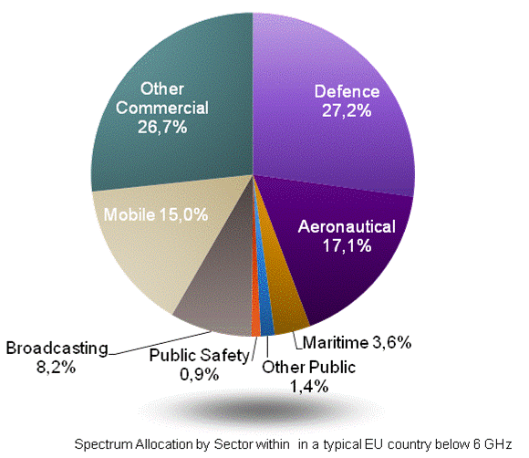
Both military and civilian users resist being fully cleared from prime bands, for valid reasons
Military
Large contiguous holdings coordinated and harmonised across countries
Reluctant to clear spectrum completely:
  Has already given up spectrum
  Invested in specific frequency equipment
  Has increasing needs for spectrum
  National security: requires flexibility
Civilian (public and private)
Public actors (e.g. aviation authorities, emergency services) and private actors (e.g. broadcasters, businesses, maritime users)
Difficult to clear these users fully:
  Have expectations of continued use
  Investments in specialised equipment
  Often narrowband users. Needing to relocate many users is a challenge
*Source: WIK-Consult, Qualcomm and Nokia reports at CEPT, May 2011.

Slide 14
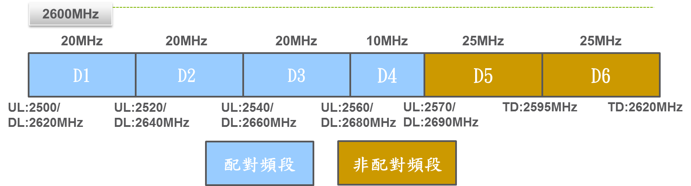
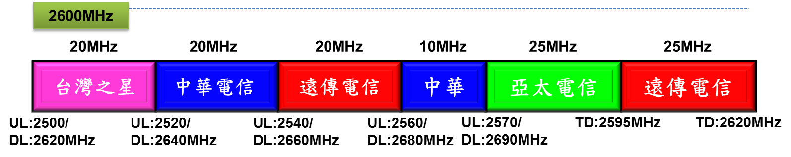
4G頻譜釋照 - 104年
中華電信:100億
遠傳電信:91.30億
台灣之星以66.15億
亞太電信以22.25億。
拍賣結果

Slide 15
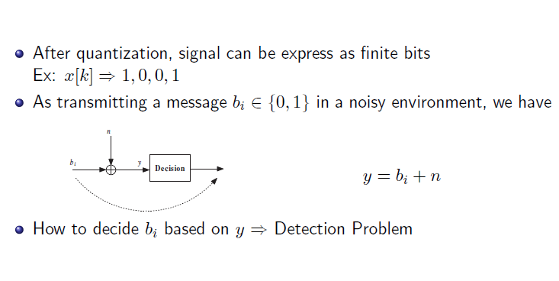
Binary hypothesis test

Slide 16
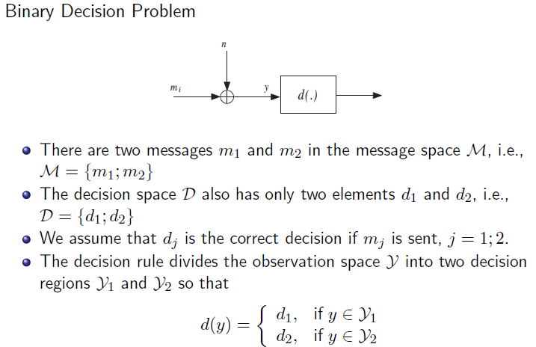
  *Applied to spectrum sensing:
  H1: Spectrum in use
  H0: Spectrum vacant

Slide 17
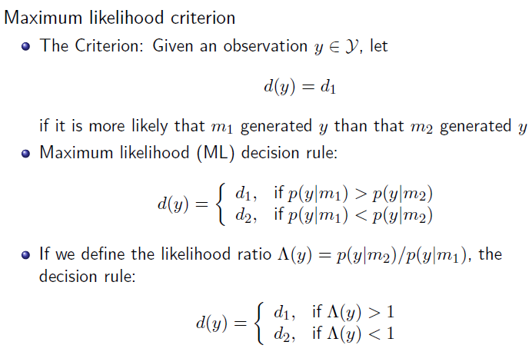

Slide 18
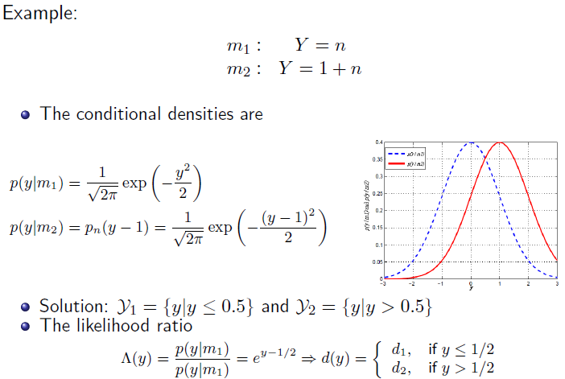

Slide 19
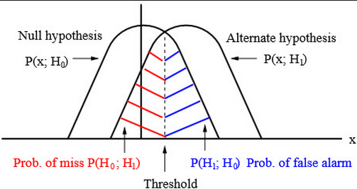
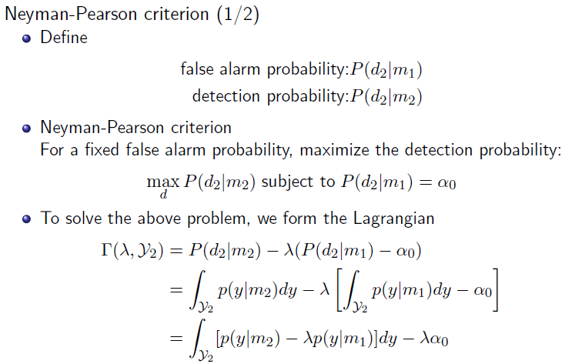

Slide 20
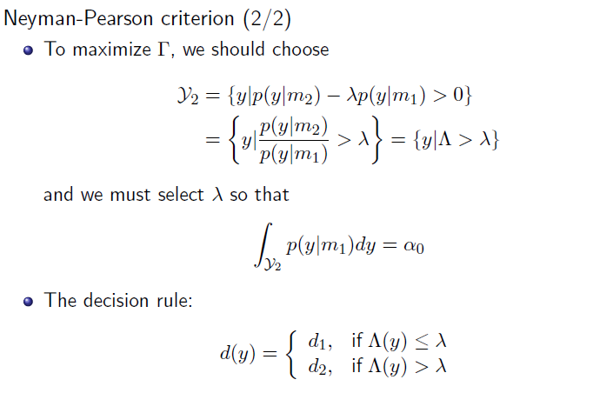

Slide 21
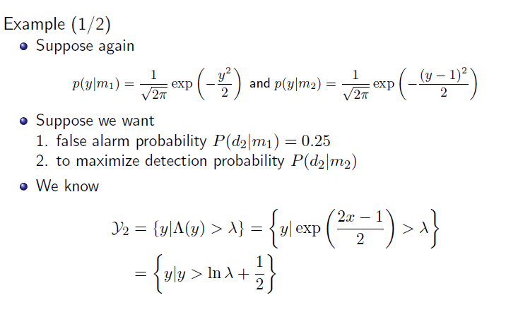

Slide 22
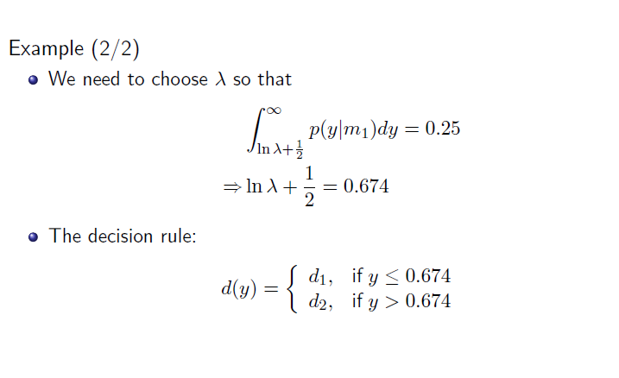

Slide 23
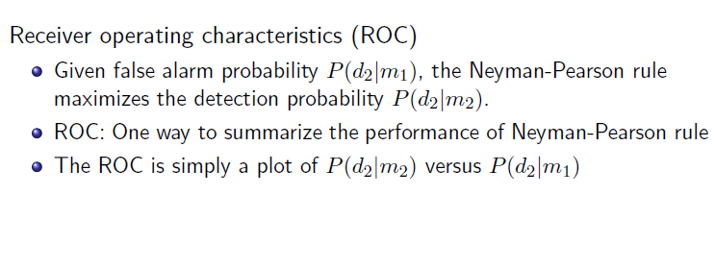
Receiver operating curve

Slide 24
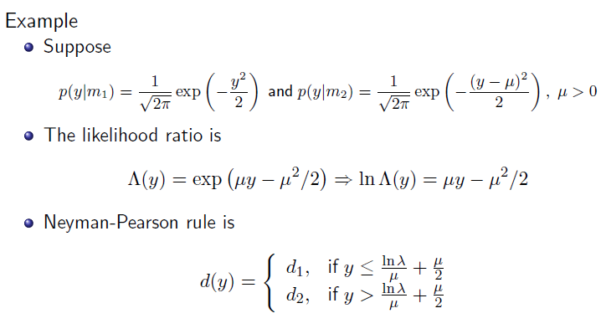

Slide 25
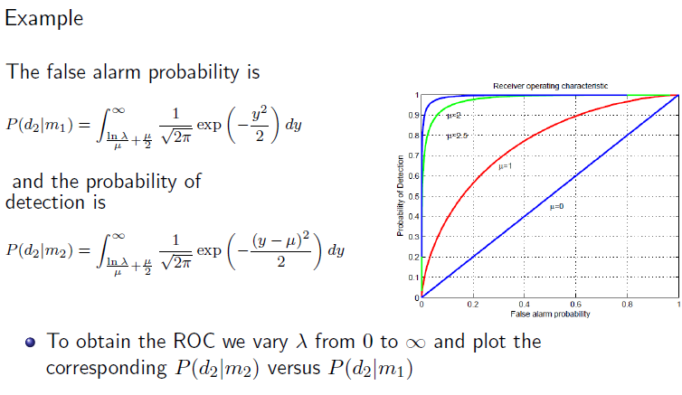

Slide 26
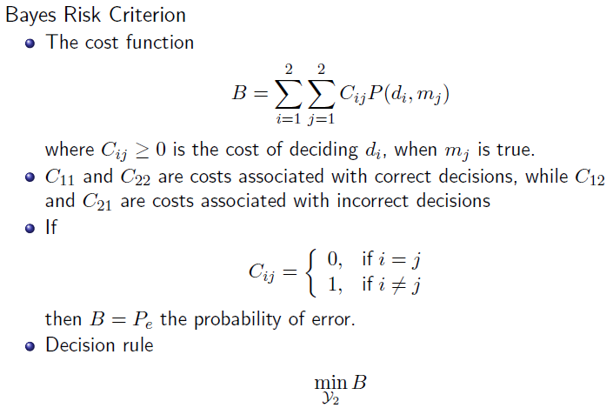

Slide 27
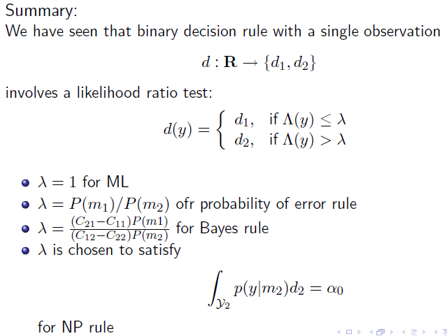

Slide 28
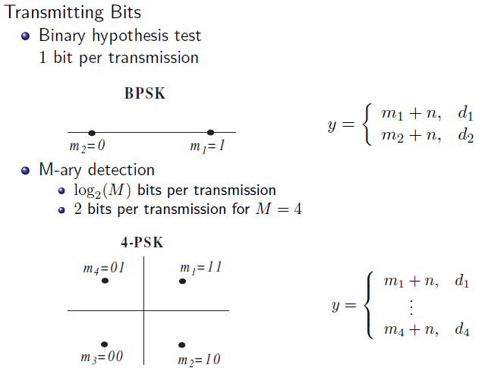

Slide 29
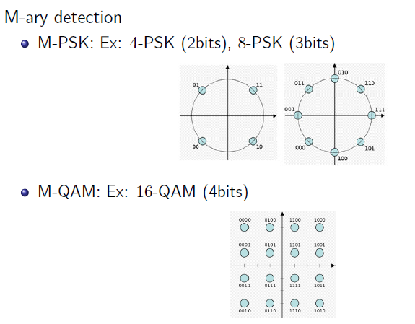

Slide 30
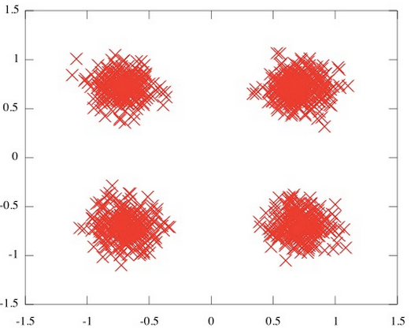
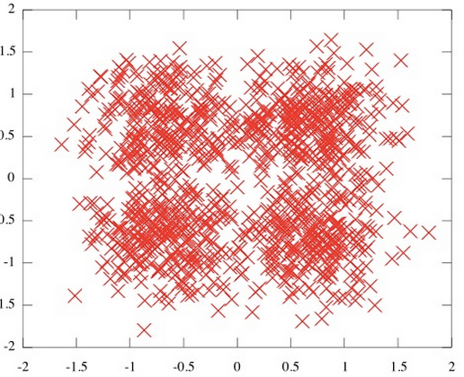
Noisy QAM v.s. Noisier QAM

Slide 31
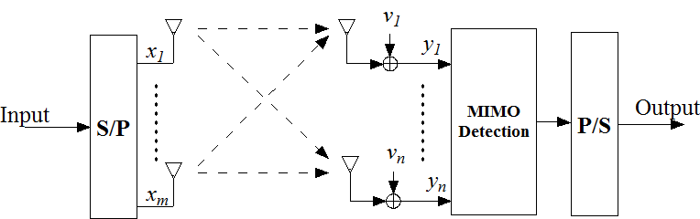
MIMO system and signal model
Signal model : y = Hx + v where x ∈ C_{m}, y ∈ C_{n}, H ∈ C_{n×m}
is a known channel matrix, and n ≥ m.
The elements of x belong to a finite alphabet S of size |S|.
Example:
BPSK: S = {1,−1}, and |S| = 2.
4-PSK: S = {1 + j, 1 − j,−1 + j,−1 − j}, and |S| = 4
Interference added: y = Hx +I+ v

Slide 32
MIMO systems
LTE R12 TM9 specifies 8x8 MIMO
With 64-QAM(i.e. 6 bits per 64 QAM symbol), there are 48 bits per 8x8 MIMO vector symbol transmission
6 bits per symbol for a SISO system
Larger data rates in Massive MIMO systems
More vulnerable to noise and interference

Slide 33
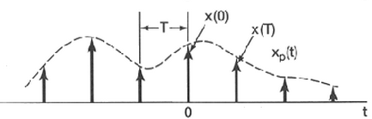



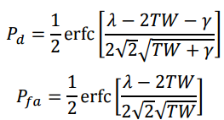
Spectrum Sensing-Energy Detector
Signal model
Test statistics and decision criterion
Distribution of test statistics
Performance

Slide 34
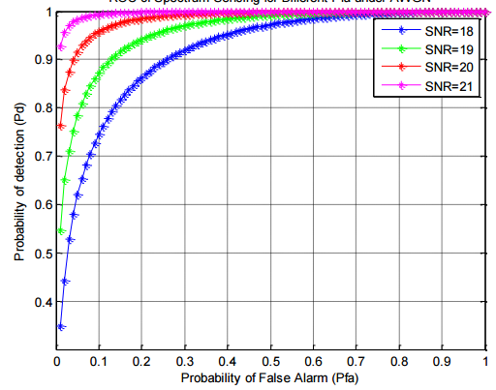
ROC of energy detector

Slide 35
Spectrum Sensing-Sequential detector
Receive samples sequentially till a satisfactory confidence can be attained
Signal model
Autoregressive modelling, and test statistic
Decision

Slide 36
Sequential detector
Examples

Slide 37
Introduction-Sensor Networks & Applications
Sensor networks have been applied in diverse applications.
  Surveillance
  Target Detection
  Spectrum Sensing
Sensors make independent decisions.
  Many applications require binary decisions.
  Accuracy of a single sensor is limited.
  Fusion of multiple decisions increases accuracies.

Slide 38
Introduction-Cognitive Radio
Wireless communications rely on spectra.
  Current usage model: frequency bands are licensed.
  The licensed band are often vacant- Low Utilizations.
Cognitive Radio-A new usage model to increase the spectrum utilization.
  Allows secondary user to access the spectrum when it’s vacant.
  Secondary users sense the spectrum before accessing.
  Accuracies of the spectrum sensing is crucial.
    Formulated as binary hypothesis test problem
      H0: Spectrum Vacant
      H1: Spectrum Occupied

Slide 39
Collaborative Decision Fusion Framework
N sensors make binary decisions.
  Probability of False Alarm
  Probability of Detection
  Sensor decisions
The fusion center makes final decision.
  Fusion Rule:
  Fusion Rule with random strategy:
  Solve the parameters of the Fusion Rule:

Slide 40
Detection Criteria and Implications in Cognitive Radio
Interpretations of PD and PFA in cognitive radio
  Detection performed by the secondary users
  H1 mean the spectrum is used by the primary users
  Secondary users access the spectrum if decision is H0
  Channel conflict occurs if decision is H0 under the truth H1
  Secondary users miss the spectrum opportunity if decision is H1 under the truth H0
Neyman-Pearson
  Upper-bound probability of false alarm while maximizing probability of detection
  Protect the spectrum opportunities of the secondary users while minimizing the channel conflicts
Lower-Bounded Probability of Detection (LBPD)
  Lower-bound probability of detection while minimizing probability of false alarm
  Protect the primary users while maximizing the spectrum opportunities for the secondary users

Slide 41
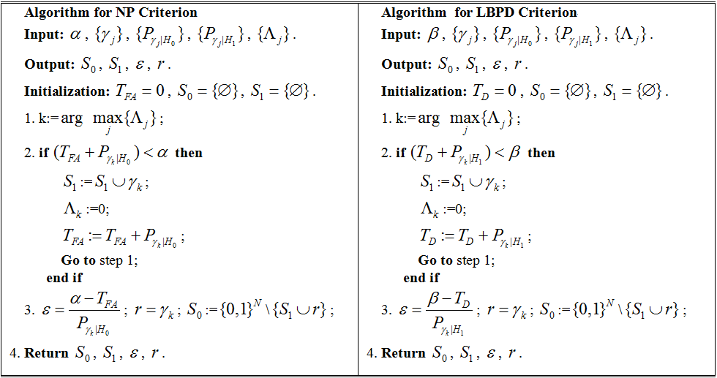
Algorithm for Computing the Fusion Rule
For each element , we denote
  by
  by
The likelihood ratio, associated with , is defined as

Slide 42
Examples
3 sensors
Proposed algorithm
K out of N
  FC declares H1 if k or more than k sensors declare H1. Otherwise, FC declares H0.
Decision Space search
  All possible combinations of decision fusion rule
4 sensors

Slide 43
Likelihood Ratio Test with Fading Statistics (LRFS)
Signal Model
Fading Gains
  Rayleigh
  Rician
Test Statistic

Slide 44
LRFS
Explicit Expressions of the test statistics
  Rayleigh:
  Rician:

Slide 45
Multi-sensor decision fusion under fading
Signal Model:
Likelihood Ratio:
Reformulate by fading statistics
  Under H1:
  Under H0:
Test Statistics

Slide 46
Numerical Examples
LRT with Fading Statistics
  LRFS under Rayleigh
  LRFS under Rician
  Matched Filter
Decision fusion with fading statistics
  3 Sensors
  2 Sensors

Slide 47
Summary of cooperative detection
Explicit algorithms of Neyman-Pearson and Lowered-Bounded Probability of Detection are derived.
Test Statistics under Rayleigh and Rician fading are derived.
Performance improvements by incorporating fading statistics
  Single-Sensor Detection under fading
  Decision fusion under fading

Slide 48
Channel access and sharing scheme
The cognitive radio (CR) networks is a promising solution for spectrum scarcity
  Secondary users (SUs) transmit on the spectrum holes of primary users (PUs)
  The main concern is the interference of SUs to PUs
Several great works provide good performance in ALOHA-based CR networks without exploiting channel state information (CSI)
We propose a novel channel access schemes to improve the ALOHA-based CR networks
  Optimize the throughput
  Conducted in distributed manner

Slide 49
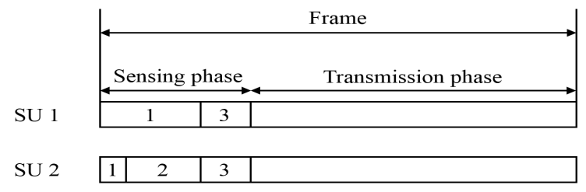
System Model
We consider N PU channels of equal bandwidth B with multiple SUs
The SUs need to sense the unused channel before transmission
For each frame with length T
  Sensing time t
  Transmission time T-t
Note that the sensing time on each channel can be adjusted by the SU

Slide 50
System Model
We consider the energy detection for sensing channels
  We can adjust the sensing time on different channel to adjust the detection and false alarm probability
For a target detection probability, we have the false alarm probability
  p_{d,n}: detection probability
  F_{2Nn}: regularized lower incomplete gamma function
  G(.): gamma function

Slide 51
Search-Based Scheme
The throughput of SU k is given by
By performing some math manipulation, the expected throughput of SU k is given by

Slide 52
Search-Based Scheme
Our goal is to determine the sensing time of each channel to maximize the throughput of SU k subject to
  Sensing time constraint
  Detection probability constraint
An optimization problem can be formulated as
The optimal solution can be found by exhaustive search
  The number of candidates is

Slide 53
Low-Complexity Threshold-Based Scheme
To simplify the computational complexity, we approximate the optimization problem by adding some reasonable assumptions
  Equal sensing time at each channel for sensing
  Equal power allocation for the transmission power at each channel
  Rayleigh fading channel
  Also, We determine whether to sense the channel by a threshold b, i.e.,
  The probability for the channel gain being larger than b is

Slide 54
Low-Complexity Threshold-Based Scheme
An alternative optimization problem is then given by
Note that

Slide 55
Low-Complexity Threshold-Based Scheme
The expected rate is now concave in most cases
  The simple one-dimensional line search can find the optimal threshold
  This significantly reduces the complexity

Slide 56
Numerical Results
Average throughput evaluation for different schemes with a single PU and a single SU
N = 5, T = 1 sec, t = 0.1 sec
f_{s}=100Hz, B=1MHz, P=1W
p_{d,target} = 0.9
p = 0.2, p_{SU} = 0.3
N = 5, T = 1 sec, t = 0.1 sec
f_{s}=100Hz, B=1MHz, P=1W
p_{d,target} = 0.9
p = 0.7, p_{SU} = 0.7

Slide 57
Numerical Results
Average throughput evaluation for different schemes with a single PU and three SUs
N = 5, T = 1 sec, t = 0.1 sec
f_{s}=100Hz, B=1MHz, P=1W
p_{d,target} = 0.9
p = 0.2

Slide 58
Summary
We investigate the channel access problem in the ALOHA-based CR networks
We propose two novel schemes to maximize throughput of SU subject to the target detection probability
  Exploiting both the CSI and collision behavior
  Search-based scheme with optimal solution and high complexity
  Threshold-based scheme with suboptimal solution and low complexity
Simulation results show that the proposed schemes outperform the prior random access scheme

Slide 59
Geo-Location database(GL-DB)
Using GL-DB as an alternative, or to complement the sensing technology
Using GL-DB for better decision accuracy
White space device interact with GL-DB to avoid interference
Identify temporal, spatial, and spectral opportunities

Slide 60
European Communications Office
(March/2015)
Sensing, Geo-location database, beacons.
  Consider GL-DB a promising solution
  ECC Report 236
  public consultation
*ECC Report 186

Slide 61
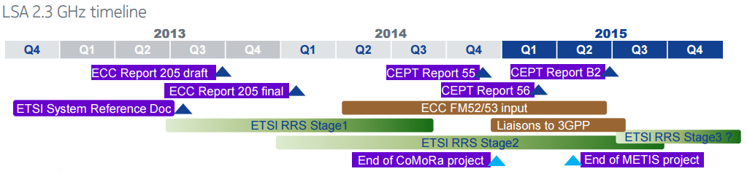
Licensed Shared Access
Allow operators to use unlicensed bands exclusively under specific time, location, or frequency.
  when and where the band is not used by the incumbent users.
Targets small cell scenario
Higher frequency, e.g., 2.3G– 3.5G Hz. More localized coverage(Qualcomm Inc.)
Claimed benefits: release underutilized spectra
2.3 G Hz timeline in Europe(Nokia Teck Report)

Slide 62
LSA
On a shared and non-interference basis
Subject to individual authorisation (i.e. licensed)
In bands allocated to the Mobile Service by the ITU (and identified to IMT)
Using cognitive radio techniques i.e. geolocation databases complemented, if required, by sensing
Enables Timely Availability and Licensed Use of Harmonized Spectrum for Mobile with Predictable Quality of Service

Slide 63



How Does The System Work Today
Spectrum licensee
grant/award of spectrum rights
Administration/Regulator
Compensation and timeline to free up the spectrum
Incumbent
Licensed Spectrum
Base station controls device access to licensed spectrum
Base station
Base station
Multi-bands
Device
Base station controls device access to licensed spectrum
*Source: Qualcomm and Nokia reports at CEPT, May 2011.

Slide 64

How Does ASA work?
ASA licensee
grant/award of ASA rights
Administration/Regulator
ASA Database
Agreement/compensation/ sharing conditions
ASA spectrum and
award rules
where/when ASA spectrum is available (Dynamic)
Incumbent
Permitted ASA spectrum
Base station controls device access to spectrum (licensed, ASA)
Base station
Base station
Incumbent
Multi-bands
Device
Base station controls device access to spectrum (licensed, ASA)
*Source: Qualcomm and Nokia reports at CEPT, May 2011.

Slide 65
LSA in 2.3-2.4 GHz – principles for sharing with PMSE
PMSE scenarios | Typical applications | Possible Implications on the protection zone
Frequent or permanent use, specific location | TV studio | Permanent protection zone
 | Theatre, stadium | Permanent protection zone
 |  | dynamic protection zone protection zone and its possible dimensions known well in advance
Temporary use, specific location, (limited mobility possible in pre-defined area) | Special events (e.g. Cycling races, Marathons, Formula One), | Dynamic protection zone, protection zone and its possible dimensions known well in advance
Temporary use, anywhere, anytime, unplanned, mobility possible | TV news, governmental use | Dynamic protection zone, protection zone needed with a short notice, location may vary due to mobility
Protection Zone: geographical area and maximum field strength level
PMSE receivers in the zone will not be subject to harmful interference caused by WBB transmissions
A protection zone is normally applicable for a defined frequency range and time period.
Rely on mechanisms making available proper information on PMSE including its position (e.g. database)
*ECO Report 03/2015

Slide 66
Qualcomm and Nokia report--The magnitude of direct benefits from 200MHz of ASA have been modelled in Europe
Yearly network operator site costs for 2020-2025, different spectrum scenarios
€bn
9
No ASA
Low frequency ASA
8
High frequency ASA
High and low ASA
Two ASA bands gives 23% extra coverage for the same cost
7
6
5
4
3
Core assumptions:
200MHz of ASA spectrum, modelled at 380MHz and 2.3GHz
25% incumbent occupancy
Data demand based on Cisco forecasts
Operator with 30% share
Operator costs move in line with current trends
2
1
0
0%
10%
20%
30%
40%
50%
60%
70%
80%
90%
100%
Population coverage
Notes:
Operator modelled assumed to have 30% market share of whole of Europe. ASA availability for one operator – 2x10MHz of 380MHz, 40MHz of 2.3GHz (TD-LTE likely so unpaired). Equivalent to c. 200MHz of additional spectrum from ASA for the whole industry
Data demand based on Cisco, then steady growth, then declining growth after 2018 (i.e. this may be conservative – impossible to predict)

Slide 67
Qualcomm and Nokia report- This suggests a potential increase in consumer surplus of over €50bn per year in Europe
Yearly increase in consumer surplus generated by ASA availability (200MHz)
€bn
60
Low frequency only
High frequency only
High and low
53
53
50
40
39
31
29
30
24
20
10
0
2020-2025*
2025-2030
* Period used for the modeling, ASA can deliver benefits earlier for Europe
Notes:
Note that the total consumer surplus increase is the same for the two periods, but the difference between 380MHz in the two periods shows the diminishing importance of low frequency spectrum as networks are increasingly built for capacity not coverage
Consumer surplus multiplier based on commentator consensus that annual incremental consumer surplus is roughly equal to total lifetime change in producer surplus. At a discount rate of 10% this gives a multiplier of 10

Slide 68
The Radio Spectrum Policy Group (RSPG) perspective
The Radio Spectrum Policy Group (RSPG) is a high-level advisory group that assists the European Commission in the development of radio spectrum policy.
“RSPG Opinion on Licensed Shared Access,” RSPG13-538, Nov. 2013.

Slide 69
RSPG
A regulatory approach aiming to facilitate the introduction of radiocommunication systems operated by a limited number of licensees under an individual licensing regime in a frequency band already assigned or expected to be assigned to one or more incumbent users. Under the Licensed Shared Access (LSA) approach, the additional users are authorised to use the spectrum (or part of the spectrum) in accordance with sharing rules included in their rights of use of spectrum, thereby allowing all the authorized users, including incumbents, to provide a certain Quality of Service (QoS).
LSA is not to be considered a new licensing regime but rather a regulatory approach.

Slide 70
RSPG
Three major parties in in LSA
  Administration, Incumbent user, LSA Users
Administration
  Define possibilities of LSA—proposals technical studies form incumbents, and LSA users
  Sharing framework
    Technical and operational conditions of LSA usage
    Protect incumbents
    Legal certainty
    Administration should set the parameters for this sharing framework (e.g.: coordination process, compatibility criteria, authorized spectrum bands, conditions of the license -such as limitations in terms of timing and location-, spectrum mask, etc.)

Slide 71
RSPG
Incumbent user
  Current spectrum holder
  Initiate a proposal to Administration after assessing a LSA request
  Incentives include reduced obligations(system evolution as required when initially contracted of the spectrum)
  Financial compensation may be consider between incumbents and LSA users
LSA users
  Make/negotiate proposals or receive proposals when opportunities available
  Obey sharing rules
  Regulatory certainty

Slide 72
RSPG-other issues
No further work on secondary trading is necessary
  RSPG04-54 Opinion on Secondary Trading
Legislation
Avoid spectrum hoarding
Make sure LSA does not affect
  Competition
  Investment and innovation
Responses from vendors and industrial associations
  Interferences (Railway, Brodcast, Entertainment )
  LSA promotes spectrum utilization (Internet related Trade Association)
  Should be technology-neutral (Internet Association)

Slide 73
LTE-U
In 2014, the LTE-U Forum was created by Verizon, in conjunction with Alcatel-Lucent, Ericsson, Qualcomm, and Samsung as members
Use 4G LTE radio communications technology in unlicensed spectrum, e.g., 5 GHz band and 3.5 Ghz
In small cell scenario
Controversy
  Interference concern
  Wi-Fi Alliance and National Cable & Telecommunications Association (NCTA)

Slide 74
LTE-U
FCC Public Notice, ET Docket No. 15-105( June 11, 2015)
  3.5 G Hz band newly available
  5 G Hz band already used by wi-fi
FCC seek information on
  Current status of LTE-U development
  Co-existence and coordination with wi-fi
  technical characteristics (e.g. bandwidth(s), listen-before-talk, transmission durations

Slide 75
LTE-U
Summary of Qualcomm response
ET Docket No. 15-105, June 2015.
LTE-U: no listen before talk; LAA:LTE-U+LBT to adopt vacant channels
Adaptive duty cycle
  Never transmits for more than 50 milliseconds continuously
  When in TX mode, enable off-time on the order of at least 1 millisecond, so Wi-Fi signals can support latency-sensitive applications
  an on/off switch, to vacate channel when not needed
  FCC should reaffirm that as long as an unlicensed technology satisfies the minimal technical requirements, there is no need for further regulatory involvement beyond ensuring compliance with those requirements

Slide 76
LTE-U
Summary of Qualcomm response
Pre-standard or proprietary
  Spec publicly available, anyone can build LTE-U device
Use of a Licensed Anchor Channel→unfair access
  Improve use experience, limit unlicensed band usage
Wi-Fi nodes back off from each other using CSMA
  CSMA requirement (at -82 dBm); ED level (-62 dBm) for non-wifi
  Wi-Fi is 100 times more aggressive to non-Wi-Fi technology than to another Wi-Fi node
LTE-U co-exist well with other applications

Slide 77
LTE-U
Summary of google document
Google response to ET Docket No. 15-105, June 2015.
LTE-U's duty-cycling causes LTE transmissions to begin abruptly, often in the middle of Wi-Fi transmissions, interrupting them and causing Wi-Fi to slow down rate/throughput in response to increased error rates
  Ex. 50% duty cycling. Fair share?
  Wi-fi interrupted often, rate reduced to 1/4 .
Wi-Fi operation in the presence of moderate interference from LTE (below Wi-Fi’s prescribed energy detect level) experiences substantial degradation

Slide 78
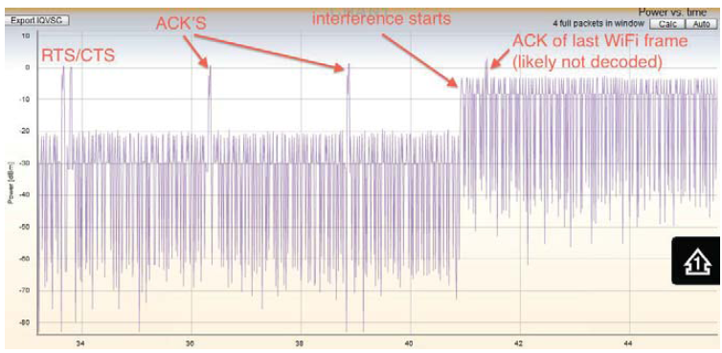
LTE-U
Summary of google document
Example of Wi-fi packet corrupted

Slide 79
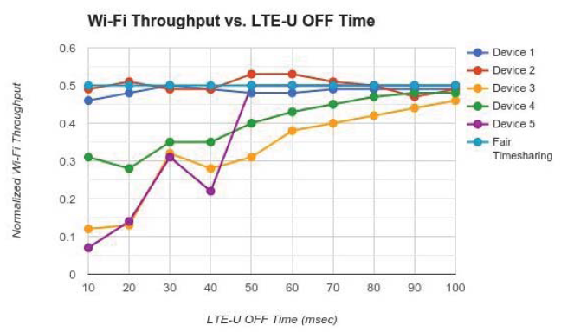
LTE-U
Summary of google document
Effective time sharing requires long LTE-U off time
The figure shows results of 50% duty cycle

Slide 80
Office of Communications (ofcom, UK)
Spectrum sharing
  Consider useful Geolocation database, sensing, sharing protocol
  On a case by case basis
  Consider high level characteristics of use(QoS, geography, directionality, etc)
Spectrum trading (OfW513 (December 2011))
  Price negotiable between trading parties
  Concurrent transfer: sharing
  Outright transfer: new owner owns exclusively

Slide 81
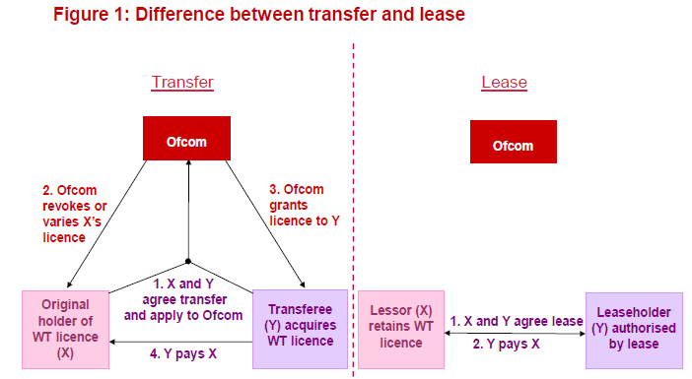
Office of Communications (ofcom, UK)
Transfer v.s. lease

Slide 82
Summary
spectrum detection techniques
  Binary detection
  Sequential
  Cooperative
  etc
LTE-U and LSA
  Sharing brings technical challenges
  Benefits and disadvantages
  Intense regulator and industry attention
  Other issues- directionality, beamforming, hidden terminal problem, etc.
  Debate ongoing

Slide 83
Q&A
Thank you!

