Slide 1
Forward Lightweight Cryptosystem Implementation
Chiou-Yng Lee
Lunghwa university of science and technology, taiwan

Slide 2
Cryptosystem architecture

Slide 3
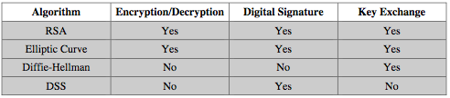
Public-Key Applications
can classify uses into 3 categories:
  encryption/decryption (provide secrecy)
  digital signatures (provide authentication)
  key exchange (of session keys)
some algorithms are suitable for all uses, others are specific to one
Notes:
Public-key systems are characterized by the use of a cryptographic type of algorithm with two keys. Depending on the application, the sender uses either the sender’s private key or the receiver’s public key, or both, to perform some type of cryptographic function. In broad terms, we can classify the use of public-key cryptosystems into the three categories:
• Encryption/decryption: The sender encrypts a message with the recipient’s public key.
• Digital signature: The sender “signs” a message with its private key, either to the whole message or to a small block of data that is a function of the message.
• Key exchange: Two sides cooperate to exchange a session key. Several different approaches are possible, involving the private key(s) of one or both parties.
Some algorithms are suitable for all three applications, whereas others can be used only for one or two of these applications. Stallings Table 9.3 (shown here) indicates the applications supported by the algorithms discussed in this book.

Slide 4
我國政府公開金鑰基礎建設之架構

Slide 5
電子商務安全
電子商務乃是指利用電腦或網際網路來完成交易的商業模式，諸如網路行銷、網路銀行、電子購物、及隨選視訊等，都是以電腦網路來做為其交易的平台
電子商務安全幾項重要議題
  電子付款
  SET安全交易
  SSL安全交易

Slide 6
電子商務面臨之安全威脅
不安全的網路環境
  偽裝 （Fabrication）
  竄改 （Modification）
  中斷 （Interruption）
  偷窺 （Interception）
電腦病毒
不誠實的消費者
  重覆消費(Double spending)
不誠實的商家
  重送 （Replay ）

Slide 7
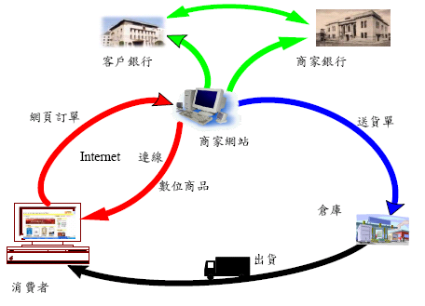
電子商務運作程序

Slide 8
普及網路交易所需的功能
簡單的付款工具
  以信用卡、電子付款或其他方式作為交易的付款工具
交易的安全性
  鑑別交易對象的身分資訊(買方，商家)
  保護交易資料在網路上的傳輸私密性及完整性
  連線信用授權，達到信用交易的安全性及迅速性

Slide 9
普及網路交易所需的功能
交易的方便性
  以網際網路瀏覽軟體(如Navigator或IE)配合其他軟體
  提供多功能且簡易的產品簡介、訂單處理、及送貨服務
  提供即時連線(On Line)的付款服務，如信用卡授權

Slide 10
電子商務中購物系統常見的功能
會員身分鑑別功能
會員資料管理功能
使用者瀏覽功能
網路購物車功能
電子付款功能
線上討論功能
暢銷商品排行榜功能

Slide 11
電子付款的架構
電子付款架構除了傳統的買方(Buyer)與賣方(Seller)之外，還必須包括：
  發卡機構(Card Issuer)
  收單機構(Acquirer)
  憑證管理中心(Certificate Authority)

Slide 12
電子付款的架構
電子付款系統可分為三大類
  預付型付款系統(pre-pay)：儲值卡、智慧卡
  後付型付款系統(post-pay)：電子支票、簽帳卡、信用卡，智慧卡
  即時型付款系統：電子現金、轉帳卡、智慧卡

Slide 13
電子付款系統的架構

Slide 14
Elliptic curve cryptography systems
Point addition
Scalar multiplication

Slide 15
Graphical Representation
Y axis
X axis
Curves of this nature
are called ELLIPTIC
CURVES

Slide 16
The Abelian Group
Given two points P,Q in E(Fp), there is a third point, denoted by P+Q on E(Fp), and the following relations hold for all P,Q,R in E(Fp)
P + Q = Q + P (commutativity)
(P + Q) + R = P + (Q + R) (associativity)
P + O = O + P = P (existence of an identity element)
there exists ( − P) such that − P + P = P + ( − P) = O (existence of inverses)

Slide 17
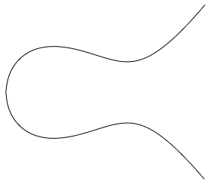
Elliptic Curve Picture
y
Consider elliptic curve
  E: y² = x³ - x + 1
If P₁ and P₂ are on E, we can define
P₃ = P₁ + P₂
as shown in picture
Addition is all we need
P₂
P₁
x
P₃

Slide 18
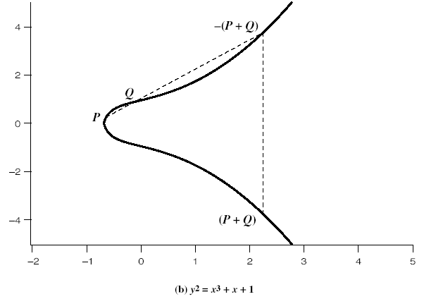
Addition in Affine Co-ordinates
y=m(x-x₁)+y₁
y
Let, P≠Q,
x
y²=x³+Ax+B

Slide 19
Doubling of a point
Let, P=Q
What happens when P₂=∞?

Slide 20
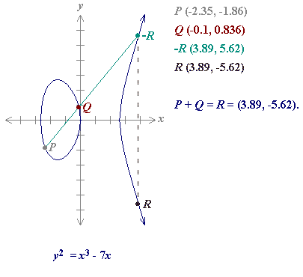
Sum of two points
Define for two points P (x₁,y₁) and Q (x₂,y₂) in the Elliptic curve
Then P+Q is given by R(x₃,y₃) :

Slide 21
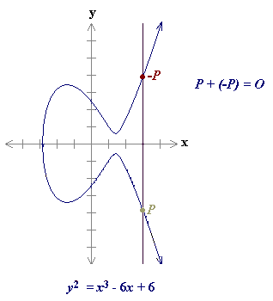
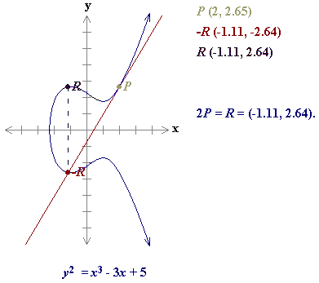
Point at infinity O
P+P = 2P
As a result of the above case P=O+P
O is called the additive identity of the elliptic curve group.
Hence all elliptic curves have an additive identity O.

Slide 22
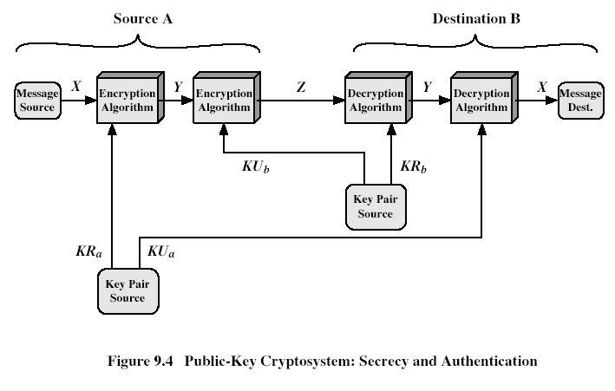
Public-Key Cryptosystems
Authentication: Only A can
generate the encrypted message
Secrecy: Only B can Decrypt
the message
Notes:
Stallings Fig 9-4.
Here see various components of public-key schemes used for both secrecy and authentication. Note that separate key pairs are used for each of these – receiver owns and creates secrecy keys, sender owns and creates authentication keys.

Slide 23
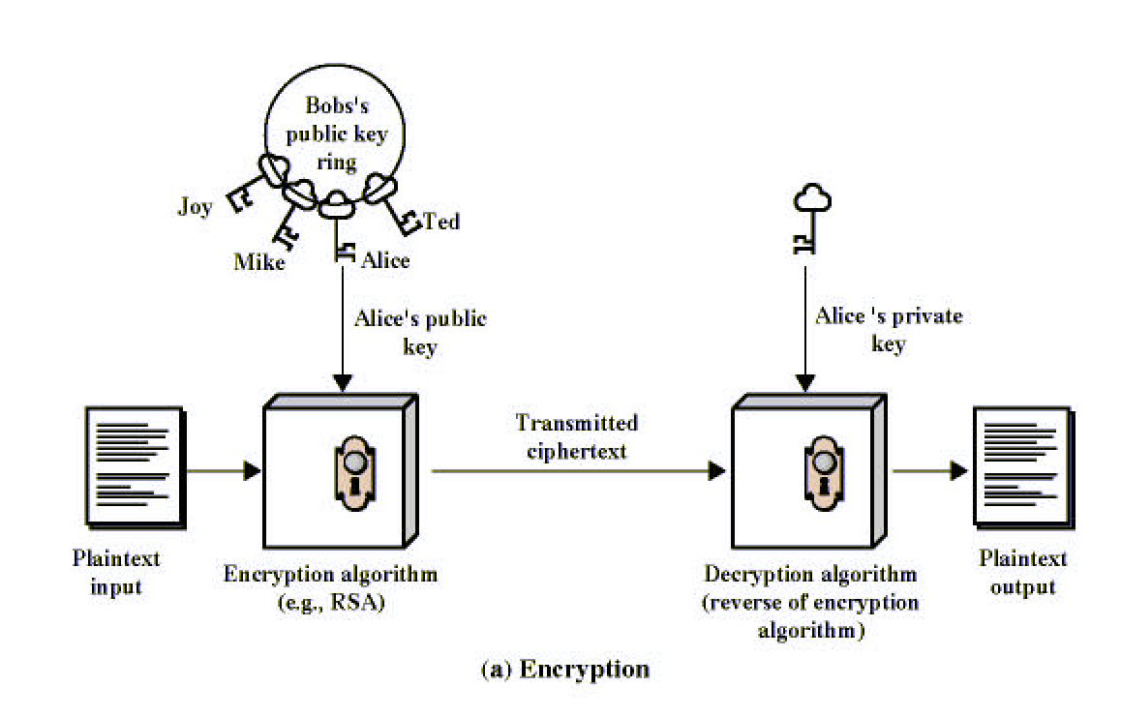
Public-Key Cryptography
Notes:
Stallings Fig 9-1.

Slide 24
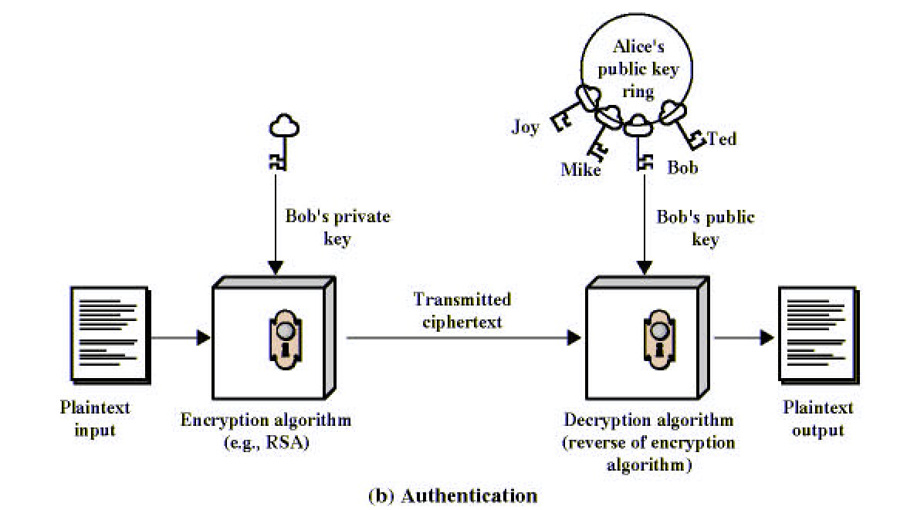
Public-Key Cryptography
Notes:
Stallings Fig 9-1.

Slide 25
Benefits of ECC
Same benefits of the other cryptosystems: confidentiality, integrity, authentication and non-repudiation but…
Shorter key lengths
  Encryption, Decryption and Signature Verification speed up
  Storage and bandwidth savings

Slide 26
Sub-Topics
Scalar Multiplication: LSB first vs MSB first
Montgomery Technique of Scalar Multiplication
Fast Scalar Multiplication without pre-computation.
Lopez and Dahab Projective Transformation to Reduce Inverters
Mixed Coordinates
Parallelization Techniques
Half and Add Technique for Scalar Multiplication

Slide 27
ECC operations: Hierarchy
ECC
Point
multiplication:
kP
Group operation:
point add/double
Finite field arithmetic: multiplication,
addition, subtraction, inversion, …
Level 0
Level 1
Level 2
Parallelize the architectures
Level 3

Slide 28
Scalar Multiplication: MSB first
Require k=(k_{m-1},k_{m-2},…,k₀)₂, k_{m}=1
Compute Q=kP
  Q=P
  For i=m-2 to 0
    Q=2Q
    If k_{i}=1 then
      Q=Q+P
    End if
  End for
  Return Q
Sequential Algorithm
Requires m point doublings and
(m-1)/2 point additions on the
average

Slide 29
Example
Compute 7P, 7=(111)₂, Q=0, R=P
  Q=Q+R=0+P=P, R=2R=2P
  Q=P+2P=3P, R=4P
  Q=7P, R=8P
Compute 6P, 6=(110)₂, Q=0, R=P
  Q=0, R=2R=2P
  Q=0+2P=2P, R=4P
  Q=2P+4P=6P, R=8P

Slide 30
Lightweight cryptography application
Lightweight does not mean “weak”. Rather, lightweight crypto is crypto designed specificity for use on constrained platforms.
Most existing solutions are designed to be efficient either on hardware or on software platforms, with performanc relatively poor on the unintended platforms.
We entered the area because there was a need: there are many applications for which traditional crypto many not be suitable and solutions well-suited to both hardware and software do not exist.

Slide 31
The need for lightweight cryptography
Area benefiting from lightweight cryptography
RFID (radio frequency identification)
SCADA (supervisory control and data acquisition)
Implantable media devices
Modern automobiles
Internet of things
Innovations yet to come– perhaps the MIT media lab will create some

Slide 32
RFID
Two billion action RFID tags and one trillion passive RFID tags will be sold 2015
Largest use of RFID is Walmart
A very inexpensive hardware-based RFID tag may have a total gate of anywhere from 1000 – 10000 gates, with only 200 -2000 gate budgeted to security
  A heroic effort recently the size of AES from 3400 gates to 2400 gates
  AES is nowhere near small enough. So if AES is your only option, you may decide to go with no crypto at all
NIST (national institute of standards and technology) in 2012
  Research in lightweight, low-power cryptography for smart meters and other devices
  Limited computational power

Slide 33
SCADA
SCADA communication must be protected. As sensing is increasingly done via battery-operated, wireless devices, the cryptography should have a small footprint
Utility worldwide, for example, are swapping out analogue meeting systems for wireless smart meters

Slide 34
Implantable medical devices
Example: insulin pumps, deep brain stimulators, pacemakers and defibrillators
Battery operated
Wireless transcutaneous RF link
No security at present

Slide 35
Internet of things
Machine-to-machine (M2M) communications, everything has embedded computers and everything is networked
Trillions, rather than billions, of network nodes

Slide 36
SIMON and SPECK block cipher
Ultra small hardware implementations
High-speed, low-memory software implementation
Multiple block and key sizes for good application fit
Flexible of implementation
Ease of implementation
Security as determined by the key size
SIMON is highly optimized for hardware and SPECK for software but both are excellent on each platform.

Slide 37
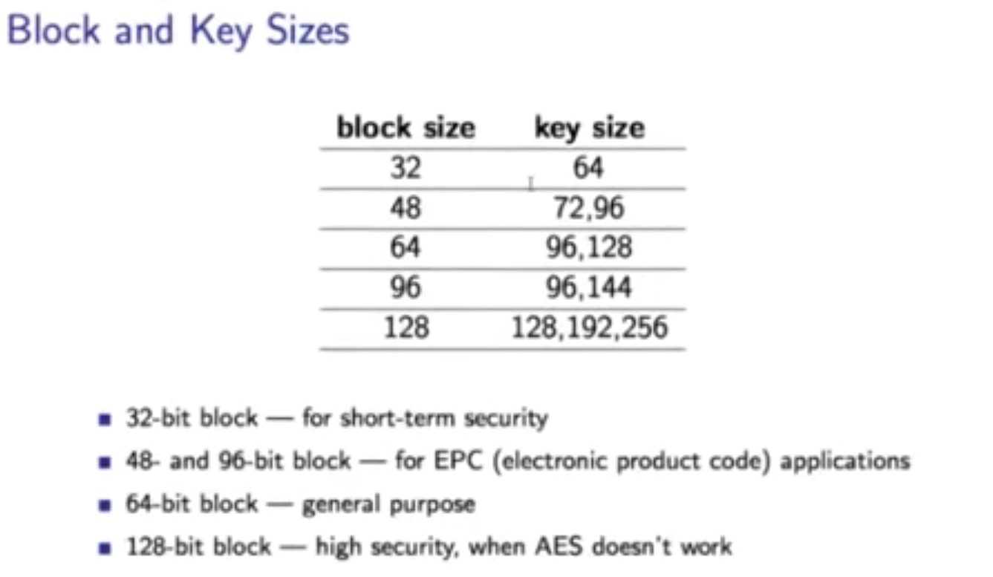

Slide 38
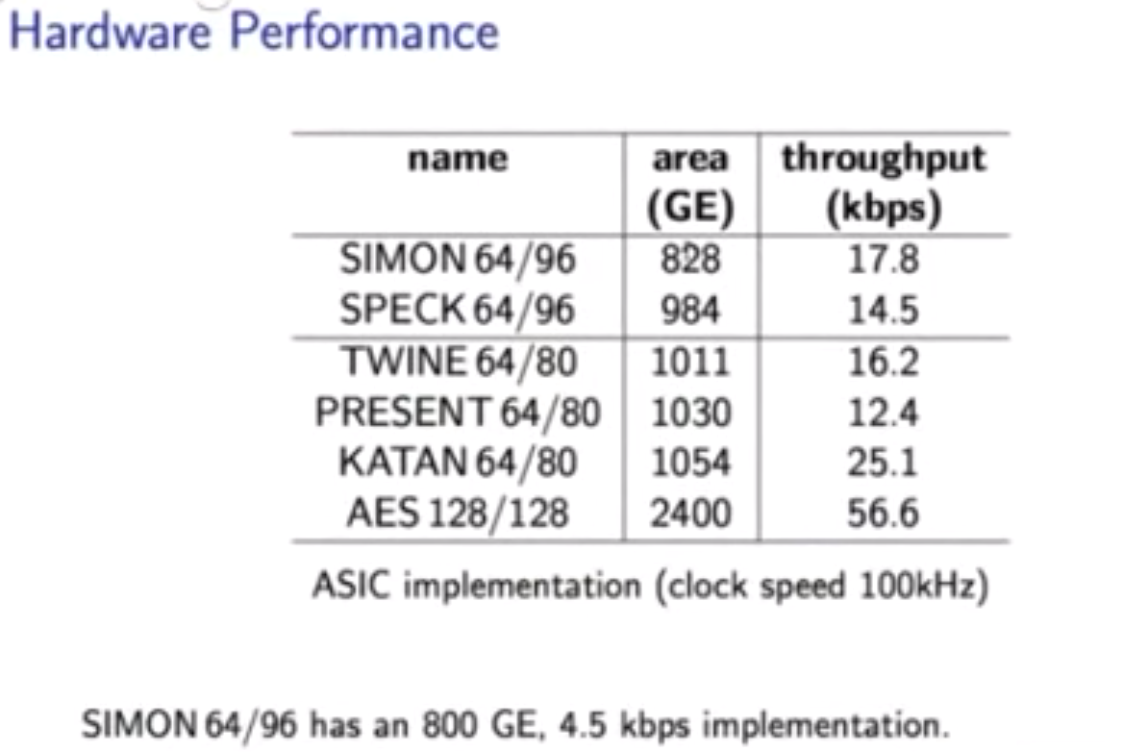

Slide 39
Introduction
Finite field applications
  Elliptic curve cryptography (ECC)
    Point multiplication involves point doubling and point addition
  Pairing computation
  Galois field counter
    Hashing function
  Error correcting codes
    Reed-Solomon code, BCH code
Binary field multiplication
  squaring of element is a simple operation
  Addition is without considering carry problem
  the field element can be represented by many basis

Slide 40
The implementation problem for ECC
ECC involves two basic operations
  Point addition
  Point doubling
Basic point operation
  Finite field multiplication and inversion
finite field multiplication becomes important objective
  Inversion can be used by recursive multiply-squaring method
  Squaring in binary field is a sample computation
Another issue for fast ECC
  How about derive multiple-operand multiplication
  It is open issue for hardware designs

Slide 41
Finite field multiplication scheme
Bit-parallel architecture
  It requires large space complexity and less time delay
Bit-serial architecture
  It require less space complexity and large computation time
Digit-level architecture
  digit-in parallel-out
  Parallel-in parallel-out
  Parallel-in digit-out
  Digit-in digit-out

Slide 42
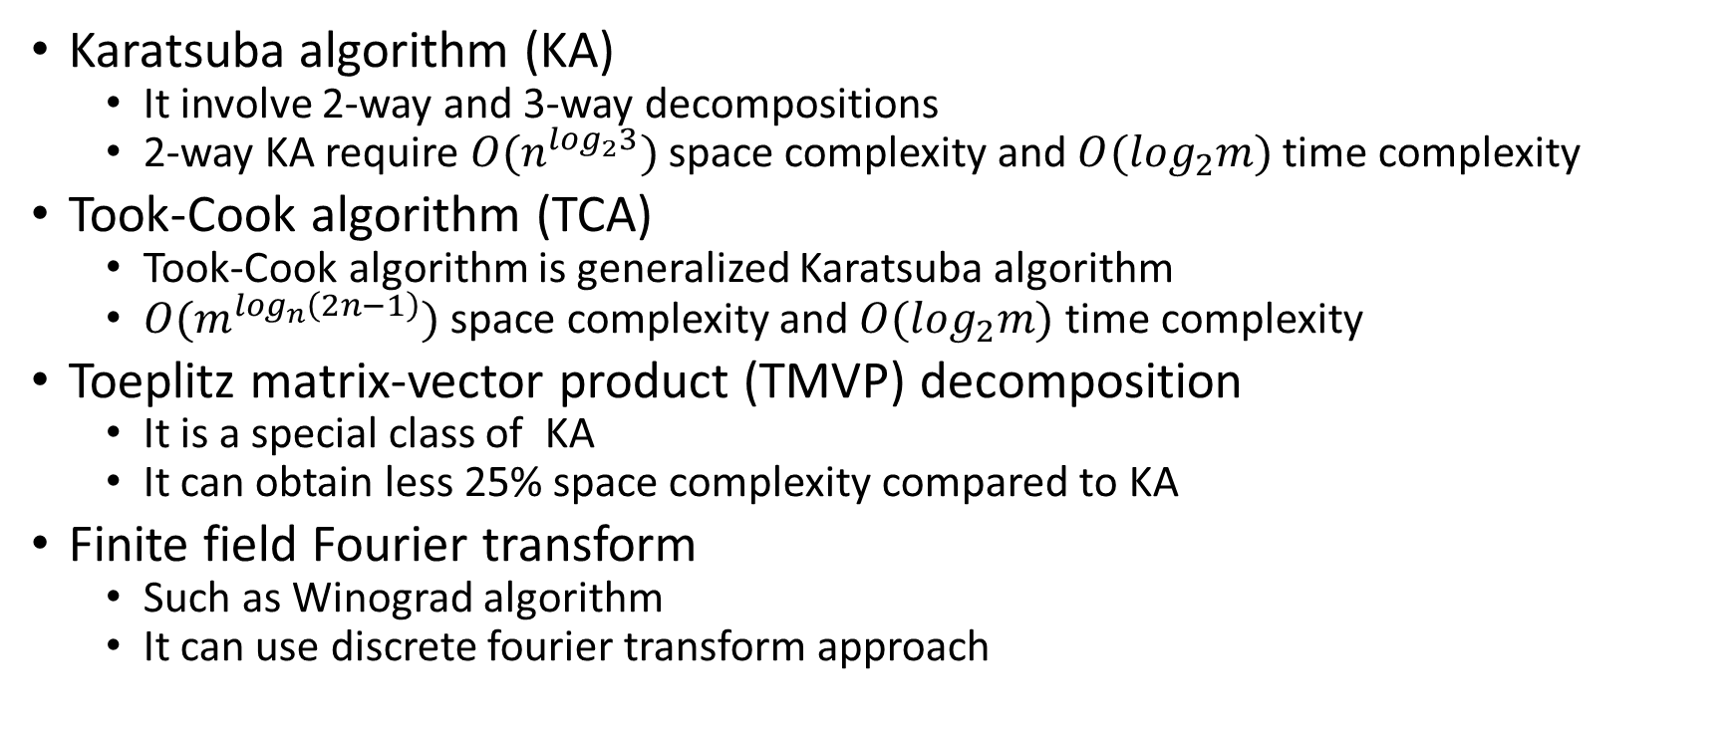
Subquadratic space computational algorithm for finite field multiplication
Karatsuba algorithm (KA)
  It involve 2-way and 3-way decompositions
  2-way KA require $O(n^{\log_{2}3})$ space complexity and $O(\log_{2}m)$ time complexity
Took-Cook algorithm (TCA)
  Took-Cook algorithm is generalized Karatsuba algorithm
  $O(m^{\log_{n}\left(2n−1\right)})$ space complexity and $O(\log_{2}m)$ time complexity
Toeplitz matrix-vector product (TMVP) decomposition
  It is a special class of KA
  It can obtain less 25% space complexity compared to KA
Finite field Fourier transform
  Such as Winograd algorithm
  It can use discrete fourier transform approach

Slide 43
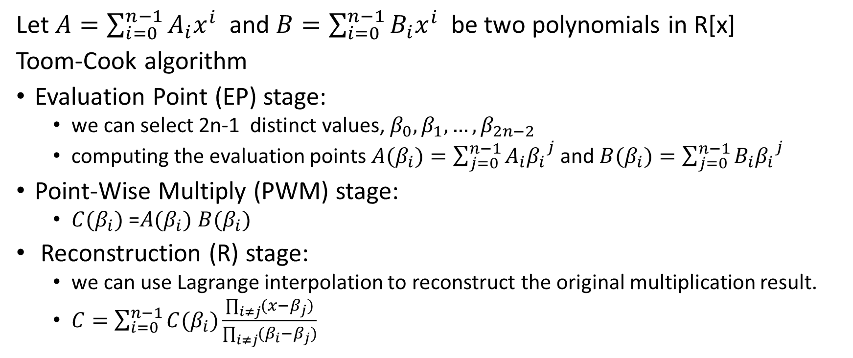
Toom-Cook algorithm (TCA)
Let $A=\sum_{i=0}^{n−1}{A_{i}x^{i}}$ and $B=\sum_{i=0}^{n−1}{B_{i}x^{i}}$ be two polynomials in R[x]
Toom-Cook algorithm
Evaluation Point (EP) stage:
  we can select 2n-1 distinct values, $β_{0},β_{1},…,β_{2n−2}$
  computing the evaluation points $A(β_{i})=\sum_{j=0}^{n−1}{A_{i}{β_{i}}^{j}}$ and $B(β_{i})=\sum_{j=0}^{n−1}{B_{i}{β_{i}}^{j}}$
Point-Wise Multiply (PWM) stage:
  $C(β_{i})$ =$A(β_{i})$ $B(β_{i})$
Reconstruction (R) stage:
  we can use Lagrange interpolation to reconstruct the original multiplication result.
  $C=\sum_{i=0}^{n−1}{C(β_{i})\frac{\prod_{i≠j}{(x−β_{j})}}{\prod_{i≠j}{(β_{i}−β_{j})}}}$

Slide 44
Polynomial multiplication based on TCA
Polynomial Multiplication
P(x)=a₀+a₁x+…+a_{n-1}x^{n-1}
q(x)=b₀+b₁x+…+b_{n-1}x^{n-1}
(a₀,a₁,a₂,…,a_{n-1})
(b₀,b₁,b₂,…,b_{n-1})
Select 2n+1 points
(p(w₀), p(w₁),…, p(w_{2n}) )
(q(w₀), q(w₁),…, q(w_{2n}) )
evaluation
Point-wise product
Polynomial Multiplication
(p(w₀)*q(w₀), p(w₁)*q(w₁),…
, p(w_{2n})*q(w_{2n}) )
(c₀,c₁,c₂,…,c_{n},…,c_{2n-1})
interpolation

Slide 45
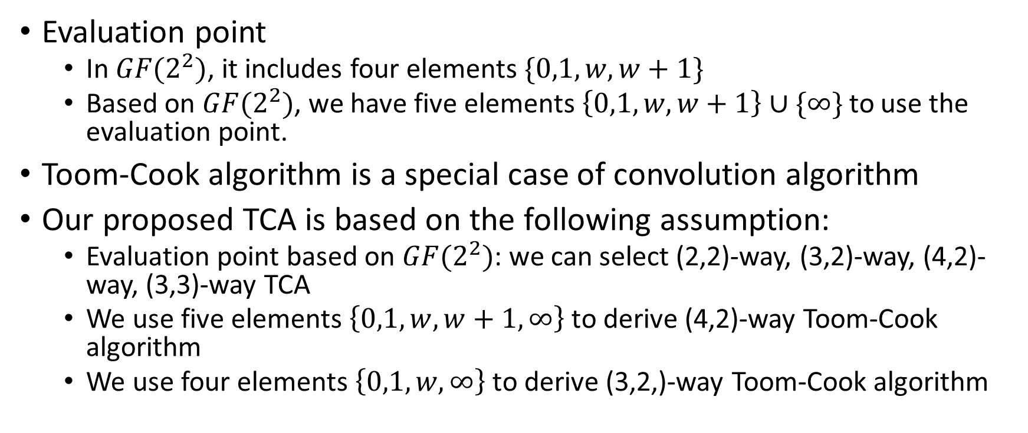
Interpolation in binary extension fields
Evaluation point
  In $GF(2^{2})$, it includes four elements $\{0,1,w,w+1\}$
  Based on $GF(2^{2})$, we have five elements $\left\{0,1,w,w+1\right\}∪\{∞\}$ to use the evaluation point.
Toom-Cook algorithm is a special case of convolution algorithm
Our proposed TCA is based on the following assumption:
  Evaluation point based on $GF(2^{2})$: we can select (2,2)-way, (3,2)-way, (4,2)-way, (3,3)-way TCA
  We use five elements $\left\{0,1,w,w+1,∞\right\}$ to derive (4,2)-way Toom-Cook algorithm
  We use four elements $\left\{0,1,w, ∞\right\}$ to derive (3,2,)-way Toom-Cook algorithm

Slide 46
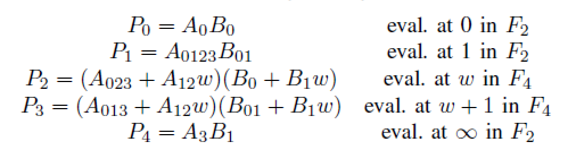

(4,2)-way Toom-Cook algorithm
Polynomial definition
  $A=A_{0}+A_{1}x+A_{2}^{}x^{2}+A_{3}x^{3}$
  $B=B_{0}+B_{1}x$
Evaluation and point-wise product

Slide 47
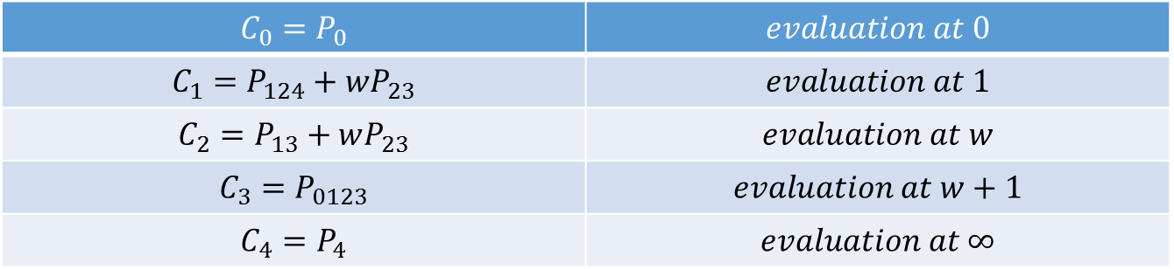

(4,2)-way Toom-Cook algorithm
Reconstruction stage
  Let the original product be $C=C_{0}+C_{1}x+C_{2}x^{2}+C_{3}x^{3}+C_{4}x^{4}$
  By using use Lagrange interpolation, we have
$$C_{0}=P_{0}$$ | $$evaluation at 0$$
$$C_{1}=P_{124}+wP_{23}$$ | $$evaluation at 1$$
$$C_{2}=P_{13}+wP_{23}$$ | $$evaluation at w$$
$$C_{3}=P_{0123}$$ | $$evaluation at w+1$$
$$C_{4}=P_{4}$$ | $$evaluation at ∞$$

Slide 48
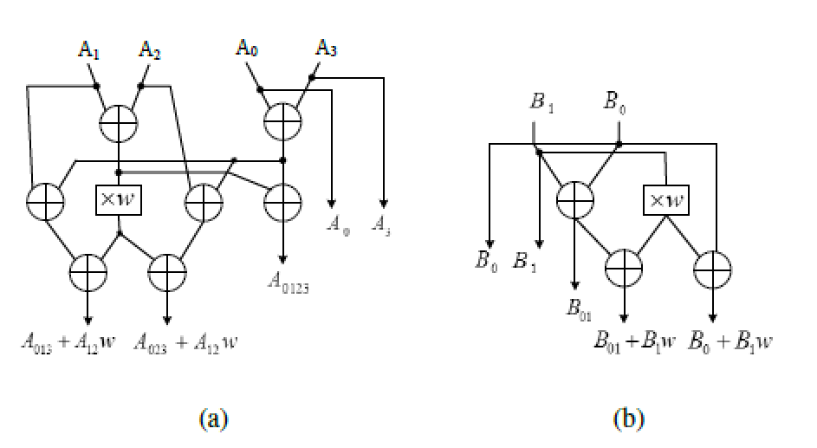
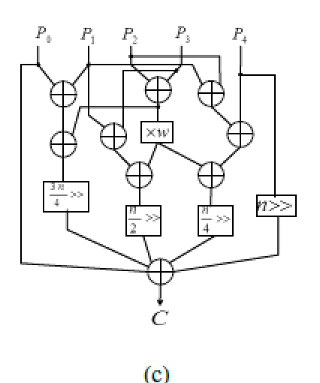
(4,2)-Way Toom-Cook architecture

Slide 49
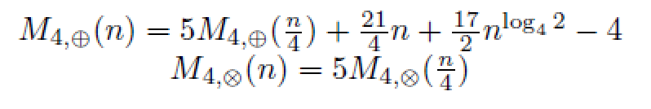
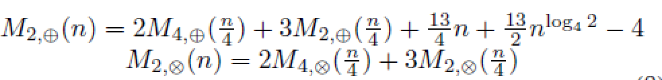

Analysis complexity for (4,2)-way TCA
Evaluation in $F_{4}$
Evaluation in $F_{2}$

Slide 50
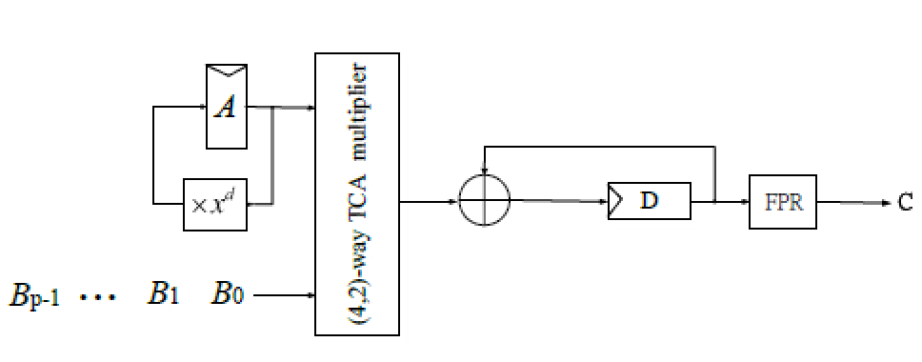
Digit-serial multiplication architecture

Slide 51
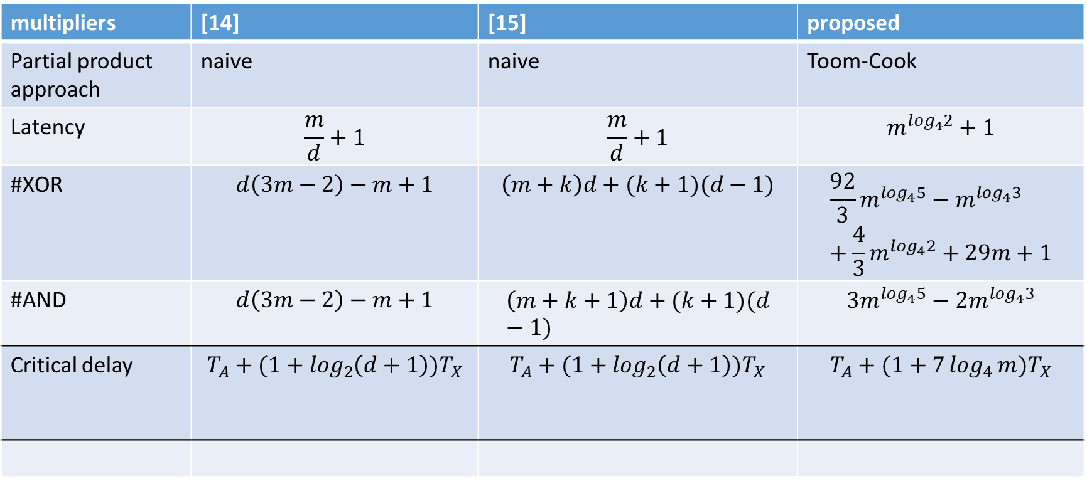
Comparison of schoolbook digit-serial multiplier and the proposed TCA multiplier
multipliers | [14] | [15] | proposed
Partial product approach | naive | naive | Toom-Cook
Latency | $$\frac{m}{d}+1$$ | $$\frac{m}{d}+1$$ | $$m^{\log_{4}2}+1$$
#XOR | $$d\left(3m−2\right)−m+1$$ | $$\left(m+k\right)d+(k+1)(d−1)$$ | $$\frac{92}{3}m^{\log_{4}5}−m^{\log_{4}3}+\frac{4}{3}m^{\log_{4}2}+29m+1$$
#AND | $$d\left(3m−2\right)−m+1$$ | $$\left(m+k+1\right)d+(k+1)(d−1)$$ | $$3m^{\log_{4}5}−2m^{\log_{4}3}$$
Critical delay | $$T_{A}+(1+\log_{2}\left(d+1\right))T_{X}$$ | $$T_{A}+(1+\log_{2}\left(d+1\right))T_{X}$$ | $$T_{A}+(1+7\log_{4}{m})T_{X}$$

Slide 52
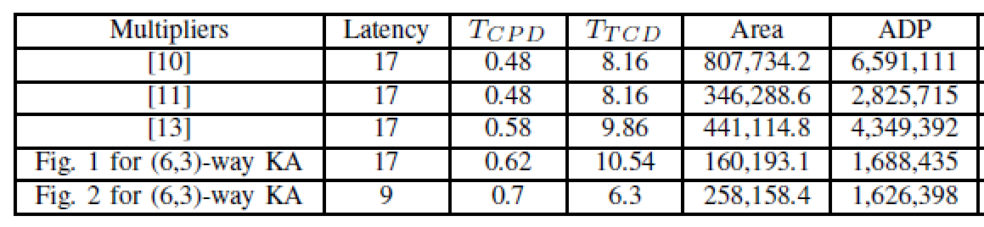
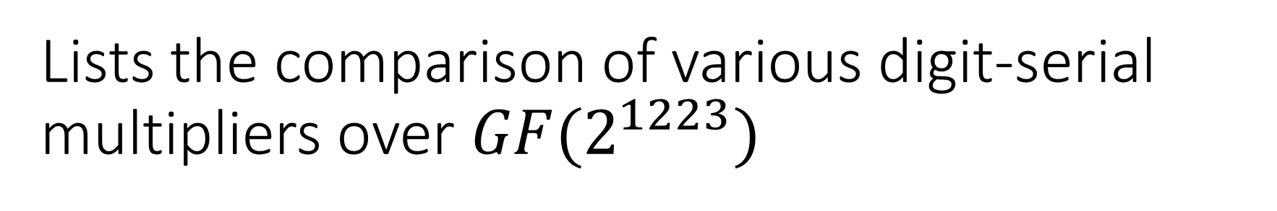
Lists the comparison of various digit-serial multipliers over $GF(2^{1223})$

Slide 53
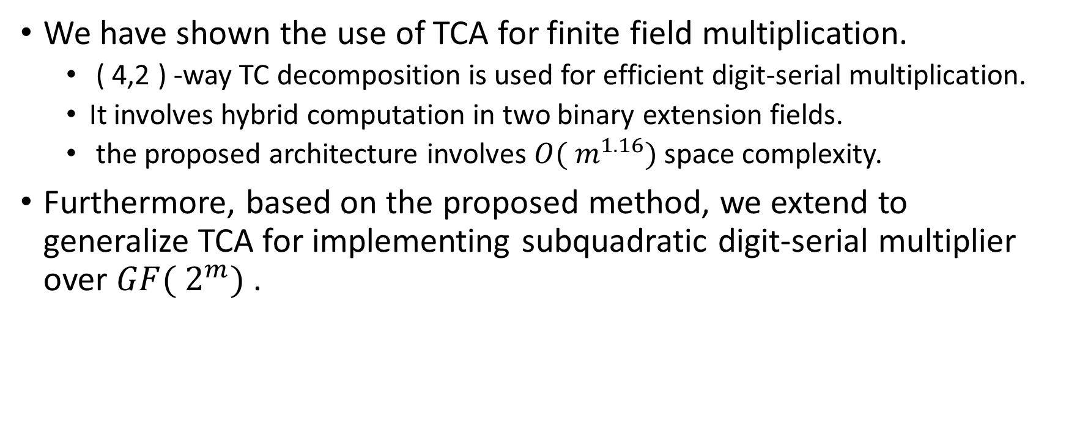
Conclusion
We have shown the use of TCA for finite field multiplication.
  ( 4,2 ) -way TC decomposition is used for efficient digit-serial multiplication.
  It involves hybrid computation in two binary extension fields.
  the proposed architecture involves $O( m^{1.16})$space complexity.
Furthermore, based on the proposed method, we extend to generalize TCA for implementing subquadratic digit-serial multiplier over $GF( 2^{m})$.

