Slide 1
醫學影像分析研究簡介
(胎兒超音波影像分析與量測)
國立成功大學 資訊工程研究所
孫永年 教授
3 /24 /2015

Slide 2
簡介 孫永年教授
匹茲堡大學電機電腦工程博士（1987）
匹茲堡大學電機電腦工程碩士（1983）
交通大學控制工程學士 （1978）
台南一中 (1971)
大成國中 (1968)
國立成功大學特聘教授 (2002~現在)
國立屏東商業技術學院教授兼副校長 (2009.8~2010.7)
國立成功大學資訊工程學系 主任兼所長 (1996~1999)
國立成功大學資訊工程研究所 教授 (1993~現在)
國立成功大學資訊工程研究所 副教授 (1989~1993)
布魯海克芬國家實驗室 助理研究員(1987~1989)
台灣塑膠公司 仁武電儀處工程師(1980~1981)

Slide 3
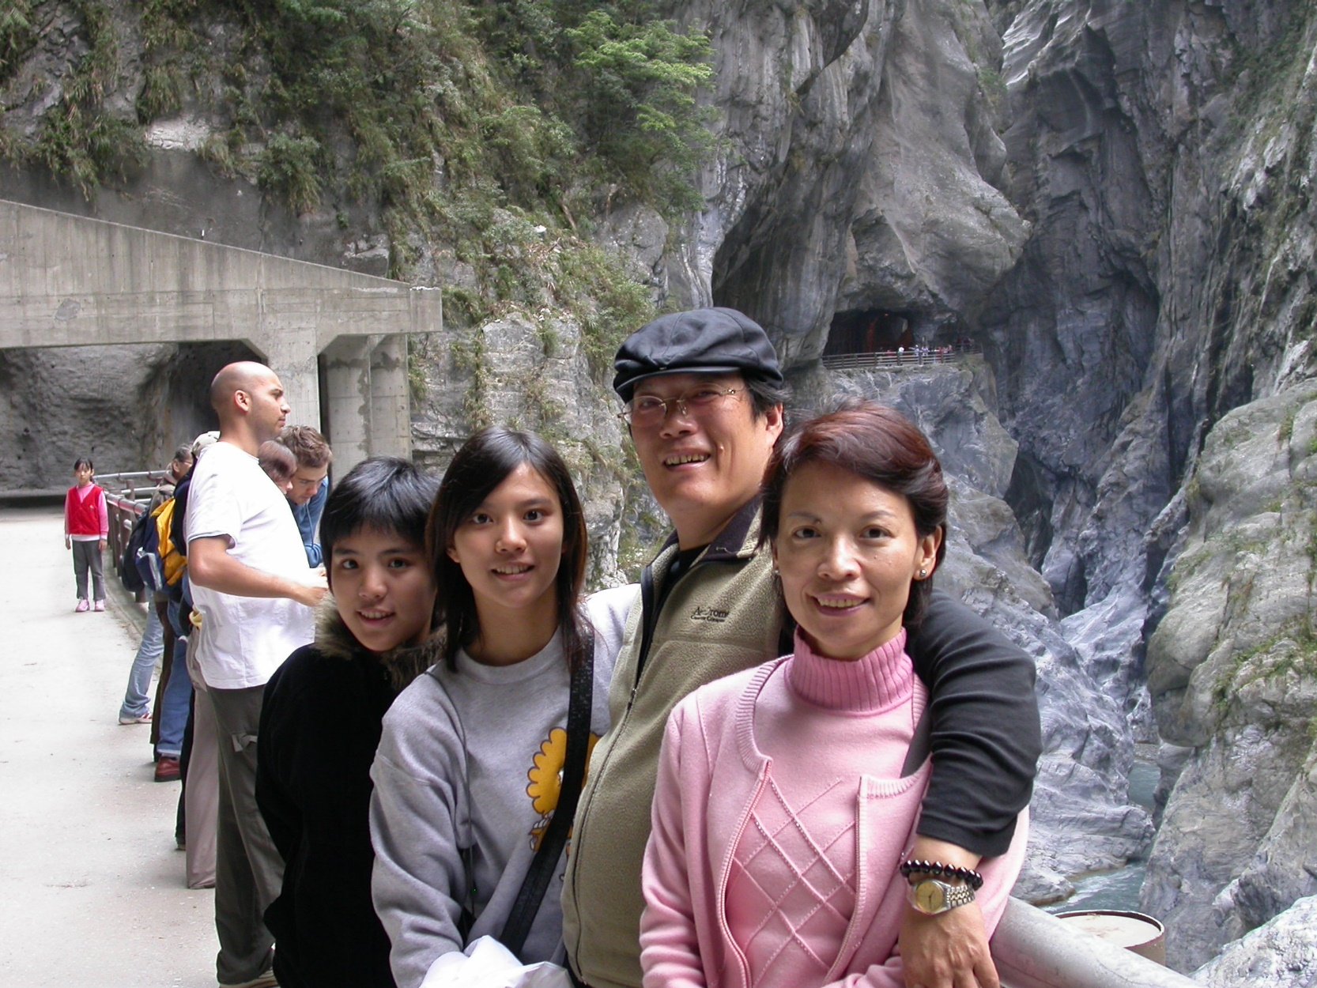
簡介 孫永年教授 (II)
我們的研究專長：
醫學影像與醫學資訊
電腦視覺及電腦圖學
動態模擬與虛擬實境
統計運算與圖像識別
影像處理與訊號處理
在上述領域進行研究二十餘年，發表二百餘篇學術論文，並指導畢業一百餘位碩、博士研究生。
國科會傑出學者研究獎 2009
國科會傑出獎 2000
國科會優等獎 1995
國科會甲種獎 1990~1994, 1996 ~1999, 2003~2004
成功大學教學傑出教師獎 2007
成功大學工學院研究優良教師 獎 八十九學年度
指導學生參加醫工學會博士研究生壁報論文競賽優等獎 2002
第一屆中華盃遊戲軟體創作大賽第三名 2001
國科會暑期大學生研究創作獎 1994, 2001
中華民國電腦學會論文佳作獎 1991, 1999
教育部主辦全國微電腦設計製作競賽優等獎 1996
龍騰博士碩士論文獎 1994, 1995, 1997
指導學生參加醫工學會論文競賽優勝獎1991
全錄優秀博士碩士論文獎1994, 1995
台南區資訊作品展榮譽獎 1991,1992
匹茲堡大學傑出博士論文獎 1987

Slide 4
Automatic Mycobacterium Tuberculosis Identification System
自動結核菌判讀系統
指導教授 ：孫永年 博士
研究生 ：陳芷涵
Notes:
各位老師，各位同學，大家好，我是陳芷涵，今天要報告的題目是自動結核菌判讀系統，Automatic Mycobacterium Tuberculosis Identification System ，我的指導教授是孫永年博士。

Slide 5
簡介
  研究動機
  根據世界衛生組織統計，全球合計約有1/3人口曾經感染結核病，每年有100萬人死於結核病。
  疾管局從民國95年開始推動全球結核病防治10年減半計畫，其中一項重要的工作就是提高痰抹片結核菌抗酸性染色的敏感性。
  根據世界衛生組織規定每片痰液抹片必須觀看300個視野，時間超過20分鐘。每個醫檢師一天只能看上20~30片痰抹片，人事成本相當高；長時間的觀看也會影響到醫檢師的判斷。
  研究目的
  我們系統的目標是希望能夠研發出一個具有高敏感性以及高準確性
  的全自動結核菌判讀系統，輔助醫檢師在臨床上的判斷並且減少其 工作量，提升工作效率，並提供資料庫供醫檢師查看。

Slide 6
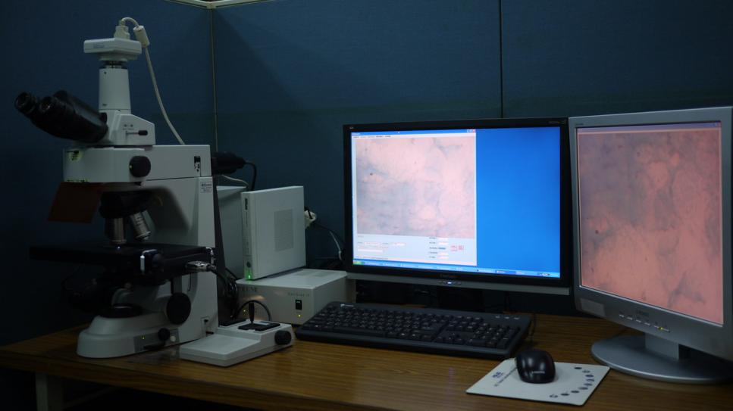
簡介
  實驗設備
A: 攝影機 : Nikon DS-Fi1
B: 顯微鏡 : Nikon Eclipse 50i
C: Prior XYZ顯微平台
A
B
C

Slide 7
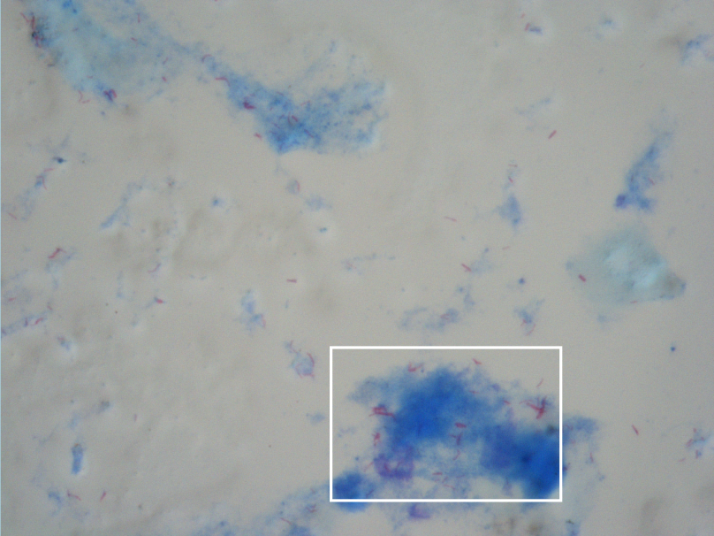
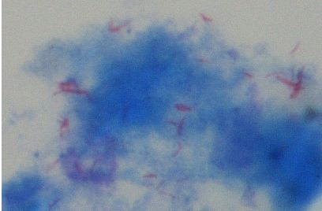
簡介
  結核菌與顯微影像特性
(a)縮小後原始影像(1280X960)
(b)圖(a)白色區域之放大影像

Slide 8
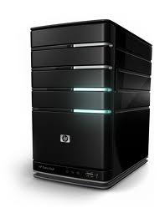
簡介
  系統簡介
用戶端
伺服器端
影像
自動結核菌判讀
抹片
多解析度顯維影像自動對焦
結果
用戶端
結果
伺服器端
結核菌資料庫
……
Demo

Slide 9
Development of image guided surgical training system: model, calibration and scenario
NCKU Visual System Lab
2013/05/31
Reporter: Miz-Tzu Chu
Advisor: Yung-Nien Sun
Notes:
各位口試委員 老師 學長學弟妹大家好，我是朱敏慈。我的論文題目是Development of image guided surgical training system: model, calibration and scenario
中文: 影像導引訓練系統開發 :
模型
校正
情境設計
我的指導老師是孫永年教授。

Slide 10
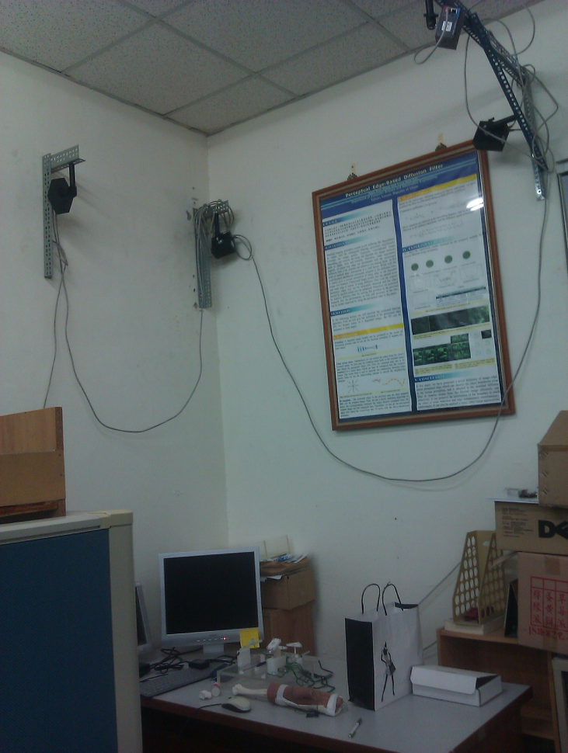
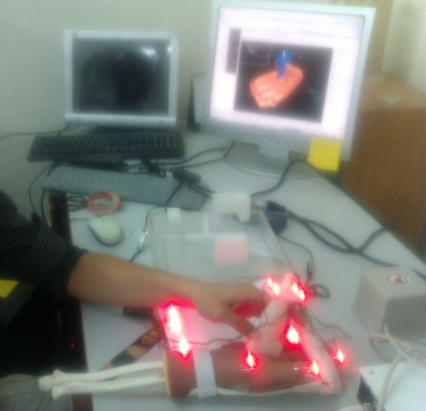
Introduction
Image guided surgical training system:
  A trainer which can simulate the surgery environment is useful.
    Phantom model construction with medical image contents is important and it is very helpful in the training procedure of the release surgery.
Optical tracking system
  Image guided medical applications often apply an optical tracking system to position the surgical region accurately.
    we usually have to describe the surgical tools or region in between the tracking world space and Image mesh model space.
The training system helps to train young surgeons for image-guided minimally invasive surgery.
  surgeon manipulates surgical instruments with the visual
  feedback of anatomical information.
Notes:
首先是Introduction
影像導引訓練系統主要是開發一個模擬真實手術情境所設計的一套訓練系統
他的特色是
1.
我們擁有一支假體的手部模型
透過電腦輔助顯示影像資訊 並且同步追蹤開刀流程
2.
開發這套系統是要透過光學追蹤系統(Optical tracking system)去做空間校正和定位 如此才能將真實手術空間與電腦模型空間整合在一起
3.
通常這樣的影像引導系統 會應用在微創手術上
因為這樣的手術 沒有直接較大的傷口可以看到解剖結構 所以通常需要影像來做輔助
同時在影像中 可以看到器具進入開刀範圍 來進行手術流程

Slide 11
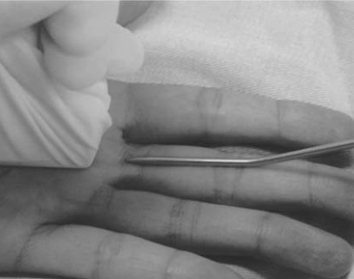
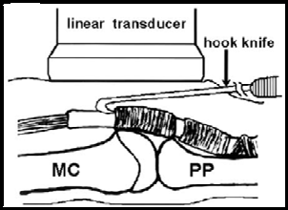
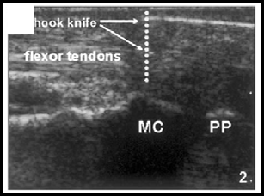
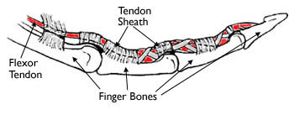
Introduction
(1) Trigger finger release:
  Jou et al. [34] proposed using ultrasound images to guide the needle and knife in releasing the trigger finger to increase the safety of percutaneous release.
  It is highly demanding on doctors’ experience and operating skill.
  There are no studies concerned with the preoperative training for image guided system.
(2) Minimally invasive surgery
  Our team cooperated with medical institute to proposed a image guided training system in the minimally invasive surgery for artificial joint replacement.
(a)
(b)
(c)
(d)
Illustration for ultrasound-guided percutaneous release [34];(a) Digital tendon-pulley system of the fingers (b)surgical release for trigger finger (c) the drawing of pulley releasing process with hook knife; (d) the acquired ultrasound image in sagittal view.
[34] Jou et al. Sonographically assisted percutaneous release of the A1 pulley: a new surgical technique for treating trigger digit. J Hand Surg -Brit Eur 2006; 31B (2): 191–199.
Notes:
本論文所發表了系統 是針對超音波導引板機指手術 所開發的訓練系統
之後也設計了通用於其他形式微創手術的一個系統開發流程
1.
首先簡單向各位介紹板機指手術:
在A圖中
在人體結構手指組成中, tendon(也就是俗稱的肌腱)負責連結肌肉與骨頭並可控制手指的運動, 正常運動情況下肌腱會在一個腔室內(pulley system)做平穩滑動
但是長期的過度使用將會造成肌腱發炎, 當肌腱發炎越來越嚴重的時候將會產生一個小瘤, 而這個小瘤將會使得肌腱無法順利滑過腔室造成手指動作上之不便。
此種情況便是俗稱的板機指疾病。
2.
成大醫院醫師提出了以超音波導引的經皮解離手術, 手術者一手拿著超音波探頭拍攝內部影像, 而藉由超音波的影像資訊輔助另一手操作手術器具以進行pulley system內小留的切割手術。
然而要進行此手術，醫師們必須有足夠的經驗以準確且安全的完成手術。除此之外，目前很少文獻探討超音波導引解離手術的術前訓練。
因此，一個可以模擬手術環境的訓練系統以讓醫師們進行 術前訓練便相當重要。
(bcd)圖分別是這個手術的手術圖 意識圖 與超音波影像
3.除了針對此手術進行訓練系統開發
我們也希望我們的系統可以通用於多種微創手術 其中包含之前與醫學院合作的人工關節置換計劃

Slide 12
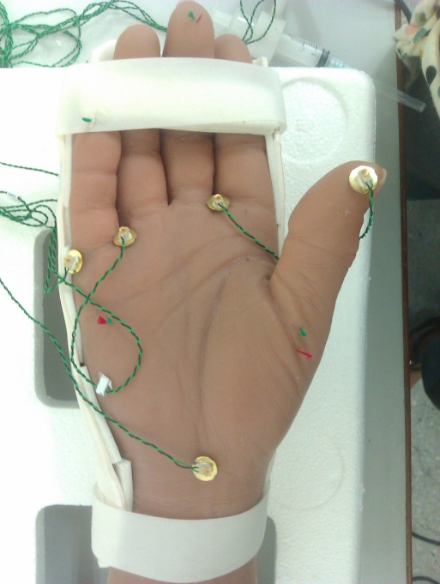
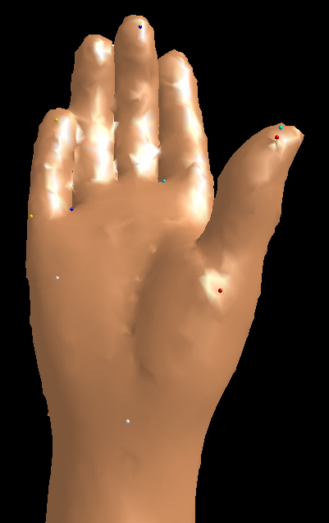
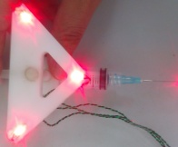
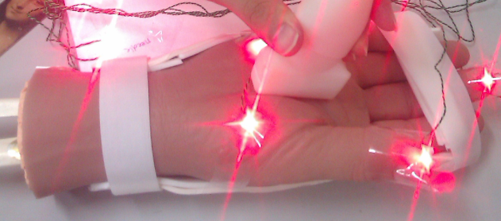
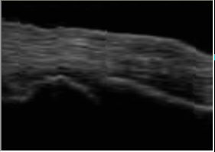
Development of image guided surgical training system
y
y
Model Coordinate(PC)
x
World Coordinate
(Tracking system)
x
z
z
1
Model
2
Calibration
3
Scenario
Bone Model
& MR volume
tools
T tracker <- tools
T MR <- US
T model <- tracker
US volume
T CT <- MR
Three step calibration:
  Initial calibration
  Gauss-Newton
  Source points adjustment
Skin
Skin Model(CT)
Demo
Probe image
T model <- tracker <- tools <- position
Notes:
這張slice是手術系統開發流程的diagram 和一些簡單方法介紹
1.
第一部分是模型的建立
這部分是利用影像融合的技術 建立出手術所需要用到的模型與影像
我們有三組醫學影像 分別是真實MR US 假體CT 首先會將超音波對MR(這部分主要是學長的碩論有詳細介紹)
另外在將對好的US MR 隊到假體CT 這部分是承襲學長方法 除了利用warping function 在加上其他限制 將他方法改善到對位效果更好
2.
當我們建立好我們的手術模型 必須將電腦模型空間與真實手術空間結合
校正部分開發了一個三階段到校正方法 首先用常用的三種校正方法得到初始參數 在利用高斯牛頓法
跌代收斂到一個最佳矩陣 最後調整對應點的位置 減少初始誤差 讓校正更準確
校正的準確度是很重要的 因為微創手術的範圍不大 影像 模型與器具之間的相對關西 誤差大很容易就即時呈現出來
若校正的準確 系統得擬真度會更加 順暢度 也會更流暢
3.
情境設計的部分 設計不同器具markers得黏貼位置 減少遮蔽效應
超音波截面呈現 是將真實空間轉換回影像空間 得到在影像中的相對位置 同時也顯示器具進入影像 超音波的呈現方式

Slide 13
Automatic Measurement of Nuchal Translucency Thickness and Growth Parameters from 3-D Fetal Ultrasound Image
由胎兒三維超音波影像進行自動頸部透明帶厚度與生長參數量測之研究
指導教授：孫永年 博士
研究生：吳旻珊
2014/07/25
Notes:
各位老師、學長姊、學弟妹大家好，我是吳旻珊
我的碩論題目是……
我的指導教授是孫永年老師

Slide 14
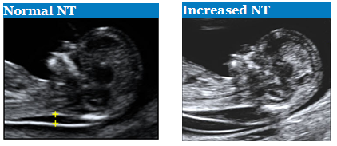
Introduction
Due to the low cost, non-invasive nature and real-time capability, routine ultrasound examination is widely used for the prenatal evaluation of growth.
First-trimester nuchal translucency thickness (NTT) measurement at 11 to 13⁺⁶ weeks of gestation has become a standard technique for the risk assessment of chromosomal abnormalities.
Nuchal translucency (NT) is the subcutaneous fluid filled space between the back of the neck of a fetus and the overlying skin. Increased NT is proven as the indication associated with trisomy 21 and many other fetal defects, genetic syndromes and adverse pregnancy outcome.
Notes:
[ 第一孕期胎兒超音波檢查: NTT/ CRL ]
因為超音波具有低成本、非侵入性、即時的特性，所以現今超音波檢查已廣泛使用於產前胎兒的生長檢查。
第一孕期大約是11~13+6天會利用超音波影像作兩項重要臨床參數量測：胎兒頸部透明帶厚度&身長
NT是指在第一孕期胎兒頸部後方會有一小塊積水的空腔，NT異常增厚顯示胎兒可能有遺傳上或基因上的缺陷。
因此，量測NTT已被納入標準超音波檢查程序裡，

Slide 15
Introduction
There are several parameters associated with fetal growth.
Crown-rump length (CRL) measurement is considered as a more reliable tool of the estimation of the gestational age (GA).
When combined with a maternal age (CRL between 45 and 84 mm), NTT can provide an effective tool of screening Down syndrome.
Otherwise, bilateral parietal diameter (BPD), head circumference (HC), and abdominal circumference (AC) also provide an effective tool as well for the assessments of chromosomal abnormalities and growth restrictions.
Notes:
[ 第一孕期胎兒超音波檢查: NTT/ CRL ]
再來還有其他臨床參數與胎兒生長發育相關。
身長量測用於估計懷孕週數已被認為是相當可信的。
目前已研究證實在身長45~84mm的範圍，NT厚度對於唐氏症的篩檢是重要的指標。
此外，胎兒頭部橫徑BPD、頭圍HC、腹圍AC，皆可助於檢測胎兒的生長發育。

Slide 16

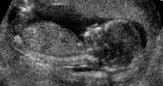
Introduction
Difficulties of the ultrasound examination：
  The quality of the ultrasound image
    The speckle noise of image
    The fuzzy boundary
    The weak edge caused by the fetal attachment to the endometrium(子宮內膜) tightly
  The operators’ experiences
    The variations between different operators
    The technique difficulty in correctly obtaining the fetal midsagittal plane(MSP)
Notes:
[ 超音波影像檢查之困難 ]
胎兒超音波影像通常會有訊號雜訊比太低、斑點狀雜訊(speckle noise)、陰影遮蔽等缺陷，造成解剖構造的觀察不明顯；
第一孕期之超音波影像更因為胎兒發育尚未完整，以及胎兒本身附著於子宮內膜造成邊界不明顯等問題，使得目前超音波影像量測與評估大都仰賴專業臨床人員的經驗，也易於導致人為的誤差。
此外，胎兒頸部透明帶厚度需在胎兒正中矢面(exactly midsagittal plane)上量測，MSP偏差會造成NTT無法正確的被量測。
如何在三維超音波影像中找到此正確觀察面，也是一項對於臨床人員相當耗時與困難的技術。

Slide 17
Introduction
We propose an automatic system using 3-D image segmentation approach for fetal evaluation.
The are three stages of the automatic system: an automatic detection of Mid-sagittal Plane(MSP), NTT measurement and a model-based segmentation for the measurement of growth parameters.
  MSP detection is proposed to obtain the correct MSP, and NTT will be measured automatically on the MSP using an active contour model technique.
  Based on the model-based segmentation, a statistic model is firstly constructed from a set of image data, and registered to the 3-D image with the information of the MSP. Then 3-D deformation is applied on the model to obtain the fetal structure from the 3D ultrasound image. With the predefined feature points, other growth parameters can be measured automatically.
Notes:
[摘要我們的方法：MSP Detection + NTT + CRL ]
我們發展自動化三維胎兒超音波影像分割與定量參數量測技術，以協助第一孕期之胎兒臨床診斷。
針對3D 超音波，首先將發展3D影像中胎兒midsagittal plane的自動偵測系統，並在正確的MSP影像上作 NTT之量測；
然後再利用MSP定位胎兒區域，加上以模型為基礎的影像分割方法，以獲得胎兒頭部和軀幹的3D模型。
我們建立出的胎兒3D 影像模型將會被標準化與座標化，使得臨床操作人員可以找出正確的觀察區域，用於胎兒生長參數的量測。

Slide 18
Related Work
Semi-automated system for NTT measurement
  J. Moratalla et al. [1] developed a semi-automated system, that the operator is requested to place an adjustable box at the back of the fetal neck. Then the boundaries of NT can be detected in the ROI and NTT will be measured automatically.
  S. Nirmala et al. [2] presented the segmentation of NT region by the mean shift analysis and canny operators. the exact thickness has been estimated using Blob analysis
Notes:
[1]“Semi-automated system for measurement of nuchal translucency thickness,”Ultrasound Obstet Gynecol 2010; 36: 412–416
[2] “Measurement of Nuchal Translucency Thickness for Detection of Chromosomal Abnormalities using First Trimester Ultrasound Fetal Images,” (IJCSIS) International Journal of Computer Science and Information Security, Vol. 6, No. 3, 2009
Problem: the correct MSP

Slide 19
Related Work
Model-based Segmentation
  H.C. Chen et al. proposed a segmentation based on the phantom head model to measure the craniofacial parameters from 3D fetal ultrasound images of second-trimester. (Ultrasound in Med. & Biol. Vol.22, No. 8, pp. 1005-1013, Aug. 2012)
  P.Y. Tsai et al. proposed a model-based segmentation method to automatically segment the fetal head and trunk structures which assist to measure the fetal parameters for clinical evaluations in the ﬁrst-trimester. (Ultrasound Obstet Gynecol 2013; 42: 154–155)
Notes:
[3] “Registration-based Segmentation of Three-Dimensional Ultrasound Images For Quantitative Measurement of Fetal Craniofacial Structure ,” Ultrasound in Med. & Biol. Vol.22, No. 8, pp. 1005-1013, Aug. 2012
[4] “An automatic algorithm to extract first trimester fetal head and trunk structures from 3D volumes,” Ultrasound Obstet Gynecol 2013; 42: 154–155

Slide 20
Experimental Materials

Slide 21
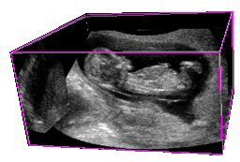
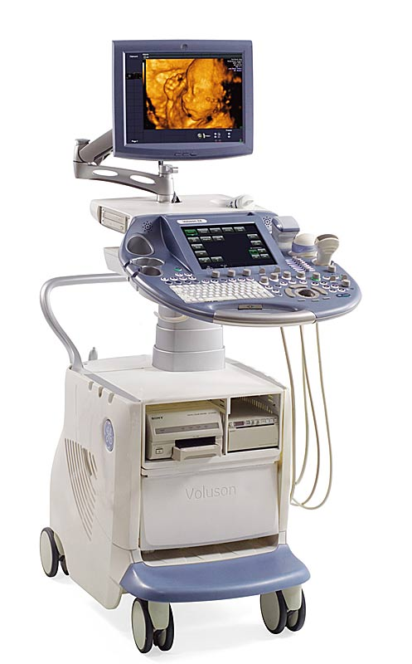
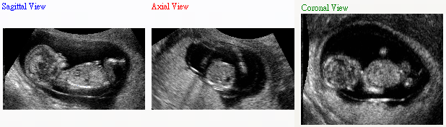
Materials
The gestational age (GA) of the fetuses was 11 to 13⁺⁶ weeks, and the volume contains the complete fetal head and trunk with varied image size, such as 199x155x185, 199x127x177, etc.
4D ultrasound machine
GE Voluson 730 Expert
(GE Healthcare, Milwaukee, WI)
Volume data
7
Notes:
[ Sagittal, coronal, axial view ]
我們使用的影像資料是第一孕期的胎兒超音波影像，包含完整的頭部及軀幹。
Volume data大小不一定，但長寬高大致上都介於150~250 voxel，解析度皆不同。

Slide 22
Methods

Slide 23
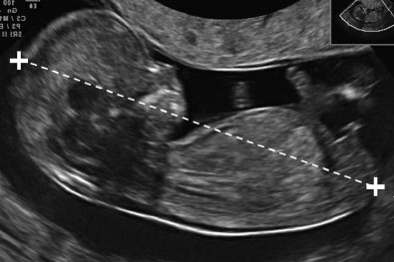
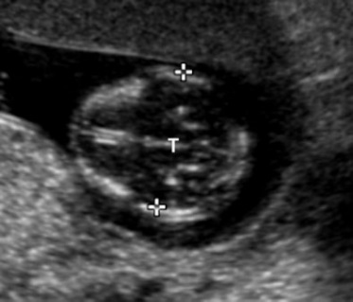
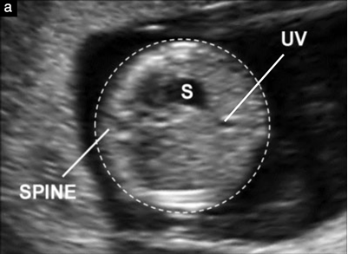
Methods
Midsagittal Plane(MSP) Detection
Nuchal Translucency Thickness(NTT) Measurement
Model-based Segmentation for The Measurement of Growth Parameters
8
Notes:
[ NTT & CRL 手動量測示意圖 ]
方法將分為三個部分作介紹
手動量測示意圖

Slide 24
Flow Chart
MSP Detection
NTT Measurement
Growth Parameters Measurement
ROI Extraction
NT Segmentation
MSP Image
NTT Measurement
NTT
Image Preprocessing
Initialization
The information of MSP
Image Enhancement & Noise Reduction
3-D Fetal Ultrasound Image
MSP Detection by Image and Anatomical Features
Database
3-D Fetal Ultrasound Images
Statistical Fetal Model Construction
1. Training Model Acquirement
3. Statistical Model Construction
Model-based Segmentation
1. MSP-based Registration
2. 3-D Segmentation by Model Deformation
Image Dataset
3-D Fetal Model &
Growth Parameters
Statistical Model
9
Notes:
[Flow Chart ]
這是完整方法的流程圖
第一部份MSP Detection可從3D超音波影像中得到MSP影像及資訊，我們蒐集170筆的影像建立完整的3D胎兒超音波影像資料庫。
再來利用MSP影像及資訊分別做NTT和生長參數的量測

Slide 25
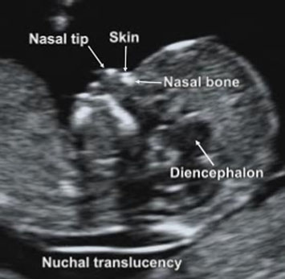
MSP Detection
Definition of Mid-sagittal Plane(MSP)
  According to the Fetal Medicine Foundation recommendations for NTT measurement, a midsagittal view of the face is defined by the presence of (1) the echogenic tip of the nose and rectangular shape of the palate anteriorly, (2) the translucent diencephalon in the center and (3) the nuchal membrane posteriorly.
Mid-sagittal view of the face
胎兒頭頸部標準MSP影像
http://fetalmedicine.org/nuchal-translucency-scan
10
Notes:
[ Intro: Definition of MSP]
首先從MSP Detection開始介紹
依據英國胎兒醫學基金會的NTT測量協定，胎兒頭頸部的Mid-sagittal plane要能看到以下特徵：
1) 前方有明顯的鼻尖點、呈矩形的上顎、
2) 中間區域有半透明的間腦、
3) 後方的頸部透明帶薄膜。
若觀察面些微偏離正確的中線平面將無法明確呈現鼻尖點，且上頷骨的觀察會偏移到顴骨突出的部位。
我們將依據這些特徵來判定平面是否為正確MSP。

Slide 26
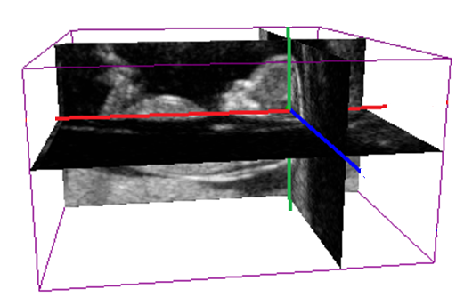
MSP Detection - Method
3-D Fetal Ultrasound Image
Initialization
  The detection starts by initializing the position of fetus.
  User is requested to select an approximate plane from the sagittal view as the initial middle sagittal plane.
  This is the only step that needs user interaction.
Volume data
MSP Detection
Initialization
The information of MSP
Image Enhancement & Noise Reduction
3-D Fetal Ultrasound Image
MSP Detection by Image and Anatomical Features
11
Notes:
[ MSP Detection - Initialization]
在輸入3D超音波影像後，我們的偵測系統會先定位胎兒位置。
此部分需要操作者先手動選取一個適當的sagittal plane，此平面影像包含最大面積胎兒頭頸部區域，
這裡也是整個系統唯一需要使用者介入的步驟。

Slide 27
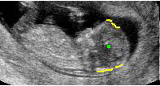
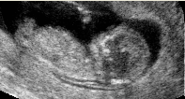
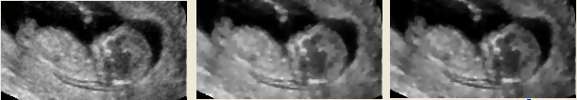

MSP Detection - Method
Image Preprocessing
  In order to extract the skull structure from ultrasound image.
  Procedure：
    Median Filter
    Anisotropic Diffusion
    Power-law Transformation
    Threshold
MSP Detection
  Magnify the image to make the fetal head and thorax occupy the whole screen.
  According to the image and anatomical features, detection of MSP can be fully automatic.
Sagittal image | a | b | c | d
12
Notes:
[ MSP Detection – Image Preprocessing ]
再來對影像作前處理，包含abcd
先對影像做去雜訊平滑的處理，再調整影像亮度及對比度，最後設定threshold從影像獲得頭骨資訊用來定位胎兒。
將胎兒定位後放大頭頸部，依據影像特徵及胎兒構造上的對稱性，經過五個步驟在空間中三方向做調整即可自動偵測出Mid-sagittal plane。

Slide 28
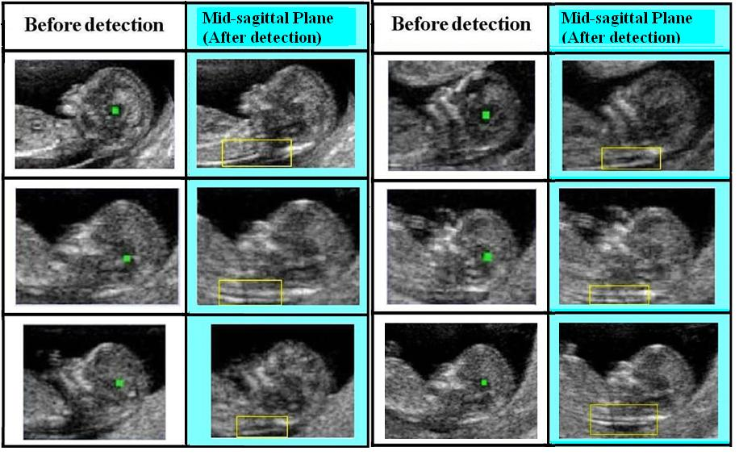
MSP Detection - Results
13
Notes:
[ Results (Images ]
胎兒3D 超音波影像之MSP自動偵測系統結果。
這裡共有6個cases
左圖為Initial sagittal plane影像；
右圖為自動偵測之結果影像，即為胎兒超音波之MSP影像，影像中黃色框指出NT區域

Slide 29
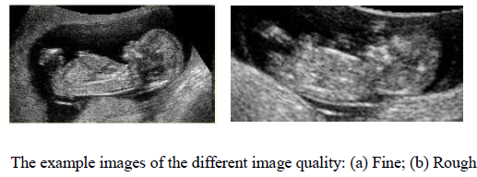

MSP Detection - Results
We have constructed a complete database of 170 ultrasound images, and we suppose to extend the database to more than 200 cases.
We proposed to test our automatic detection system on this database by simple majority vote.
  For every result images of MSP detection, three experts are required to vote whether the result image is MSP or not without knowing others’ answers. Then, we chose the final answer with maximal number of agreements.
14
Notes:
[ Results (database performance & classification ]
目前為止，我們已蒐集170筆影像資料並建立完整的胎兒3D 超音波影像資料庫，近期會增加至200筆以上影像資料。
利用此資料庫影像測試我們的MSP自動偵測系統已有良好的成果，準確率可達85%以上。

Slide 30
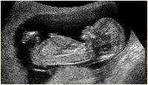
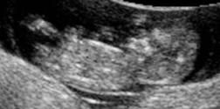
MSP Detection - Results
Promoting results were obtained with the accuracy of more than 85 %.
The average executed time of MSP detection is 5 seconds per image.
In the failed cases, we can apply little user interactions to refine the result image and obtain the correct MSP.
Detection Result Image Quality | Successful cases (Correct MSP) | Failed cases (Incorrect MSP) | Total cases
Fine （strong edge） （attachment 50%↓） | 90_{/95} 94.7% | 5_{/95} 5.3% | 95
Rough （weak edge） （attachment 50%↑） | 56_{/75} 74.7% | 19_{/75} 25.3% | 75
Total cases | 146_{/170} 85.9% | 24_{/170} 14.1% | 170
14
Notes:
[ Results (database performance & classification ]
目前為止，我們已蒐集170筆影像資料並建立完整的胎兒3D 超音波影像資料庫，近期會增加至200筆以上影像資料。
利用此資料庫影像測試我們的MSP自動偵測系統已有良好的成果，準確率可達85%以上。

Slide 31
NTT Measurement

Slide 32
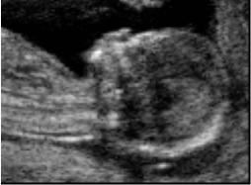
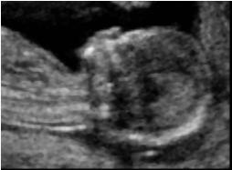
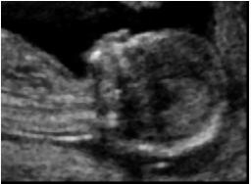
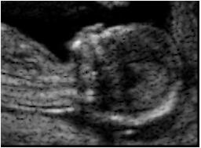

NTT Measurement - Method
NTT Measurement
Mid-sagittal Plane Image
  Image Preprocessing
    Median Filter
    Gamma Correction
    Valley Enhancement
    Anisotropic Diffusion
ROI Extraction
NT Segmentation
MSP Image
NTT Measurement
NTT
Image Preprocessing
a |  |  | b
c |  |  | d
15
Notes:
Snake model
Based on MSP

Slide 33
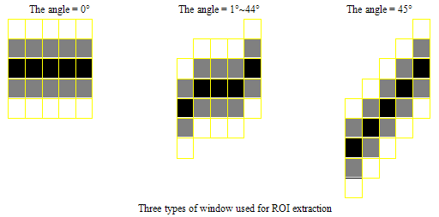
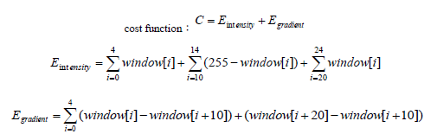
NTT Measurement - Method
ROI Extraction
The window for extraction is designed based on the salient feature of NT.
  The definition of NT
Extract in a specified region
  with the information of MSP.
    The center of the head
    The orientation of the body
16
Notes:
NTT Result
Future Work

Slide 34
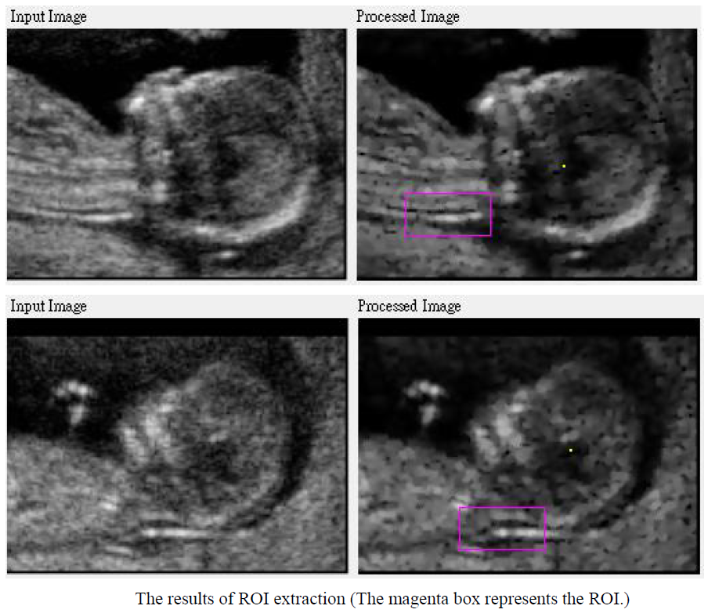
NTT Measurement - Method
ROI Extraction
16
Notes:
NTT Result
Future Work

Slide 35
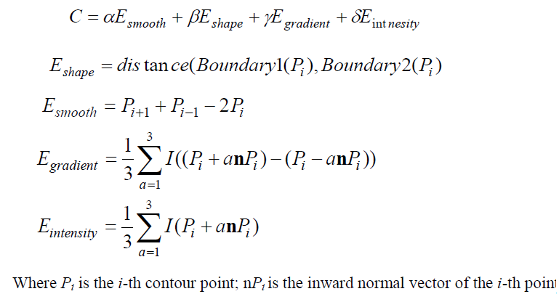
NTT Measurement - Method
NT Segmentation
  Edge detection in the ROI
  The boundaries model is constructed by double cubic spline with 5 control points each
  Use a 2- D snake model to match the accurate edge and smooth the curve.
16
Notes:
NTT Result
Future Work

Slide 36
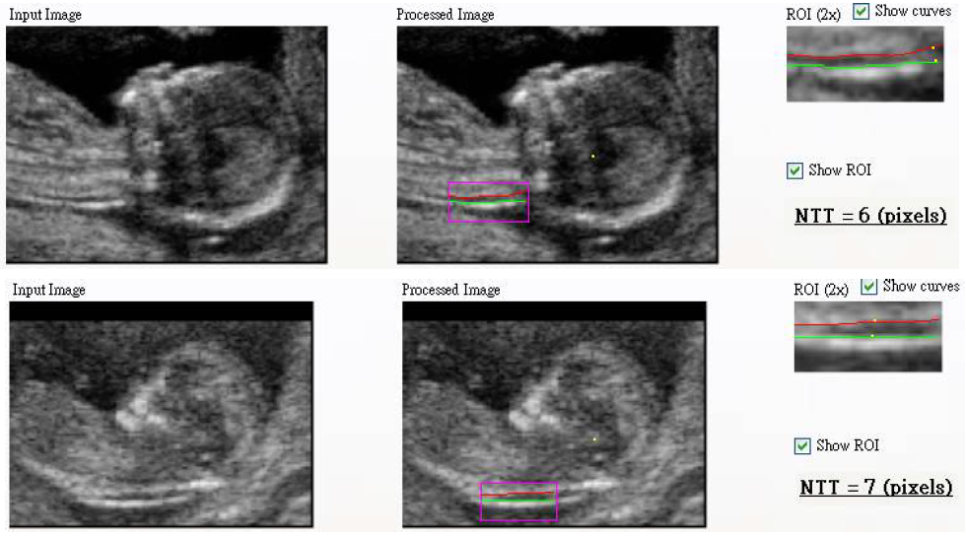
NTT Measurement - Method
NTT Measurement
  Measure the maximum distance from the inner to inner borders of the two detected edge lines.
16
Notes:
NTT Result
Future Work

Slide 37
Growth Parameters Measurement

Slide 38
Growth Parameters Measurement
We proposed an automatic model-based segmentation of fetal head and trunk structure, and measured CRL based on predefined feature points on the 3D model.
First, we construct a statistical model by training a set of ultrasound images. Using the information of the MSP, the initial model can be registered to the image automatically.
Then, 3D deformation is applied on the statistical model to match the volume image and the fetal structure will be obtained. The deformation approach includes 3D active shape model(ASM) and active contour model(Snake model).
18
Notes:
簡述方法
Model-based Segmentation

Slide 39
Growth Parameters Measurement – Flow Chart
Growth Parameters Measurement
Statistical Fetal Model Construction
1. Training Model Acquirement
3. Statistical Model Construction
Model-based Segmentation
1. MSP-based Registration
2. 3-D Segmentation by Model Deformation
Image Dataset
3D Fetal Model &
Growth Parameters
Statistical Model
19
Notes:
Flow Chart: Model-based Segmentation
Model training
MSP for Registration
3d deformation

Slide 40
Growth Parameters Measurement – Method
Statistical Fetal Model Construction
Image
Preprocessing
Median Filter
Training Model
Acquirement
MSP-based Registration
Statistical Model Construction
Model Alignment
Anisotropic Diffusion
Gamma Correction
Initial Model Deformation
Mean Shape Model
Principle Component Analysis(PCA)
Statistical Model
Prototype Model
20
Notes:
Statistical Model training
Preprocessing
Registration
Mesh Deformation
Model Construction

Slide 41
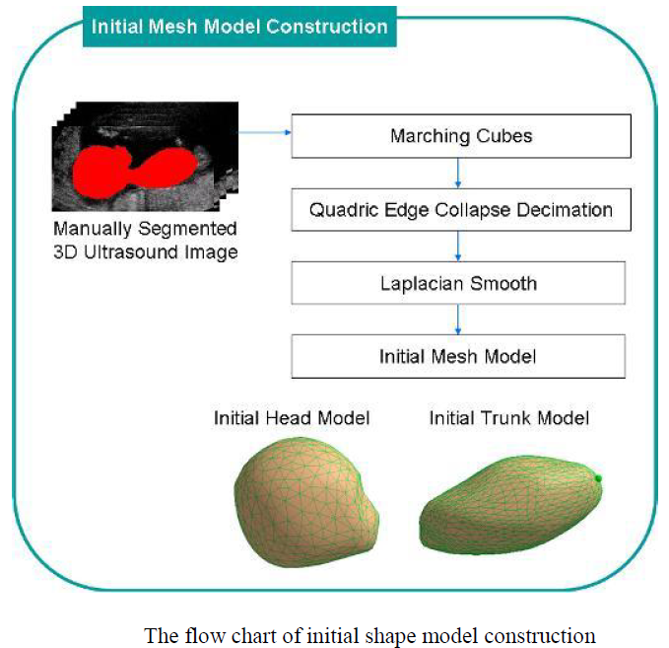
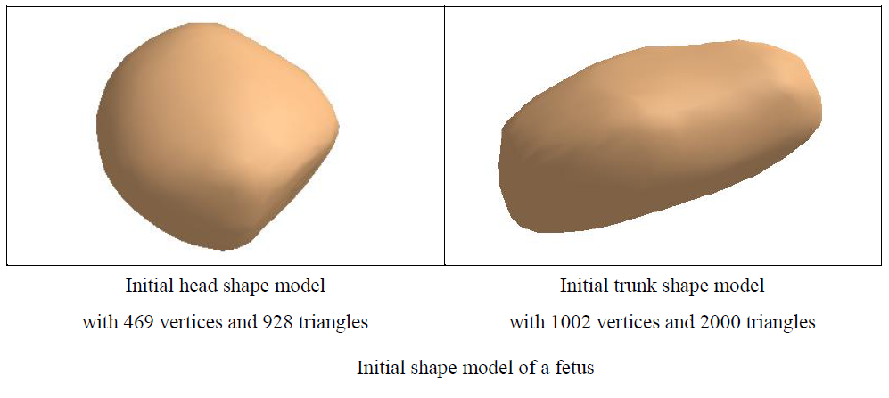
Growth Parameters Measurement – Method
Statistical Fetal Model Construction
  Training Model Acquirement
    The prototype model is constructed by manual segmentation.
      Head model：469 vertices, 928 triangles
      Trunk model：1002 vertices, 2000 triangles
21
Notes:
Statistical Model training
Preprocessing
Registration
Mesh Deformation
Model Construction

Slide 42
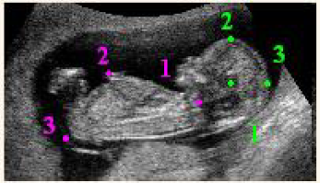
Growth Parameters Measurement – Method
Statistical Fetal Model Construction
  Training Model Acquirement
    MSP-based Registration
    With affine transforms and the predefined features of the MSP, the prototype model is registered to the training images.
Model | Features
Head | Center of Head * 2) Forehead 3) Crown
Trunk | Connect point * 2) Abdomen 3) Rump
21
Notes:
Statistical Model training
Preprocessing
Registration
Mesh Deformation
Model Construction

Slide 43
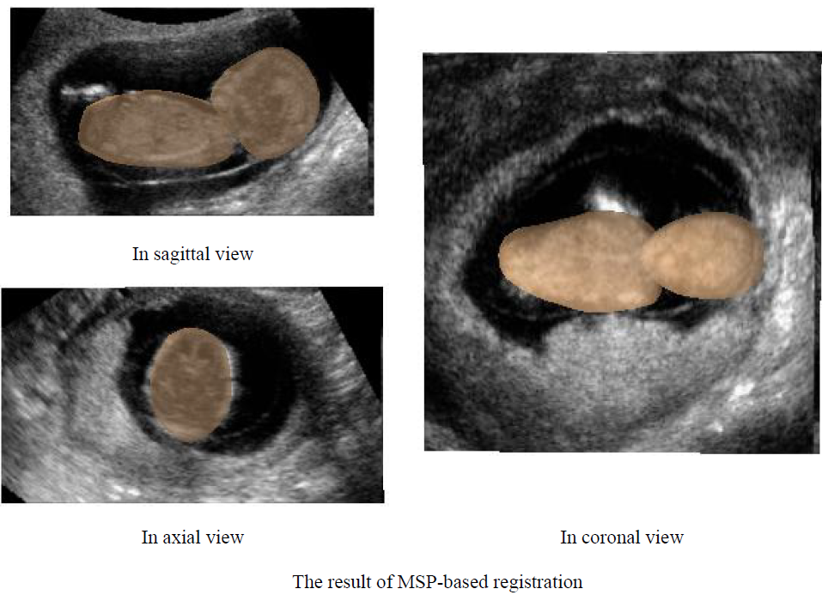
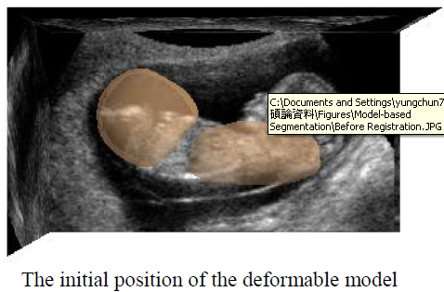
Growth Parameters Measurement – Method
Statistical Fetal Model Construction
  Training Model Acquirement
    MSP-based Registration
21
Notes:
Statistical Model training
Preprocessing
Registration
Mesh Deformation
Model Construction

Slide 44
Growth Parameters Measurement – Method
Statistical Fetal Model Construction
  Statistical Model Construction
    Then a free-form deformation is applied on the initial model to obtain other training shape models.
    Different shape models are aligned using affine transformation
    The mean shape model is obtained from the training image dataset.
    Principle component analysis(PCA) is used to extract the PC from the training images.
      The first four components are adopted.
    The statistical fetal head and trunk models are constructed.
22
Notes:
Statistical Model training
Preprocessing
Registration
Mesh Deformation
Model Construction

Slide 45
Growth Parameters Measurement – Method
Model-based Segmentation
MSP-based Registration
3-D Segmentation by Model Deformation
Global Deformation
Local Deformation
3-D Active Shape Model (ASM)
Corresponding Feature Points of the volume image and the model
3-D Snake Model
Affine Transformation
Translation
Rotation
Scaling
24
Notes:
Model-based Segmentation
Registration
ASM
Snake

Slide 46
Growth Parameters Measurement – Method
Model-based Segmentation
  3-D Segmentation by Model Deformation
    Global Deformation： 3D ASM
    ：Mean shape model, ：Current deformed model
    P：Components, b：parameter of P, where
    Evaluate the distance between the current deformed model and the feature points on the image to find the best value of b, which makes the model match to the volume image accurately.
25
Notes:
Model-based Segmentation
Future Work: dynamic Snake

Slide 47
Growth Parameters Measurement – Method
Model-based Segmentation
  3-D Segmentation by Model Deformation
    Local Deformation： 3D Snake Deformation
      Energy function：
      Edge Term：
      Shape Term：
      Smooth Term：
      K = number of neighbors of v_{i}
22
Notes:
Statistical Model training
Preprocessing
Registration
Mesh Deformation
Model Construction

Slide 48
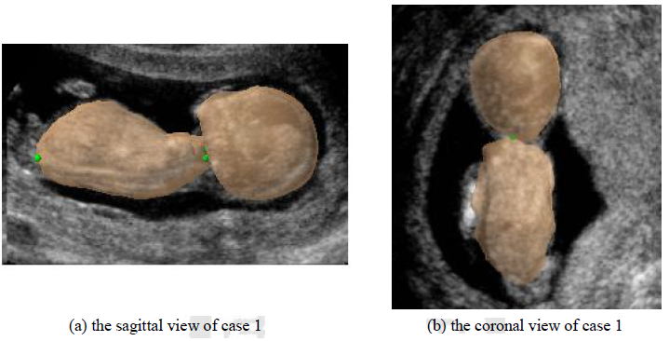
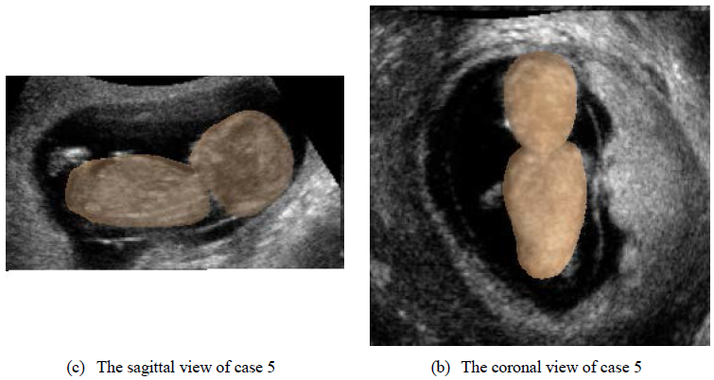
Growth Parameters Measurement – Results
Model-based Segmentation Results
26
Notes:
[ Segmentation Results ]
自動分割胎兒3D頭部與軀幹模型結果。
左圖為矢狀面(sagittal view)影像，矢狀面方向可以明顯看出3D胎兒模型與影像的貼合程度；
右圖為冠狀面(coronal view)影像，冠狀面方向則可看出頭部與軀幹模型的方位。

Slide 49
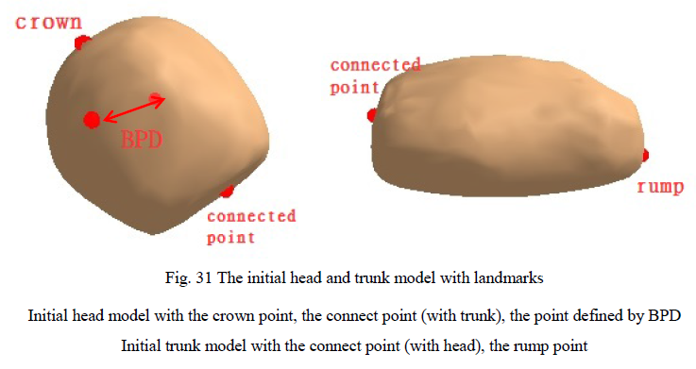
Growth Parameters Measurement – Measurement
With the feta fetal and the manually pre-defined landmarks, we can measure the clinical parameters.
27
Notes:
CRL Measurement

Slide 50

Growth Parameters Measurement – Measurement
CRL Measurement
  With the pre-defined feature points on the initial shape model, we calculated the CRL in two ways.
  the distance between the crown and the rump point
  the sum of the maximal length of these two models individually
27
Notes:
CRL Measurement

Slide 51



Growth Parameters Measurement – Measurement
Measurement of Bilateral parietal Diameter (BPD), Head Circumference (HC), and Abdominal Circumference (AC)
HC
BPD
AC

Slide 52
Experimental Results & Discussion

Slide 53

Experimental Results
Experimental Data Descriptions
  Dataset 1 : 2-D images used in clinical manual measurement
    Image Size: 800 x 600 pixels
  Dataset 2 : result images of automatic MSP detections
    Image Size: ~250 x 150 pixels
    Constructed by 3-D volume images

Slide 54

Experimental Results
NT Segmentation
  10 images from Dataset 1 and Dataset 2

Slide 55


Experimental Results
NTT Measurement
  30 images from Dataset 1
    Three experts measured NTT on these 30 images, and we regarded the average value as the results of manual measurements, referred to as M1.
    Automatic measurement is applied on the same 30 images, referred to as A1.

Slide 56



Experimental Results
Model-based Segmentation
  The projected 2-D contour of segmentation results on the MSP.
28
Notes:
[手動&自動 initial差異 ]
Snake model is sensitive to the noise.

Slide 57
Discussion
MSP Detection
  An automatic detection provides a standard and convenient coordinate system for clinical observation.
  A database of 3-D fetal ultrasound images
NTT Measurement
  With the information of MSP, ROI can be extracted automatically.
  We consider a double cubic spline model of NT may be more stable to maintain the continuity of the boundaries.
28
Notes:
[手動&自動 initial差異 ]
Snake model is sensitive to the noise.

Slide 58
Discussion
Growth Parameters Measurement
  Model-based segmentation method
  The features of fetal face are more complex than the skull, thus a weighting cost function for ASM is designed to adjust the different features of head model.
  A fully automated system for the assessment of clinical growth parameters from 3-D ultrasound images.
  Due to the variety in the first trimester, for the failed case, little user interaction can be applied to refine the results.
28
Notes:
[手動&自動 initial差異 ]
Snake model is sensitive to the noise.

Slide 59
Conclusion & Future Works

Slide 60
Conclusion
Different to previous studies in US image segmentations for the second or the third trimester, we focus on the analysis of fetus image of the ﬁrst trimester.
Different to the previous segmentation method, we proposed an automatic detection of MSP for model registration, thus reducing the scanning time and the variation between different operators.
The proposed method precisely measures fetal clinical parameters using 3D US in the ﬁrst-trimester, making it useful for clinical service.
29

Slide 61
Future Works
Some issue can be improved based on the proposed system
  The initialization of the detection system.
    With the fetal statistical model, the system can detect the orientation and the position of the fetus in ultrasound volume image approximately as the initial step of the MSP detection.
  The robustness of the proposed method
    Due to the weak edge of ultrasound image, we propose a dynamic snake model, which can apply different parameter set depended on the different texture of the edge. (to be continued)
  The consistency of the measurement between using 2-D image and 3-D model
    So far, the clinical measurements are all defined based on 2-D ultrasound image. Thus, the consistency between using 2-D image and 3-D volumes can be discussed as next issue.
30

Slide 62

Future Works
In the future, the system can be applied to more clinical parameters measurement, for example, the intracraninal translucency (IT), the fetal volume estimation, etc.
30

Slide 63
Thank you!
Comments & Questions !

