Slide 1
體感互動娛樂軟體設計簡介
盧天麒 副教授
國立嘉義大學資訊工程學系
tclu@mail.ncyu.edu.tw

Slide 2
大綱
嘉大資工遊戲專題
體感互動設備簡介
娛樂軟體設計理論

Slide 3
大綱
嘉大資工遊戲專題
體感互動設備簡介
娛樂軟體設計理論

Slide 4
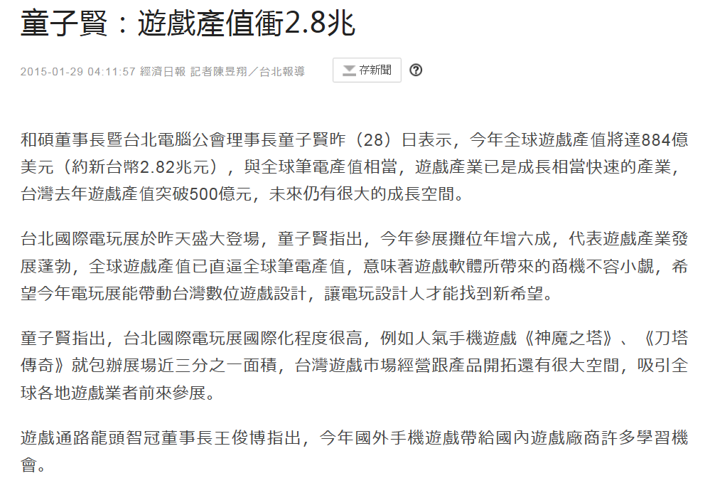

Slide 5
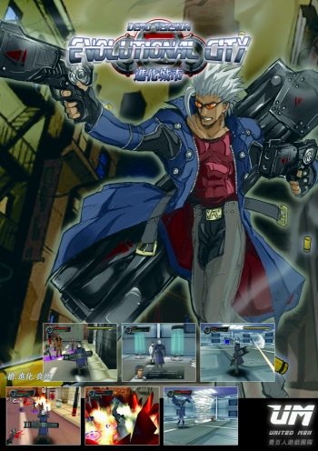
嘉大資工遊戲專題
  鬼厝 (2005)
    多系合作開發 - Virtools
    組長：蔡閔智
    鬼屋解謎遊戲
  十八年的約定 (2005)
    資工系自製 - Virtools
    組長：楊棠皓
    冒險益智遊戲
  進化城市 (2006)
    資工系自製 - Virtools
    組長：楊棠皓
    打鬥射擊遊戲
  呆丸島漂流記 (2007)
    資工系自製 – OpenGL game engine
    組長：柯堇宏
    寵物競速遊戲

Slide 6

嘉大資工遊戲專題
  大必汀 (2008)
    資工系自製 – Java M3GE
    組長：徐千雅
    手機休閒小品遊戲
  殭屍的咚咚殭屍ㄘㄟˋ(2009)
    資工系自製 – Ogre3D game engine
    組長：林一棟
    角色扮演遊戲
  女神之翼 (2010)
    遊戲學程合作 – Unity3D
    組長：林巧燁
    休閒冒險闖關遊戲
  GoGo賽馬 (2011)
    產學合作 – Ogre3D game engine
    組長：陳禹辰
    體感競速賽馬遊戲

Slide 7
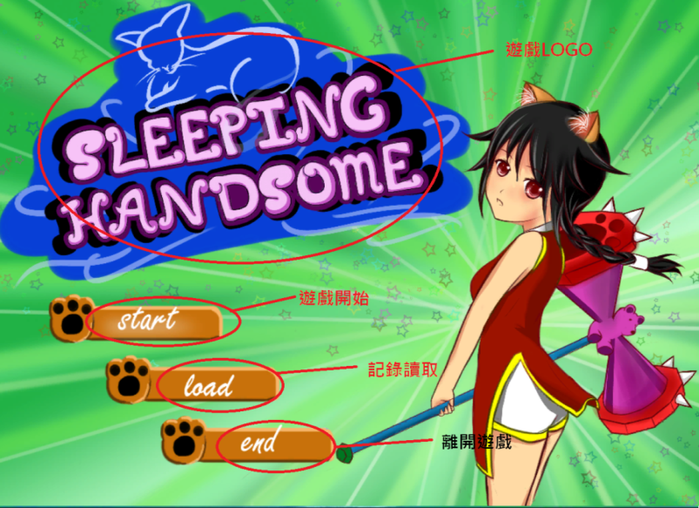
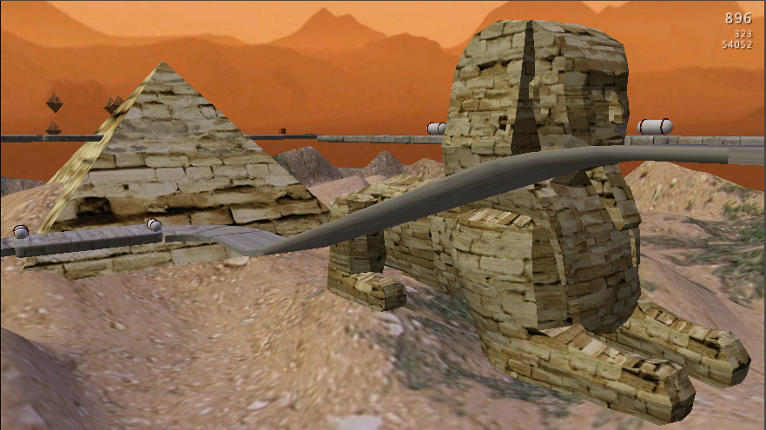
嘉大資工遊戲專題
  Sleeping Handsome (2012)
    資工系自製 - Unity3D
    組長：鄧詠任
    童話冒險故事類型兼動作RPG遊戲
  GO!GO!BALL! (2013)
    資工系自製 - Shiva3D
    組長：蔡岳霖
    平板軌道滾球遊戲
  拍拍走 PaPaWalk (2014)
    資工系自製 - Unity3D
    組長：宋冠杰
    手機戰鬥與抽卡遊戲
  舞限 (2014)
    資工系自製 - Unity3D
    組長：林哲緯
    體感互動跳舞遊戲

Slide 8
大綱
嘉大資工遊戲專題
體感互動設備簡介
娛樂軟體設計理論

Slide 9
體感互動設備簡介
體感互動裝置主要是即時捕捉使用者的動作，與電腦程式進行互動
  控制器的互動 (controller)
  視覺為主的互動 (vision-based)
  觸碰為主的互動 (touch-based)
  其他

Slide 10
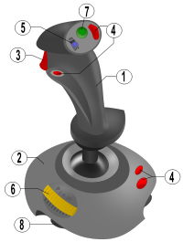
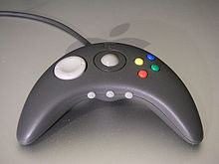
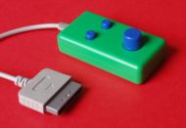
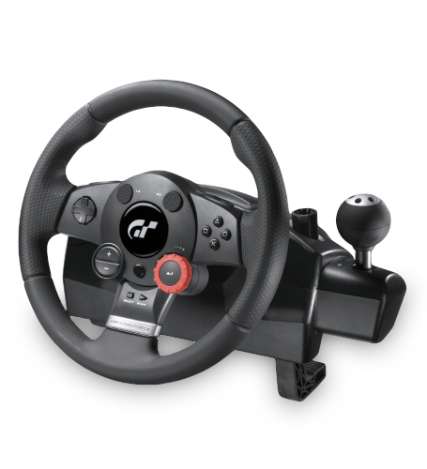
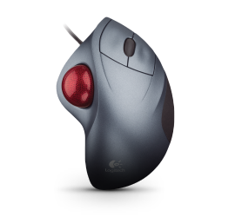
控制器的互動
Keyboard
Mouse
Joystick
Gamepad
Paddle
Trackball
Steering Wheel
Wii Remote
Light Gun

Slide 11
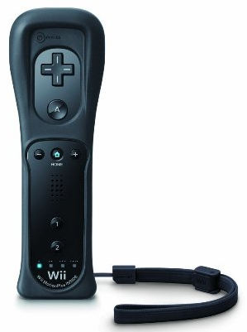
Wii Remote
內容物：
  藍牙：訊號傳輸
  按鍵：類似搖桿的按鍵
  三軸加速規：感測三度空間各方向的加速度力，用來感測動作
  光學感測器：感測主機所發射的LED光源，用來定位
  可使用Wiimote函式庫來撰寫與Wii Remote溝通的程式

Slide 12
視覺為主的互動
以攝影機視覺為主的互動技術，一直是電腦視覺的研究領域中很熱門的研究題目
主要目的：捕捉人體肢幹的移動，瞭解使用者的意圖
成功的業界應用
  動作捕捉器 (Motion Capture System)
  Kinect
  Leap Motion

Slide 13
主要步驟
視覺互動可分為以下四個步驟 †
  初始化(initialization)
  追蹤(tracking)
  姿態估測(pose estimation)
  辨識(recognition)
  † Moeslund and Granum, “A survey of computer vision-based human motion capture,”
  Computer Vision and Image Understanding, Vol. 81, pp. 231-268, 2001.

Slide 14
主要步驟
初始化
  主要工作為環境建置與攝影機校正(camera calibration)，調整現場環境與攝影機的參數
追蹤
  在每張畫格之間，建立人體肢幹的關聯性
姿態估測
  估計人體肢幹的長度比例、方向、位置
辨識
  根據估測的特徵數值來進行動作分類

Slide 15
動作捕捉器 (Motion Capture System)
捕捉人體肢幹的細微動作
常運用於電影工業(例：阿凡達)
優點：即時、準確
缺點：軟硬體設備昂貴、需要特定環境、穿戴式設備有動作的限制
分為光學式與非光學式

Slide 16
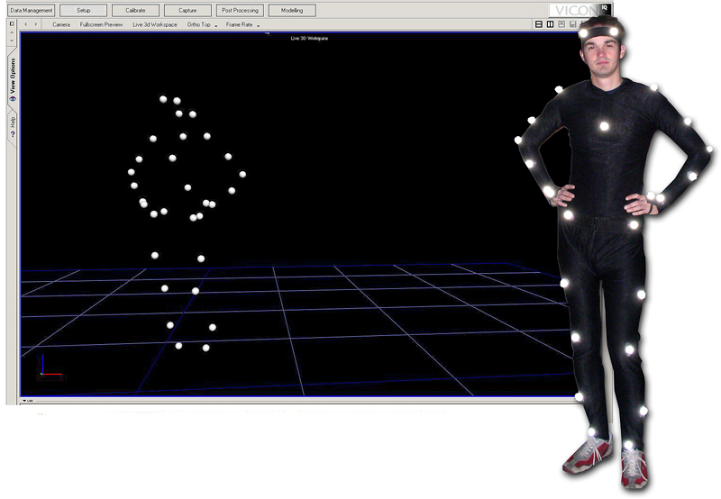
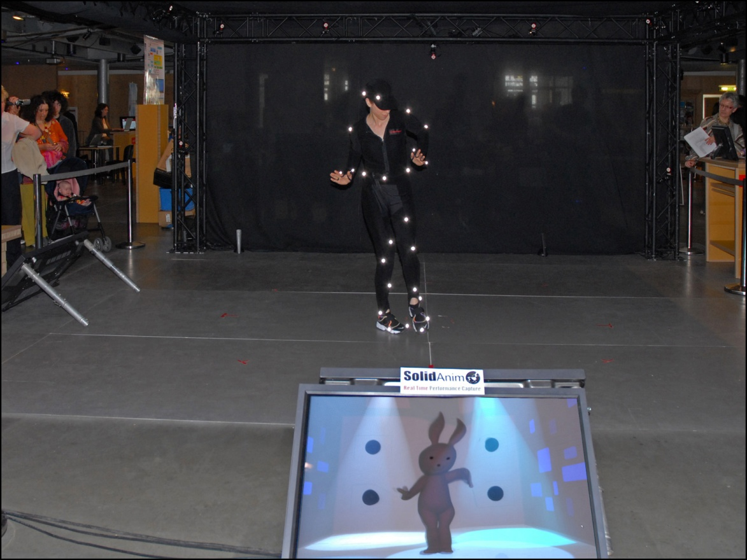
光學式動作捕捉
被動式
  演員穿戴具反光效果的markers，由一台以上的攝影機捕捉演員身上的markers
主動式
  Marker本身會發光，可擴大欲捕捉的現場環境

Slide 17
非光學式動作捕捉
機械式
  演員穿戴機械骨架，動作可直接由骨架的轉動來記錄
磁力式
  演員戴上磁性線圈，捕捉運動時會產生的電力變化
慣性式
  以陀螺儀來記錄肢體的方向和位置

Slide 18
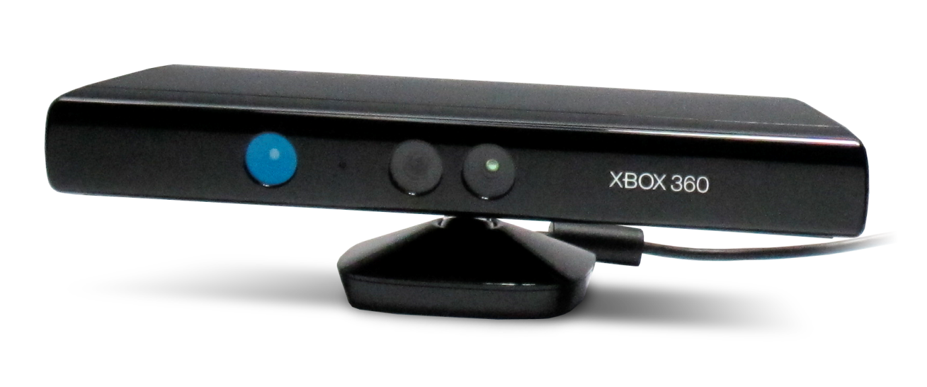
Kinect簡介
①紅外線攝影機
②彩色攝影機
③陣列麥克風
④傾斜驅動馬達
❷
❶
❶
❸
❹

Slide 19
Kinect規格
環境
  攝影機感測距離：0.7m ~ 6m
  攝影機感測角度：水平57°，垂直43°
  驅動馬達旋轉角度：水平垂直各27°
  搭配Xbox遊戲軟體時，適當的感測距離：1.2m ~ 3.5m
硬體
  攝影機解析度：640×480 ~ 1280×1024
  攝影機畫格速率：9Hz ~ 30Hz

Slide 20
Kinect SDK
軟體
  官方提供software development kit (SDK)來開發應用程式
  SDK基本功能有
    控制存取紅外線攝影機、彩色攝影機、陣列麥克風
    追蹤多個人體之骨架
    聲音訊號處理，可與window speech recognition API整合，進行語音辨識

Slide 21
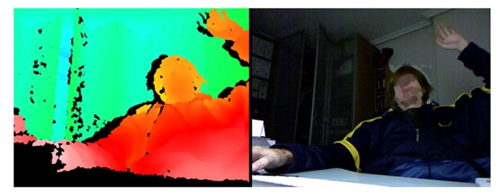
Kinect主要技術
3D空間深度感測
身體動作追蹤
缺點：只計算了關節的位置，並未得出其旋轉角度

Slide 22
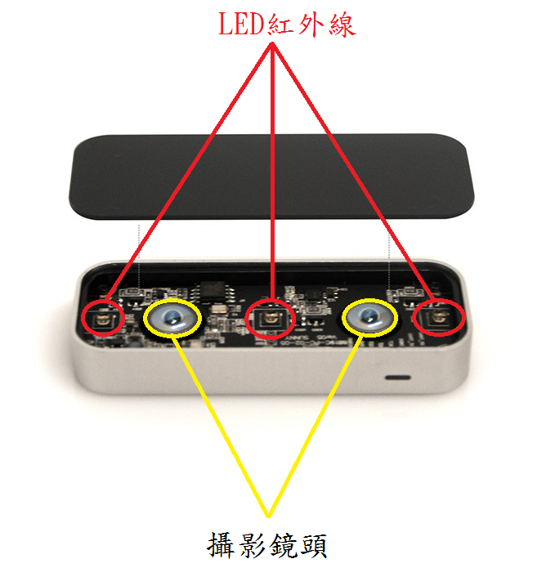
Leap Motion
內有三個LED紅外線與兩個攝影鏡頭
可以定位手掌、手指、或手中的工具
提供App供程式設計師開發應用軟體

Slide 23
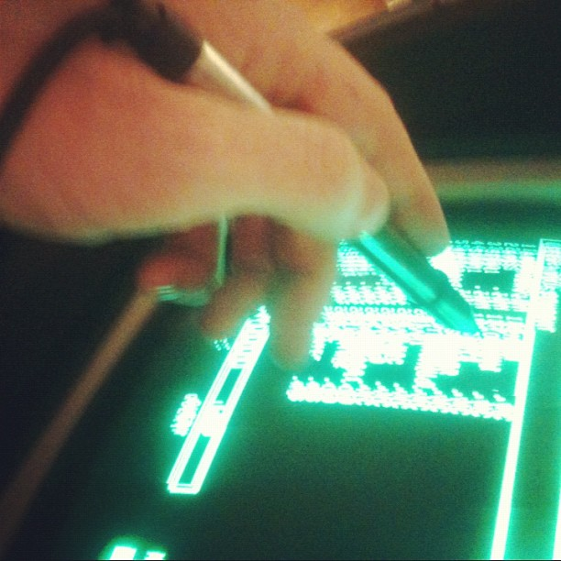
觸碰為主的互動
透過觸控螢幕，以直覺的方式操控螢幕裡的程式或物件，取代鍵盤和滑鼠
早期用在光筆的觸控
現今以手指的觸控已經廣泛應用在消費性電子產品中

Slide 24
其它
聲控
  語音辨識
  業界已成功與消費性電子產品整合，如iPhone Siri, Google Glass
眼控
  眼球追蹤
  早期以昂貴的眼動儀來追蹤，目前也有消費性電子產品引入該技術

Slide 25
其它
腦控
  以Electroencephalography (EEG)讀取頭皮上的電流，代表腦神經活動的狀況
  Mind Flex是很著名的商業玩具產品，以腦控來玩遊戲
生理訊號
  目前可量測的生理訊號有心跳、血壓、呼吸、皮膚導電…
  應用在測謊機，說謊時人體的生理訊號會有不尋常的變化；近來也有應用於遊戲產品中

Slide 26
大綱
嘉大資工遊戲專題
體感互動設備簡介
娛樂軟體設計理論

Slide 27
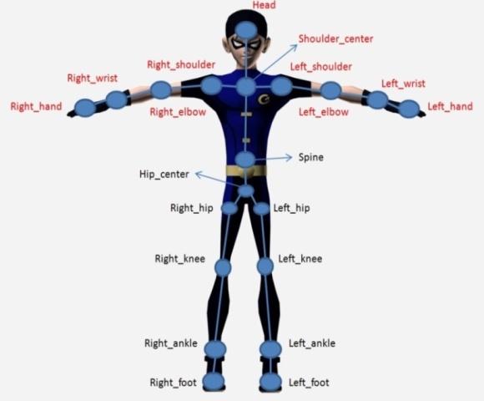
娛樂軟體設計理論
Physics-based Simulation
  PD tracking
Motion Classification
  SVM
Dimensionality Reduction
  PCA
Markerless Motion Capture
  Sums of Gaussians

Slide 28
Physics-based Simulation
Take Physics into account
Inspired from Robotics
Classic method (1995~2013)
  Proportional-derivative (PD)
Improved method (2011~2014)
  Stable Proportional-derivative (SPD)
PD tracking demo
Kinematics simulation demo
Notes:
[Zordan and Hodgins 1999]

Slide 29
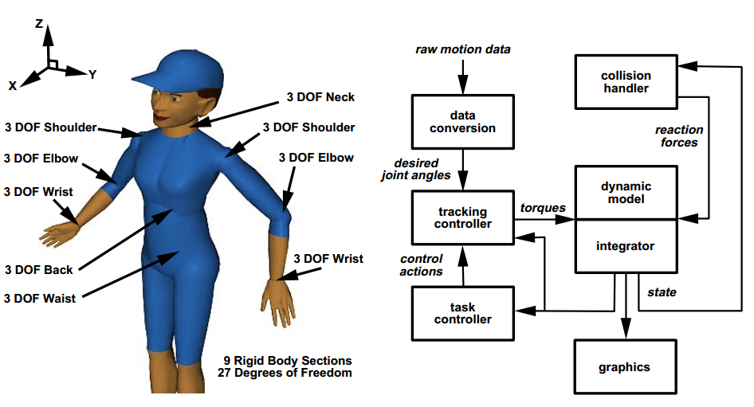
Physics-based Simulation
Zordan and Hodgins 1999
Apply PD in human bodies [Zordan and Hodgins 1999]
Notes:
[Zordan and Hodgins 1999] Tracking and Modifying Upper-body Human Motion Data with with Dynamic Simulation

Slide 30
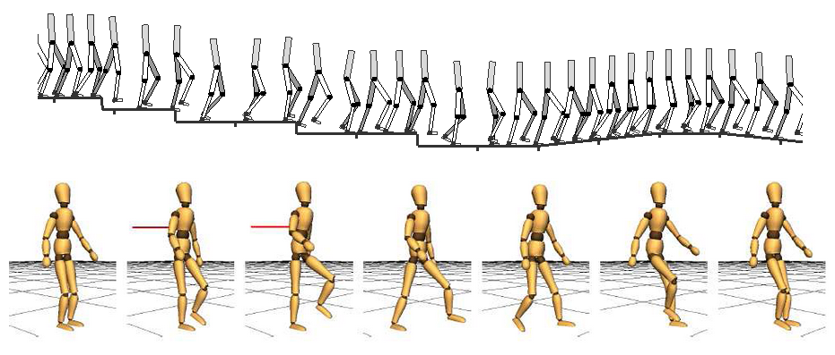
Physics-based Simulation
SIMBICON
Add balance Mechanism on PD control [Yin et al. 2007]
Notes:
SIMBICON: Simple Biped Locomotion Control

Slide 31
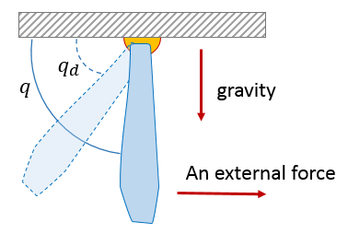
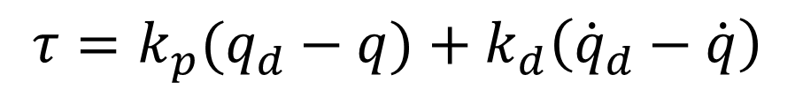
Proportional-derivative (PD)
Drive with torque
Use “difference" as parameters
  Ex: positions, velocities
Equation
$$τ=k_{p}(q_{d}−q)+k_{d}\left({\dot{q}}_{d}−\dot{q}\right)$$
How the PD works

Slide 32
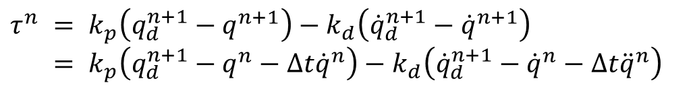
Stable Proportional-derivative (SPD)
Improvement
  Enhance the stability of PD with big time step
  Allow large gain parameters
Use motion states at next time step as parameters
Equation
$τ^{n} = k_{p}\left(q_{d}^{n+1}−q^{n+1}\right)−k_{d}\left({\dot{q}}_{d}^{n+1}−{\dot{q}}^{n+1}\right)$
$= k_{p}\left(q_{d}^{n+1}−q^{n}−∆t{\dot{q}}^{n}\right)−k_{d}\left({\dot{q}}_{d}^{n+1}−{\dot{q}}^{n}−∆t{\ddot{q}}^{n}\right)$
Notes:
[Tan et al. 2011]

Slide 33
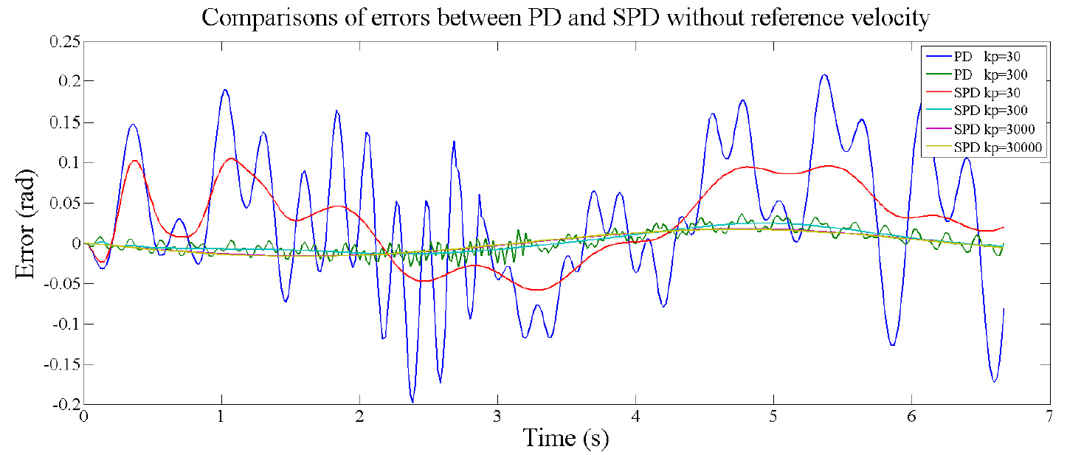
SPD & PD
Comparisons of tracking errors
Stable Proportional-Derivative Controllers [Tan et al. 2011]

Slide 34
Motion Classification
Support Vector Machine (SVM)
  Similar roots with neural network
  Widely used in classification
  Predict which set it should belong to when there is a new data

Slide 35
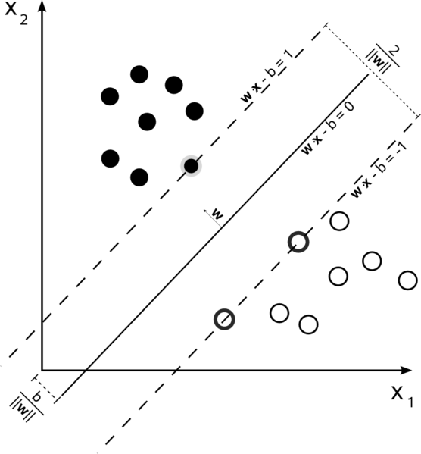
SVM
Maximum-margin hyperplane

Slide 36
SVM
Libsvm
  Train: training a model
    Grid search: calculating c & gamma value
      c: tolerant of error value(c↑, tolerant ↓)
      gamma: distribution of the new feature space which the data is mapped to
  Predict: predict data’s accuracy
  Scale: scale feature size (0~1 or -1~1)
  Toy: 2D simulation result

Slide 37
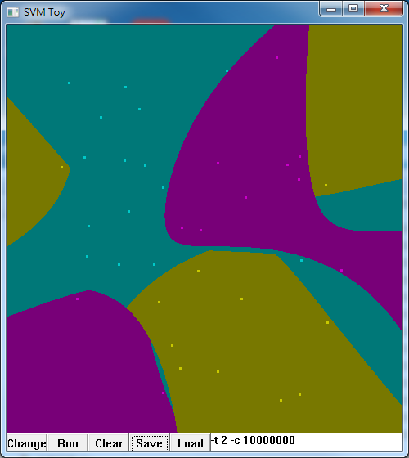
SVM

Slide 38



Dimensionality Reduction
Principal Component Analysis (PCA)
PCA is a useful statistical technique
  Face recognition, image compression…
  Finding patterns in data of high dimension
Choose the component that can contain how much information about the original data
Kinect game demo

Slide 39
Steps of PCA
1.Get some data
2.Subtract with mean
3.Calculate covariance matrix
4.Calculate eigenvectors and eigenvalues with covariance matrix
5.Choosing components and forming a feature vector
6.Deriving the new data set

Slide 40
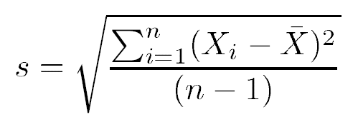
Standard Deviation
The Standard Deviation of a data set is a measure of how spread out data is
For example :
If X=[0 8 12 20] and Y=[8 9 11 12]
the mean of X is 10 and Y is also too
According to the formula, we can know the data set X are spread more than Y

Slide 41
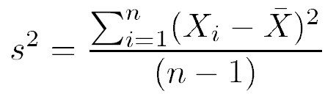
Variance
Another measure of the spread of data in a data set
Simply, the variance is the standard deviation squared

Slide 42
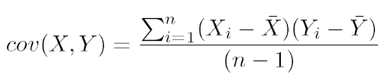
Covariance
It is consider between two variable
If there is a dataset (X, Y, Z) three dimensions
You need to consider cov(X,Y), cov(Y,X) and cov(X,Z)
Also, we can easily know that cov(X,Y) is equal to cov(Y,X)

Slide 43
Covariance Matrix & Eigenvector
It is composed by covariance
  Choose from the dimensionality, it must be square
And we first know that eigenvector can be only found for square matrices

Slide 44
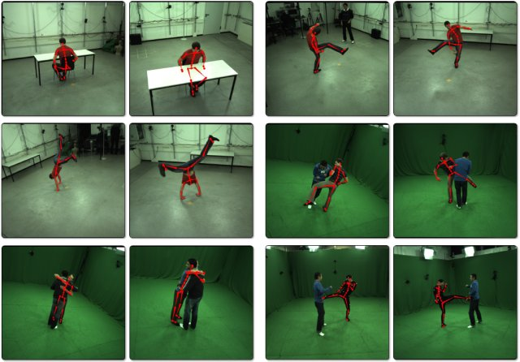
Markerless Motion Capture
Stoll C., Hasler N., Gall J., Seidel H.-P., and Theobalt C., Fast Articulated Motion Tracking using a Sums of Gaussians Body Model, International Conference on Computer Vision (ICCV'11), 951-958, 2011. demo

Slide 45
Markerless Motion Capture
Markerless
Multi-view video sequences
Sums of Gaussians (SoG)
To replace the complex and expensive motion capture studios
Applications
  Sport science
  Animation for games and movies
  …

Slide 46
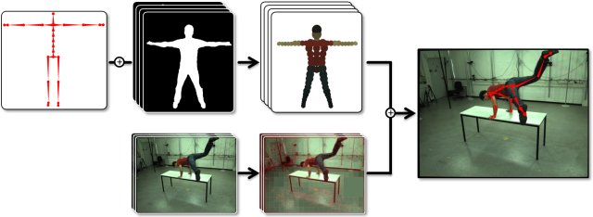
Markerless Motion Capture
Pose estimation is performed by efficiently matching the 3D SoG model of the actor to the 2D SoG models of the images

Slide 47
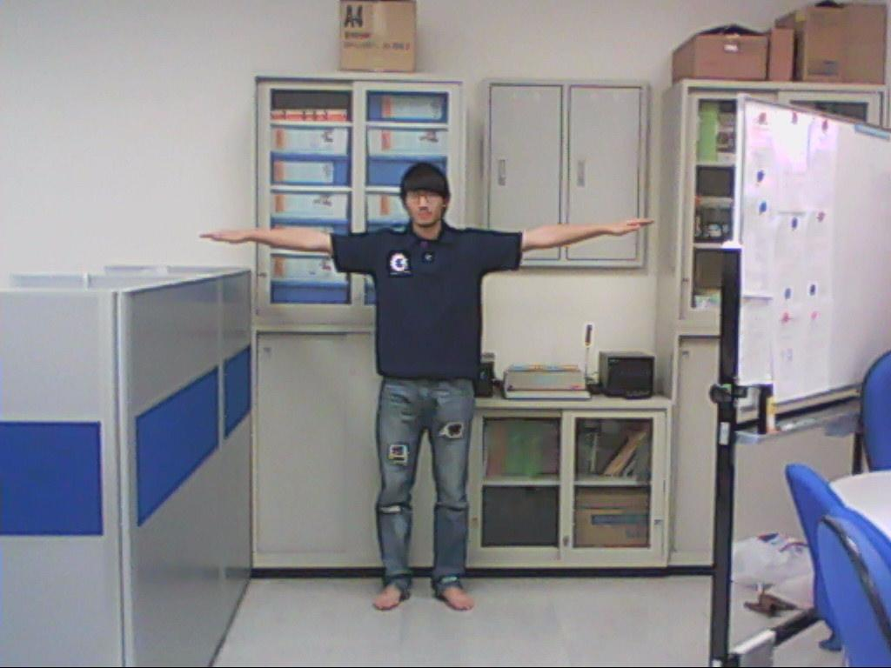
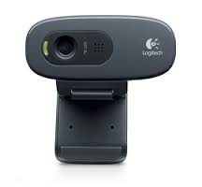
Markerless Motion Capture
Image frame captured from Webcams

Slide 48
SoG-based Similarity
A single Gaussian β
A Sum of Gaussians Κ
Both body model and images are represented as collection of Gaussians with associated colors

Slide 49
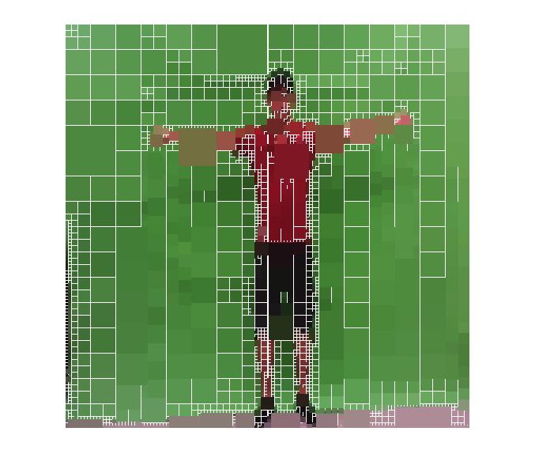
SoG-based Similarity
Quad-tree structure
  Cluster image pixels with similar color into larger regions
: is half the side-length of the node
: is the center of the cluster
cluster

Slide 50
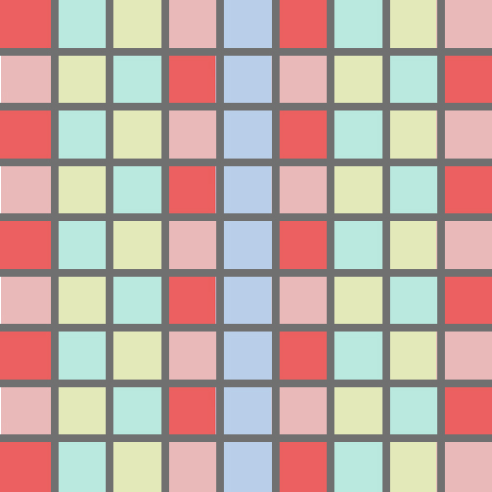
SoG-based Similarity

Slide 51
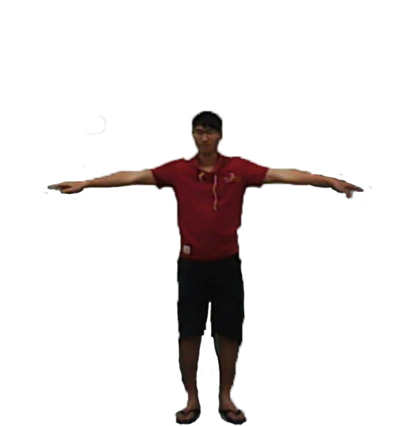
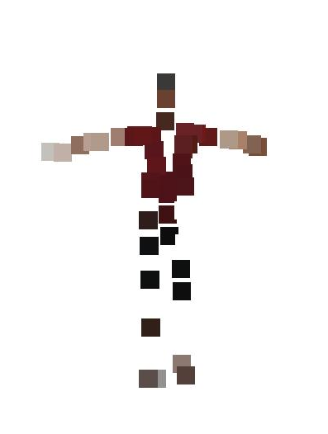
Approximating Images using SoG
Input image
actor-specific model (image model)

Slide 52
Image Model
color model C = {ci} for each SoG K,
Color Information
SoG Information

Slide 53
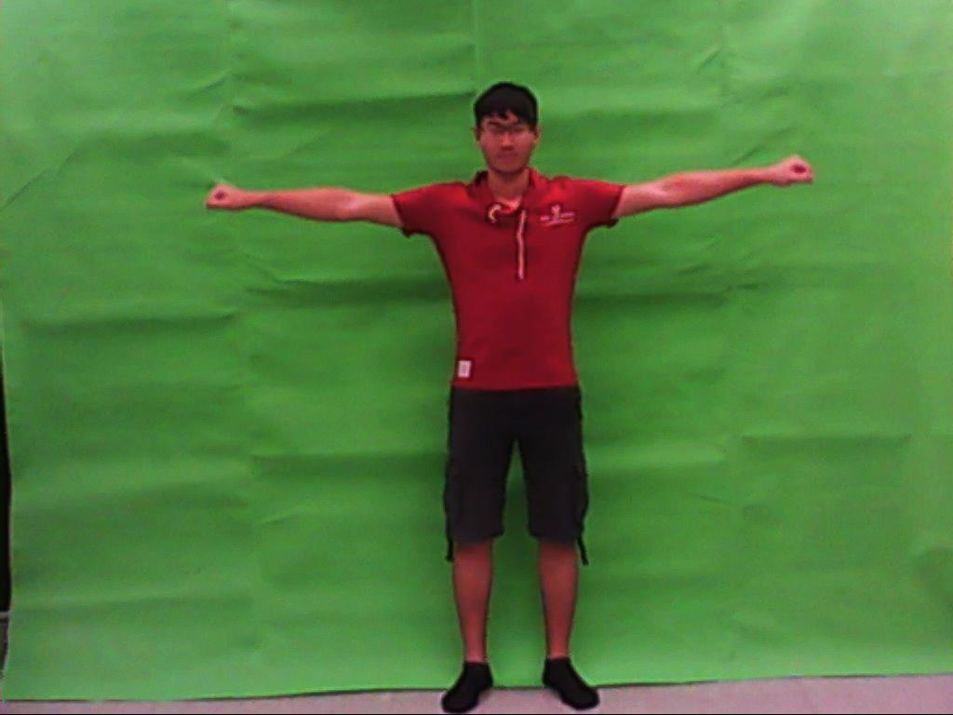
Approximating Images using SoG
quad-tree structure
SoG : Each square is represented by a single Gaussian
Input image
quad-tree structure

Slide 54
Detection Performers
Using the image model and SoG to detection performers
Quad-tree threshold = 0.15
  quad-tree depth of typically 8
SoG threshold = 0.01
  Input image and Image model
Color threshold = 60
  Sum of RGB

Slide 55
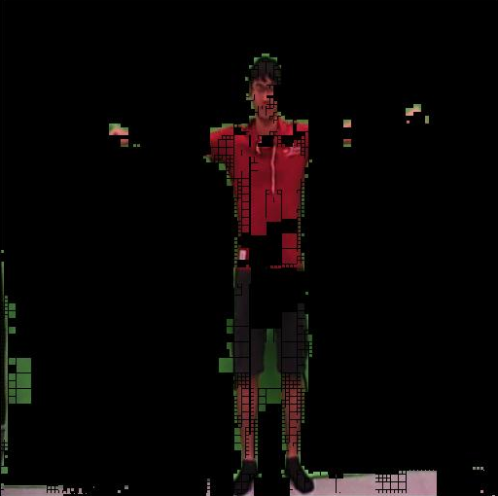
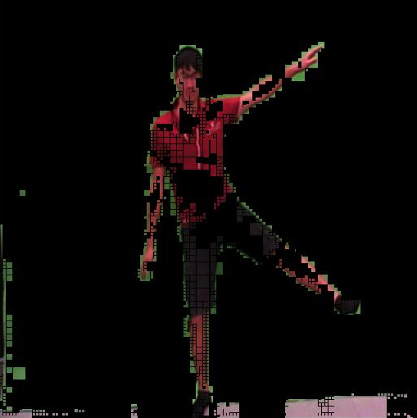
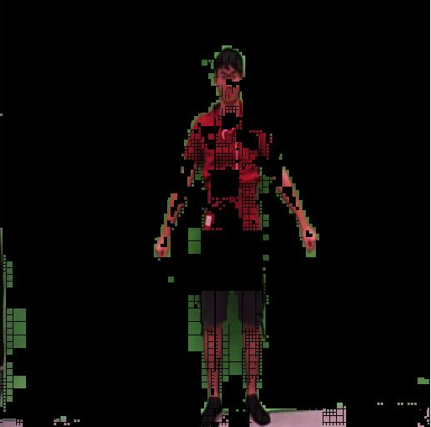
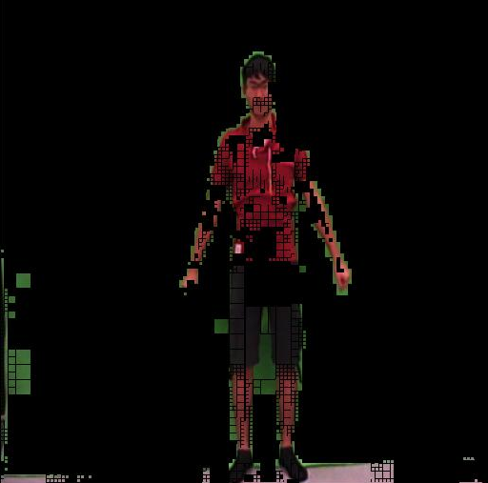
Demo

Slide 56
Body Model with SoG
An actor-specific body model
  A kinematic skeleton
  Represent the shape and color statistics

Slide 57
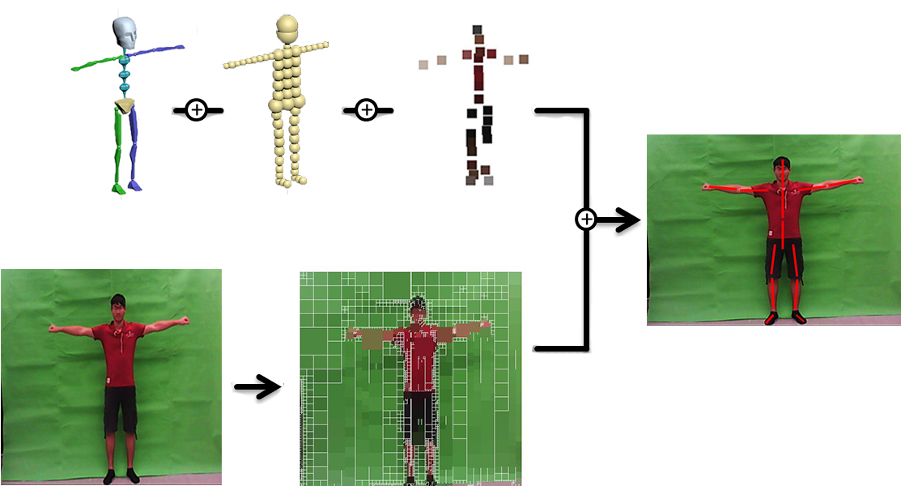
Expected Results

Slide 58
Thanks for your attention
Q & A

