Slide 1

Thermal-aware 3D Network-on-Chip Designs
Dr. Kun-Chih (Jimmy) Chen (陳坤志)
Postdoctoral Fellow,
Intel-NTU Connected Context Computing Center (INC),
National Taiwan University (NTU)
URL: https://www.researchgate.net/profile/Kun-Chih_Chen

Slide 2
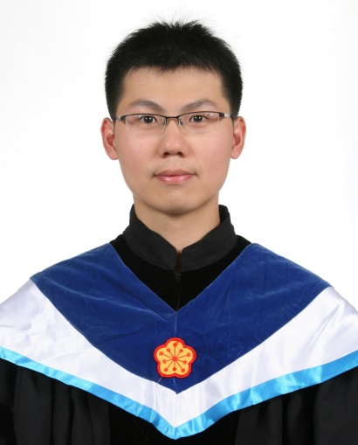

Education
  Ph.D. in Electronics Engineering,
  National Taiwan University (NTU), 2009 − 2013
  M.S. in Department of Computer Science and Engineering,
  National Sun Yat-sen University (NSYSU), 2007 − 2009
  B.S. in Department of Computer Science and Engineering,
  National Taiwan Ocean University (NTOU), 2003 − 2007
Experiences (2009 - 2014)
  Postdoctoral Fellow, Intel-NTU Center, 2014 − present
  Research Assistant, NTU GIEE, 2009 − 2013
  Part-time Assistant, NTU SoC Center, 2010 − 2013
Specialty
  Network-on-Chip multicore system design
  Thermodynamics for multicore systems
  Fault-tolerant system design
  Arithmetic unit design
  Software define network (SDN)

Slide 3

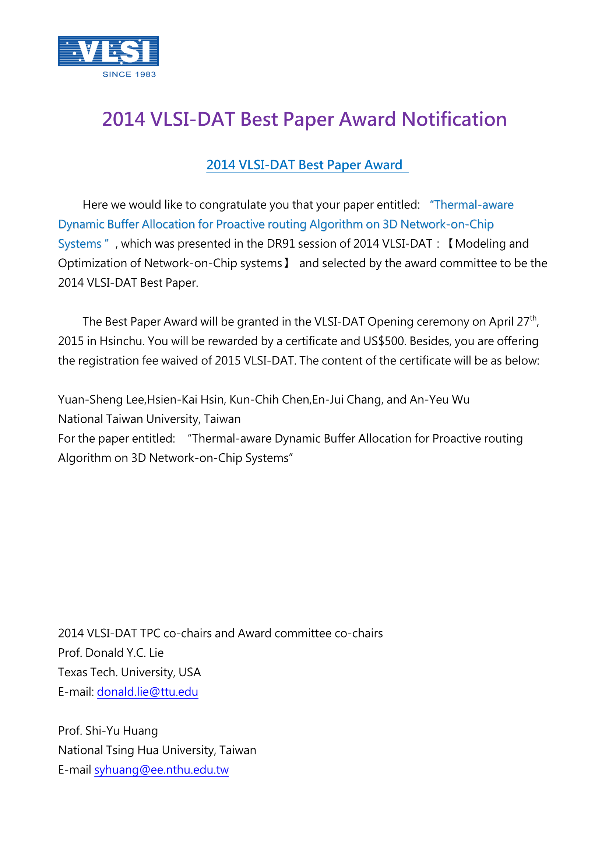
Academic Honors/ Services
B.S. Degree in NTOU CSE
  National Taiwan Ocean University Scholarship for Students under Poverty Line, 2004 − 2005
M.S. Degree in NSYSU CSE
  The only one from NSYSU CSE got the qualify of Campus Resident Representatice of Foxconn
Ph.D. Degree in NTU GIEE
  Best Paper Nomination of VLSI-DAT 2014
  Invited book chapter
  Invited Talks (NTPU-CSIE, NTU-GIEE)
  Assistant of IEEE SiPS 2013
  Reviewers of journal and conference papers
  Nomination of IC Design Contest, Taiwan, 2010
  National Taiwan University EE Scholarship
  Funding at international academic conferences by
  graduate students, National Science Council x 2

Slide 4
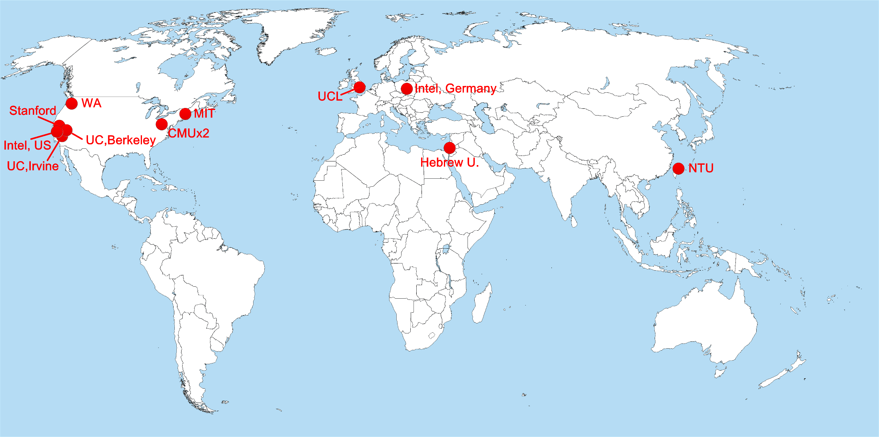
WHAT IS:
Intel-NTU Connected Context Computing Center
Only one academic research center in Asia
One of the Intel Labs University Research Program
Notes:
Big Data
Embedded computing
Security computing
IoT
Cloud computing
…

Slide 5
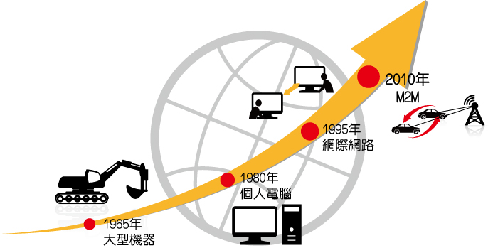
MISSIONS:
Intel-NTU Connected Context Computing Center
To provide end-to-end solutions for intelligent interaction and secure information sharing amongst a multitude of connected devices.
Center Structure
  SIG-ARC (Autonomous Reconfigurable Connectivity)
  SIG-CAM (Context Analysis and Management)
  SIG-SSA (Smart Service and Application)
  SIG-GSP (Green Sensing Platform)
Notes:
SIG = Special Interest Group 研究群
ARC (自主可調式連結)：著重在機器間的自主連結，例如高速移動的車子間要怎麼達到有效率且自主的連結
CAM (情境分析與管理)： 大量資料上傳到雲端後，透過情境分析的能力來預測並採取相對應的行動，例如室溫上升人體開始冒汗，電風扇及空調會開始調整風向及風力
SSA (智慧感測應用)：透過感測技術的開發來尋找可能的應用，例如車與車之間如果能互相感知並且溝通，便能大幅降低車禍發生率
GSP (綠能感測平臺)：著重於高效能低功率的感測平臺開發

Slide 6



Outline
Part I: Thermal-aware 3D Network-on-Chip Designs
Part II: 研究生應有的觀念態度

Slide 7
Outline
Part I: Thermal-aware 3D Network-on-Chip Designs
Part II: 「研究生應有的觀念態度」談「念完研究所的機會與挑戰」

Slide 8
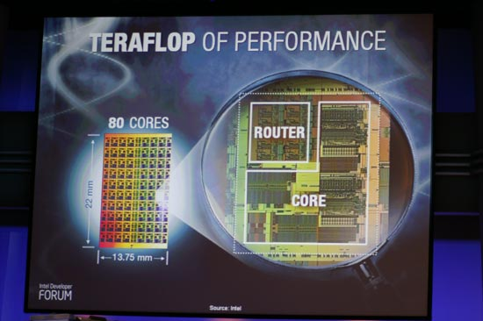
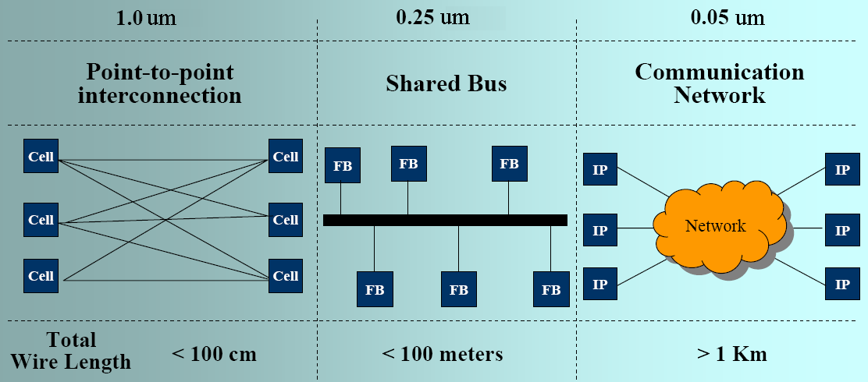
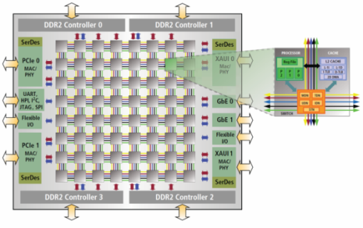
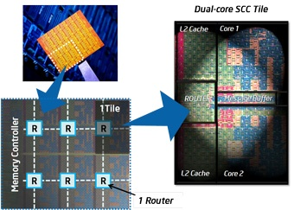
Background - Network-on-Chip
Network-on-Chip (NoC) has been viewed as a novel and practical approach to connect SoC IPs in current and future design.
Intel 80-core (2007 ISSCC)
Tilera Tile64
Intel Single-Chip Cloud Computer (SCCC)
[2]
In existing high-performance prototyping & commercial chips, mesh-based topology is mostly adopted for its scalability.
Notes:
隨著製程的演進，早期的點對點連線會造成繞線複雜度越來越高，而後來的bus架構也因為延展性不夠而容易造成效能下降。大約在10年前，有人提出要使用網路的概念來連結晶片內的各個component，我們稱作network-on-chip。在各種network on chip的toplogy中，又以mesh-based topology最受歡迎，因為它具有良好的scalibility以及flexibility。而目前也已經有一些commercial product以及prototyping出來了，例如…

Slide 9
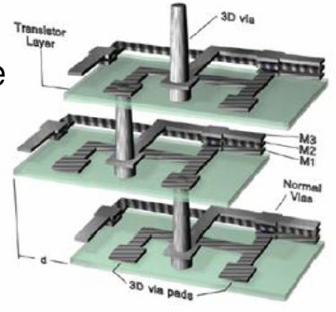
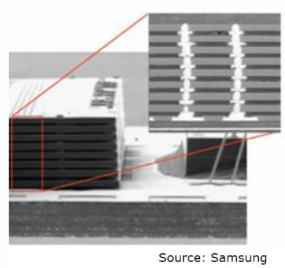
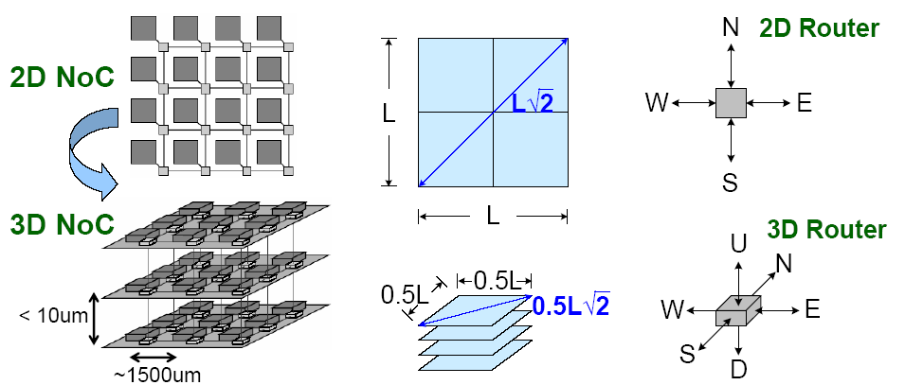
3D NoC Opportunity
TSV-based die-stacking technology + NoC → 3D NoC
3D NoC Advantages
  Improve data locality
  Improve performance
  Reduce power
  Reduce form factor

Slide 10
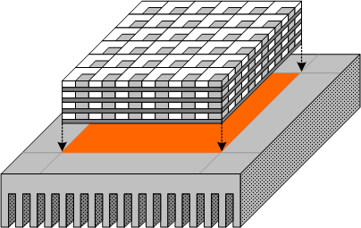
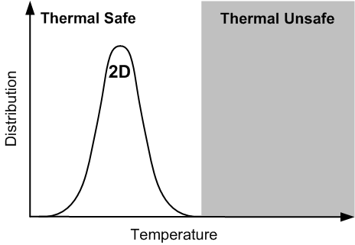
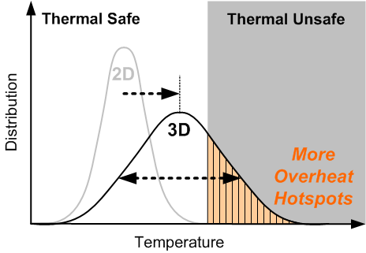
Thermal Challenge for 3D NoC Systems
3
Thermal problems is worse in 3D chips
Longer dissipation path
Larger power density
Different thermal conductance in different layer
1
2
Negative influences
Leakage power
Reliability
Package cost
Performance
Temperature distribution is pushed higher and wider
  → More tiles will be thermally unsafe!

Slide 11
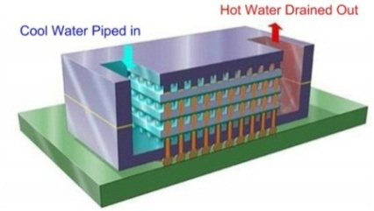
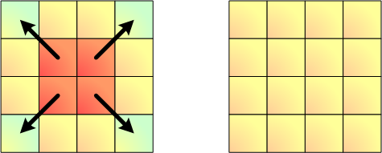
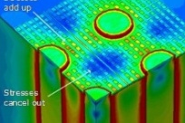
Prevention of Thermal Runaway for
Performance Improvement
Must have solutions to ensure: T_{MAX} ≤ T_{LIMIT}
  Cut the positive feedback cycle
  ➔ High Performance, but Not Higher Temp.
Solutions to improve margin:
Higher temperature
Increase leakage current
More
thermal energy
Control Energy-In Profile
Relax Energy-Out Bound
Dynamic Thermal Management
Micro-Fluidic Channel (MFC)
Thermal TSV (TTSV)
Benefit
Benefit
Design of Thermal-aware 3D NoC Systems

Slide 12
A. Thermal-Aware Routing
Thermal-Aware 3D NoC Design
A.
Reactive Thermal Management
B.
Thermal-aware Routing
C.
Proactive Thermal Management
Thermal-Aware 3D NoC Designs
2010 IEEE/ACM NOCS
2012 ACM Trans. Embedded Computer Systems (TECS)

Slide 13
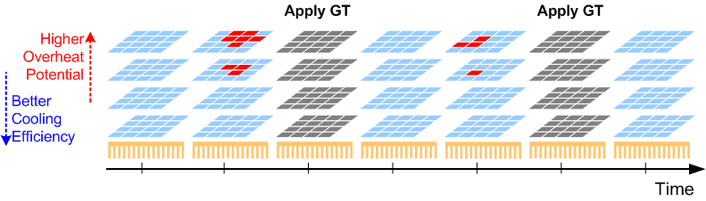
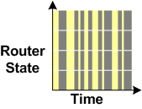
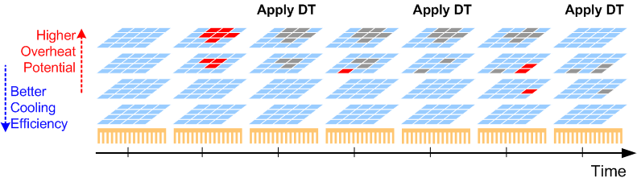
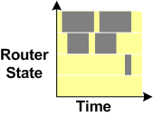
Traditional RTM Schemes: Revisit
Global Throttling (GT)
Large off number
Distributed Throttling (DT)
Long off time
Performance impact = Avg. off router number × Avg. off time
  Fewer off router and shorter off time → Less performance impact
Both GT and DT suffers from huge performance impact!!

Slide 14
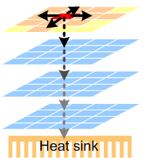
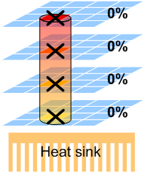
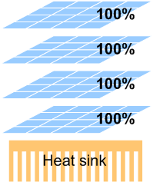
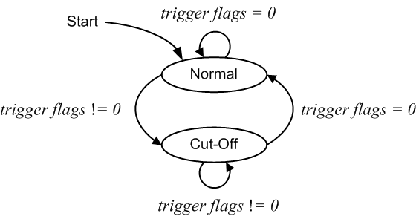
I. Vertical Throttling (VT) RTM
Idea:
  Actively create a heat dissipation channel for fast cooling.
Approach:
  Collaborative control of vertical aligned routers
  State change triggered for entire group
    One triggered → cut-off (VT)
    All nodes are cooled → normal
Normal
Cut-off

Slide 15
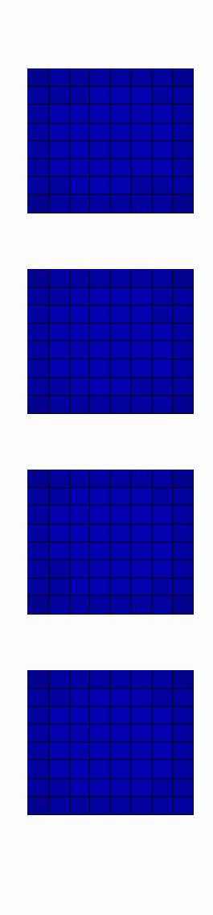

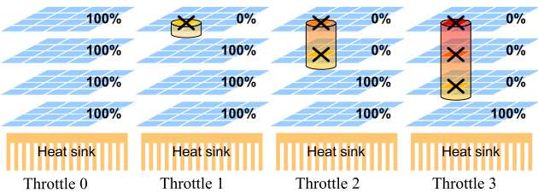

II. Thermal-Aware Vertical Throttling
Idea: The control granularity of VT can be refined for further reducing the performance impact.
Thermal-Aware Vertical Throttling (TAVT) is proposed to adaptively increase the size of heat-generation-null region for faster cooling.
w/o TAVT
w/ TAVT
溫度(°C)
動態溫度感知垂直節流技術
(Thermal Aware Vertical Throttling, TAVT)
Notes:
Usually the quota has to be very small for effectiveness of cooling

Slide 16
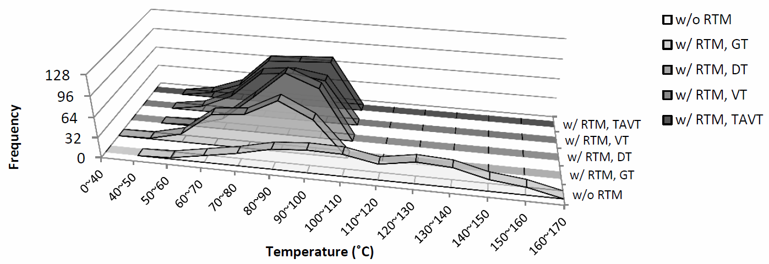
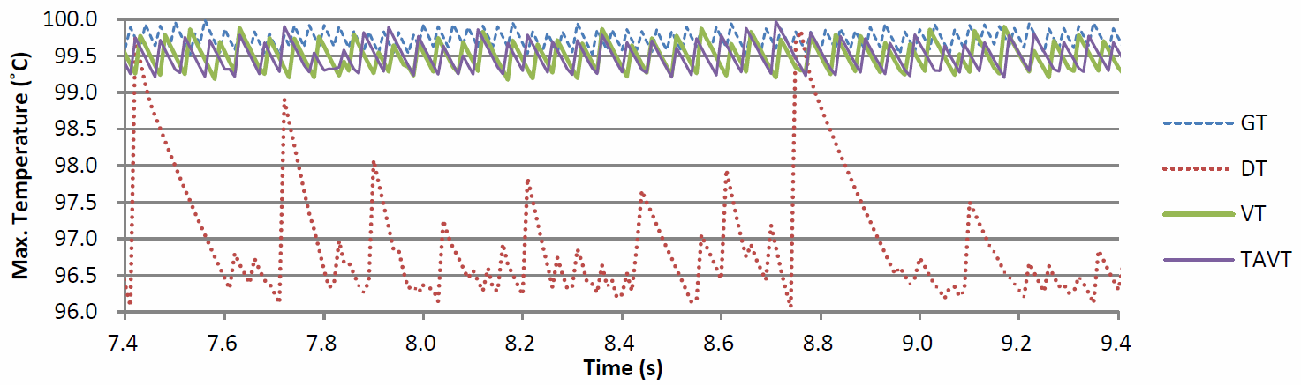
Temperature Distribution and
Margin for Emergency Cooling
With RTM, all GT/DT/VT/TAVT schemes can control the temperature T_{L}<100 ˚C
DT requires large temperature margin
  Less packet delivered.
The proposed VT/TAVT-RTM can use small margin as GT-RTM because VT/TAVT also cools hotspot fast.
  More packets delivered
Hard Thermal Limit
T_{L}=100 ˚C ; T_{T,DT} = 96.1˚C, T_{T,GT} = 99.7˚C, T_{T,VT} = T_{T,TAVT} = 99.3˚C

Slide 17
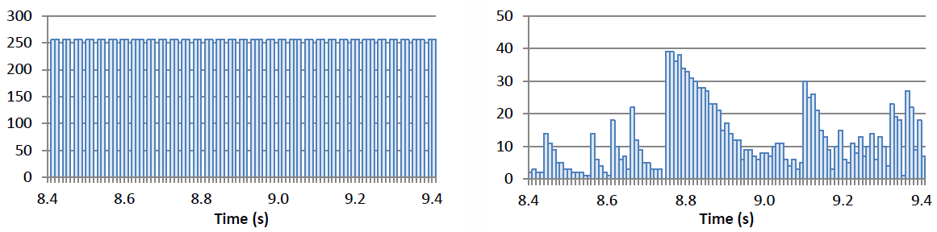
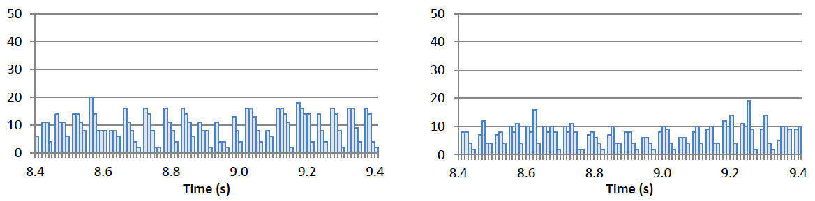
Number of Throttled Router
GT
DT
VT
TAVT

Slide 18
Performance Impact
 | GT | DT | VT | TAVT
Avg. Throttle Time of Throttled Router (ms) | 22.0 | 289.7 | 38.7 | 46.7
Stdv. of Throttle Time of Throttled Router (ms) | 7.1 | 102.6 | 11.4 | 15.9
Avg. Number of Throttled Router | 174.9 | 12.2 | 7.9 | 5.7
Network Availability (%) | 31.7% | 95.2% | 96.9% | 97.8%
Performance Impact (Avg. Throttle Time * Avg. Throttle Number) | 3847.6 | 3525.2 | 305.4 | 266.8
GT-RTM and DT-RTM suffer from huge performance impact
VT-RTM combines the advantages of GT and DT
  Only around 8% impact of DT-RTM.
TAVT-RTM further reduces performance impact
  Performance impact reduced by 13% over VT-RTM.

Slide 19
B. Reactive Throttling-based DTM
Thermal-Aware 3D NoC Design
A.
Reactive Thermal Management
B.
Thermal-aware Routing
C.
Proactive Thermal Management
Thermal-Aware 3D NoC Designs
2011 IEEE SOCC
2012 ACM TECS
2012 IEEE SiPS
2012 IEEE VLSI-DAT
2013 IEEE TPDS
2014 IEEE VLSI-DAT (Best Paper Award)

Slide 20
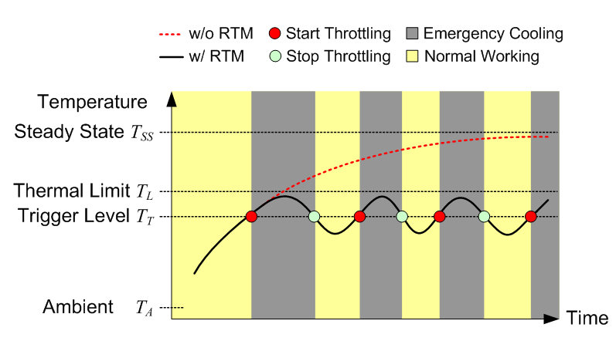
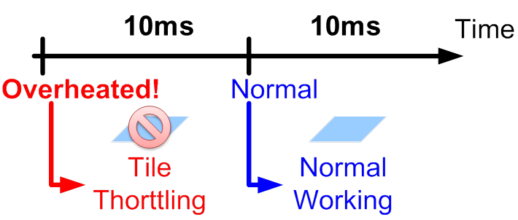
On-line Temperature Control
Concept proposed by
Shang et al. [7] for 2D NoC
systems, as run-time
thermal management (RTM)
Composed of:
  Temperature sensor
  Thermal-aware controller
Control mechanism in NoC
  Throttle near-overheated routers
    Block inputs of the near-overheated router
    Switching activity ↓ , heat generation ↓
Near-
Notes:
To solve the thermal problem of NoC router, Shang et al. proposed a RTM scheme for 2D NoC systems, and we improve it for 3D NoC systems.
The design rule of RTM is to keep transient temperature lower than thermal limit, TL.
RTM is composed of <> and <> to control the temperature for each router.
As we see, when the temperature is higher than trigger level, the router will be throttled.
The inputs of the ~ are blocked, and then the SA is reduced, leading to less heat generation.

Slide 21
Traditional RTM Schemes and Problems
Global Throttling (GT)
Large off number
Distributed Throttling (DT)
Long off time

Slide 22
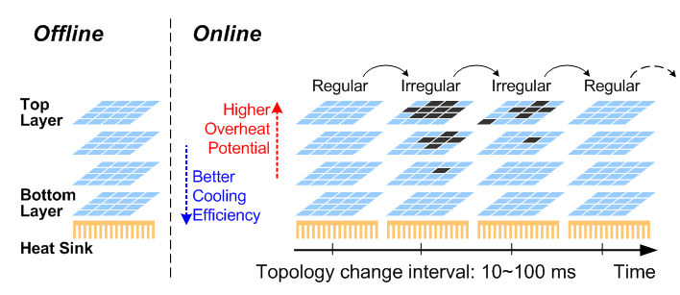
Problem Formulation
Routing and sustainability problem of packet delivery in Non-Stationary Irregular mesh (NSI-mesh)!
  Traditional algorithms are infeasible in the thermal-aware NSI-mesh:
    Topology transforms very frequently because of throttling
    Inactive number of routers (large range availability change) ranges very large.
~10ms, i.e. ~10⁷cycle for 1GHz network
Notes:
RTM的機制所造成的throttled node無法提供正常運作，相當於topology的改變，再加上這個改變是隨著時間而不同，因此定義了我們的問題:Non-stationary irregular mesh (NSI-mesh)
由於傳統上的routing algorithm無法有效應用在NSI-mesh，因此我們針對了NSI-mesh發展了一套有效的routing algorithm

Slide 23
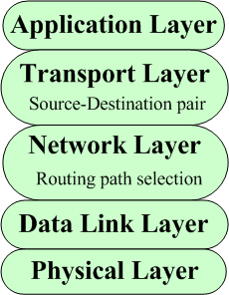

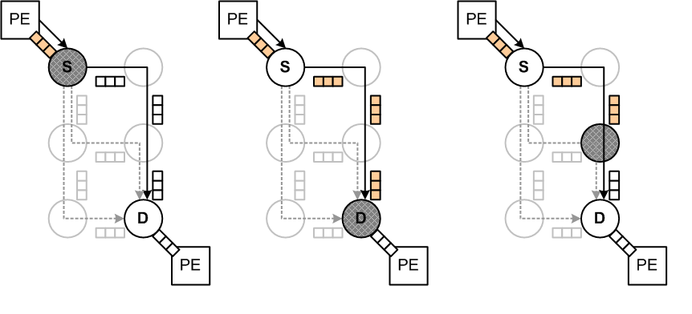




I. Transport Layer Assisted Routing (TLAR) Scheme
P2
P3
P1
(b)
(c)
TMC
(a)
(a) Source router is not serving
(b) Destination router is not serving
Can be handled in Transport layer
Joint Transport Layer and Network Layer
    (c) Any router on selected path is not service
    (d) Head-of-Line blocking
TMC: Traffic Message Channel
Notes:
Transport layer can solve:
P1. Source router is not serving
P2. Destination router is not serving
Only transport or network layer can’t solve :
P3. Any router on selected path is not service
說明重點是說在network layer很難解決P3 因為網路上的資訊不足 (i.e., 在傳統的方法中當封包送出前只會知道Source和Destination是否正常而已)

Slide 24
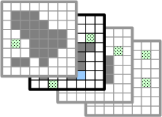
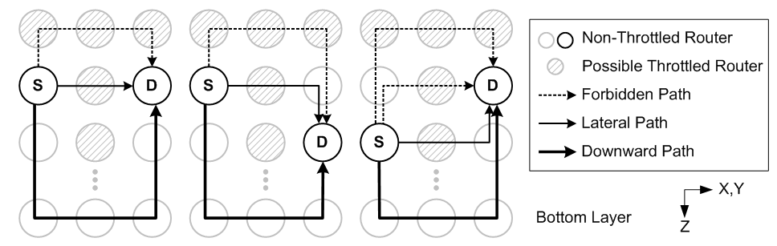

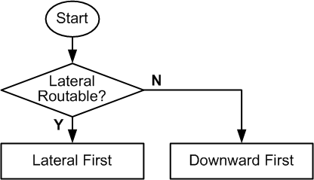

Proposed Transport Layer Assisted Routing (TLAR) Scheme
Assume TAVT-RTM is adopted, we can transform the data delivery problem to a layer selection problem: lateral-first, followed by downward-first
For successful data delivery, following rules are applied to transport layer
  Payloads with non-deliverable source-destination pairs are not packetized nor injected to the network layer.
  Payloads with deliverable destination node are packetized and injected if the routing path is guaranteed deliverable.
    Bottom layer is guaranteed routable, but too many traffic will result in congestion.
    If source layer is guaranteed routable, the packet is routed in lateral direction first.
Notes:
1. Downward-Lateral Deterministic Routing (DLDR) in TLAR Framework
上半部與左圖:
受限於turn model的限制(避免deadlock), packet不會先往上走在水平走,
因此 routing最先必須要處理的問題是: 先水平走source layer那層 或是 先向下走到最底層
下半部與右圖:
第一點: payload的source或destination是throttled,一定會卡住, 所以這樣的payload將會等到兩者皆恢復non-throttled狀態才傳送
第二點: 當source destination都可以傳時, 如果source layer檢查後發現是guaranteed routable, 那優先傳水平方向 (lateral-first)
若source layer的路徑不是guaranteed routable, 那只能以bottom layer傳送, 優先向下傳(downward-first)

Slide 25
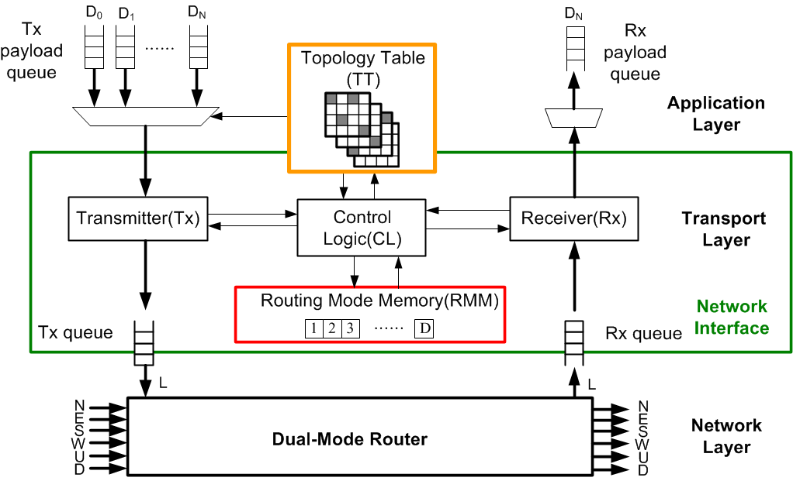
Architecture Design for TLAR Scheme
Topology Table (TT)
  Store throttling information for solving (a) and (b)
Routing Mode Memory (RMM)
  Store routing mode for reducing computation latency for (c)
Notes:
The TLAR network interface has additional topology table and routing mode memory than traditional network interface.
Topology Table: This table stores 1-bit throttling information of each destination, and updates on each topology change. Application layer and transport layer share this information. TT is required for all NSI-mesh networks to solve the problem of
Source router is not serving and (ii) Destination router is not serving. Direct implementation of TTrequires XYZ bits for an X-by-Y-by-Z 3D NoC.
Routing Mode Memory (RMM): RMM is required to reduce the timing overhead of checking routing mode for each packet. The mode for each destination is checked once as topology changing and stored in RMM.
Before injecting a packet to network layer, the correspond routing mode is queried from RMM. Direct implementation of RMM requires XYZ bits for an X-by-Y-by-Z 3D NoC.
We have proposed memory reduction techniques to reduce area overhead. TT: XYlog2(Z) RMM:XY (銀子駒碩論page47~page49)

Slide 26
Total (NI+ Router) Area Overhead
Design Parameters
Technology | TSMC 130nm
Clock period/frequency | 2.8 ns/360 MHz
Topology | 8x8x4 3D Mesh
Number of ports per router | 7
Queue Depth Setting | 80-core [9] (16 flits)
Flit size | 32 bits+2 bits(control bits)
Implementation | a network interface and a router
 | Baseline (for Regular Mesh) | Proposed (for NSI-Mesh)
NI: Tx/Rx | 52,007 | 52,007
NI: TT | N/A | 15,487
NI: RMM | N/A | 7,019
NI: CL | 1,937 | 6,151
Router | 191,059 | 191,577
Total (Router+NI) | 245,003 | 272,241(+11.1%)
(μm²)
Notes:
Traditional architecture is smallest. However, it cannot work in NSI-mesh. Severe fail delivery occurs.
The overhead of direct implementation is 26%. With the proposed table reduction technique and the proposed memory reduction technique, the overhead is reduced to 11%.

Slide 27
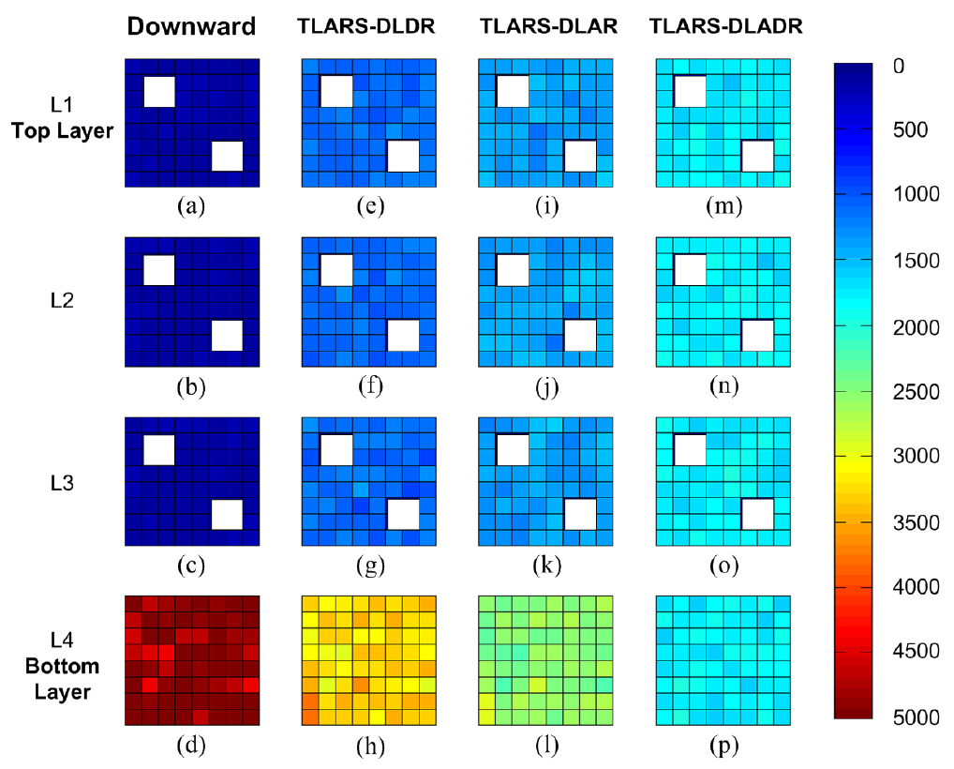
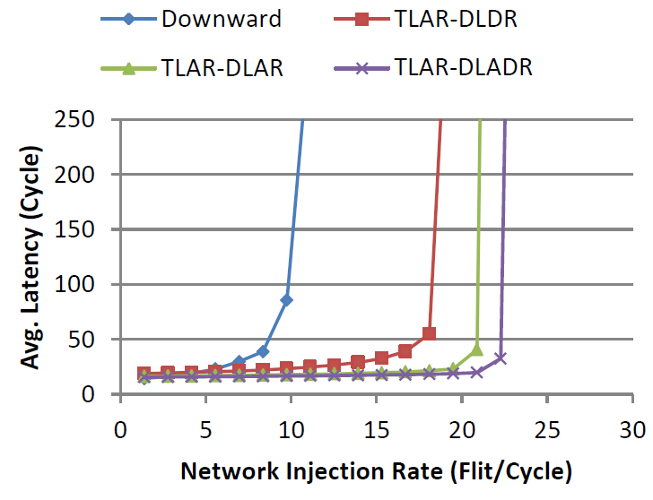
Statistical Traffic Load Distribution (STLD) and Latency vs. Network Injection Rate
 | Down-ward | TLAR-DLDR | TLAR-DLAR | TLAR-DLADR
Mean | 1476.0 | 1707.6 | 1679.5 | 1764.4
Stdv. | 2160.5 | 980.4 | 514.3 | 96.6
STLD and statistics of STLD show significant load balance by adopting TLARs.
With TLAR, the average latency in DLDR, DLAR, and DLADR are respectively reduced by 48.3%, 65.6%, and 69.4% with less than 11% area overhead.
Notes:
我們所提出來的TLAR可以使網路交通變得更加平均，並且可以大幅提升系統效能。此外，所額外增加的儲存空間只有小於11%而已(詳細架構在附錄中)。
Downward-lateral (Adaptive) Deterministic Routing. (DLDR)

Slide 28
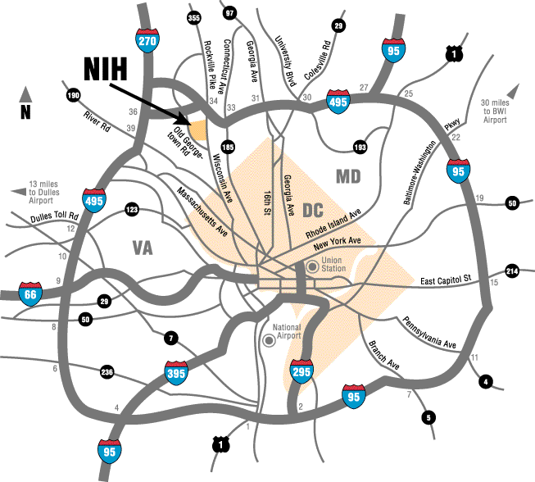
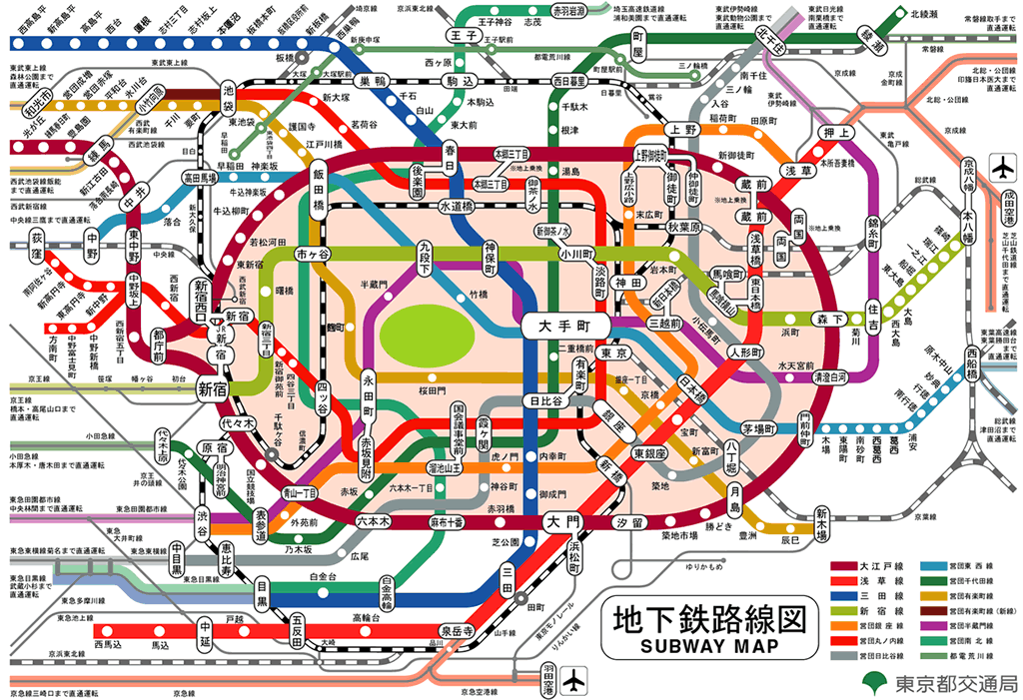
II. Proposed Topology-Aware Adaptive Beltway Routing Scheme
Dst
Src
Capital Beltway Washington, DC
Circular Line
Tokyo Metro System
Traffic congestion in NoC
Design Goal
  Fully utilize the non-congested non-minimal routing path for lateral traffic balance
Design Concept
  Follow the design concept of beltway through two-phase cascaded routing
Notes:
Beltway routing講解概念即可。至於如何選擇beltway routing的cascaded routing建議淡化，只須強調我們是透過在SiPS發表的cascaded routing來達到beltway routing的效果即可
Beltway routing細節:
為了提高path diversity，我們在這邊設計了一個beltway routing，提供一條non-minimal的路徑。當中間過熱的時候，便可以往外圍比較冷的地方送
Beltway的設計，參考washington DC的環狀公路，會在蓋在NoC的最外環。在routing上的設計，我們會先傳到一個中繼的cascaded node，再利用兩階段的routing到達destination，那這樣的方式其實也是遵守turn-model的限制
在beltway cascade node的選擇上呢，其實在四個角落的點都可以，我們會選擇距離最小的，也就是這個公式上提到的，作為cascade node，以減少額外的latency overhead

Slide 29
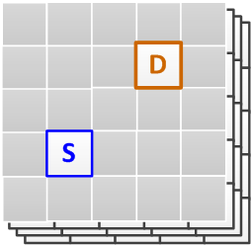
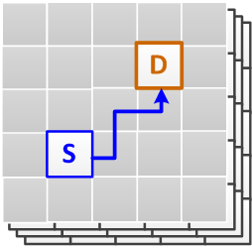
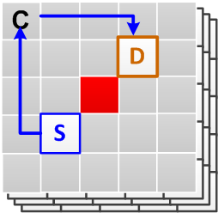
Routing Cases in Beltway Routing
Non-congested Minimal Routing Region
Non-congested Minimal Routing Region
Minimal Adaptive Routing
The congestion information should be known before packet injection.
Minimal adaptive routing is also a cascaded routing
Beltway Routing
Notes:
我們可以透過網路上的congestion information來判斷該走non-minimal beltway或是minimal adaptive routing

Slide 30
Statistical Traffic Load Distribution (STLD) and Latency vs. Network Injection Rate
 | Down-ward | DLDR | DLAR | DLADR | Beltway
Mean | 33042 | 28999 | 30028 | 29028 | 27812
Stdv. | 39087 | 12279 | 19951 | 12326 | 4405
STLD and statistics of STLD show significant load balance by adopting Beltway routing.
Compared with the Downward, DLDR, DLAR, and DLADR, the proposed Beltway routing can improve the throughput by 172.7%, 57.9%, 50.0%, and 50.0%, respectively.

Slide 31
C. Proactive Throttling-based DTM
Thermal-Aware 3D NoC Design
A.
Thermal-
Aware
Routing
B.
Reactive Thermal Management
C.
Proactive Thermal Management
Thermal-Aware 3D NoC Designs
2013 IEEE VLSI-DAT
2014 IEEE VLSI-DAT
Accepted by IEEE Trans. Parallel and Distributed Syst.
US/ROC Patent Application

Slide 32
Performance Impact on Reactive Throttle Nodes
Problems caused by reactive thermal management
Many unnecessary inactive nodes
  Pessimistic reaction (block) on the near-overheated nodes for emergent cooling
Routing problem caused by throttled nodes
Heavy traffic congestion
  Packets are blocked in the network by using conventional routing algorithm
Notes:
造成Performance impact的原因有兩點：第一點是因為我們所採用的reactive DTM會造成許多不必要的fully throttled node出現因而造成的performance degradation、第二點是因為fully throttled node所引發的routing problem接下來幾頁會針對這兩個問題作介紹。

Slide 33
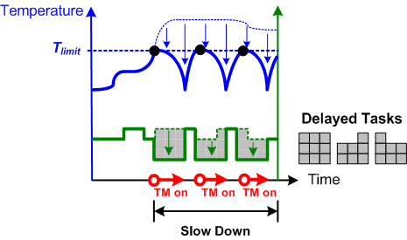
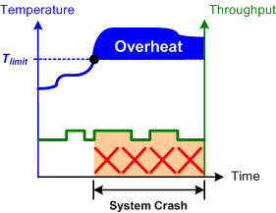
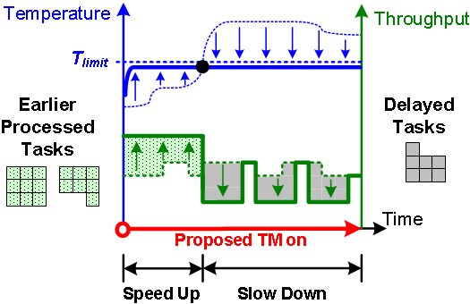

Reactive v.s. Proactive Thermal Management
Reactive Thermal Management
Proactive Thermal Management
Thermal problem in 3D NoC System
Thermal-aware design
Overheat prevention
Serious performance degradation!!
Required Techniques:
Accurate temperature sensing results
Thermal prediction model
DVFS at system level

Slide 34

Proactive Dynamic Thermal Management (DTM)
Prevention is better than cure!
  Thermal Prediction Phase
  Through the thermal RC model, the future temperature can be predicted with low computational complexity.
Thermal Management Phase
  Early control the temperature based on the information of predictive temperature.

Slide 35
Related Works of Temperature Prediction Scheme
Table-based Methods
Phase-Aware Thermal Prediction
  Predict the future temperature based on the data in the look-up table
  Low computational complexity
  Precision depends on the offline profiling
  Large area overhead
Computing-based Methods
RC-based Thermal Prediction
  Predict the future temperature based on the sensing results and current workload
  Less area overhead
  Application independent approach
  Precision depends on the computing time or initial computing parameters

Slide 36
I. Proposed Thermal Prediction Model
T₀: Initial temp.
T_{ss}: Steady state temp.
b: Thermal parameter
T(t): Temp. at time t
Predict the temp. after Δt=> T(t + kΔt_{s}) = T_{current} + ΔT
How to obtain ΔT?
First differentiation can be adopted
ΔT₁
(Current slope)
(Predictive slope)
(Predictive temp. diff.)
Proposed Baseline Prediction Model
ΔT₁
ΔT₂
ΔT_{k}
Constant
Notes:
Now, I will use this figure to show you how we predict the future temperature.
Based on the fourier’s law and the first law of thermodynamics, the temperature increasing trend is an exponential-like trend. And the transient temperature behavior of one tile can be formulated as the TTE. I don’t want to explain the detail the derivation. If you are interested in this, you can read my paper or discuss with me in off-line time.
We assume there is one embedded thermal sensor in each tile, and it can provide one sensing result every delta ts. If the current time is time t, we want to know the temp. at time t plus k delta ts. We call the parameter k as the prediction distance. It mean that the thermal sensing time far away from the current time. Obviously, the temperature at time t plus delta ts is equal to the sum of the current temperature and delta big t. The current temp. can be resulted from the embedded thermal sensor. So, the recent problem is how to obtain the delta big t.
To solve the problem, we apply the differential analysis to the TTE. After that we can approximate the temp. different between the current time t and the previous thermal sensing time. By using the same derivation, we can predict the temp. difference between any future sensing time and its previous sensing time. Finally, we add each temp. difference from the time t the time t plus k delta ts to obtain the delta big t. If the prediction distance k is determined, this term is a constant. Besides, this term is only a summation of geometric series. Therefore, the computational complexity is very low.

Slide 37

Accuracy Analysis of Runtime Thermal Predictor
Index | Setting
Mesh size | 8x8x4
Buffer depth | 16 flits
Packet length | 8 flits
Routing Algorithm | XYZ routing
Traffic Pattern | Uniform Random
Sensing Period | 10ms (or 0.1sec.)
We can confidently predict the temperature under the error, 0.2°C, within 50ms!
Notes:
We also analyze the accuracy of the proposed prediction mode on an 8x8x4 3d noc. To simplify the problem, the xyz routing is adopted and the uniform random traffic is applied. Beside, we use the Hotspot to simulate the embedded thermal sensor.
Because the prediction error affects the efficiency of thermal management, we set the tolerated error to 0.2 degree centigrade as an design example. By this figure, we can find that the prediction error is less than 0.2 degree centigrade while the prediction distance is less and equal to 5. Because we set the sensing frequency to 10ms, we can confidently predict …50ms

Slide 38

II. Early Temperature Control Scheme:
Throttle-based Proactive RTM
P51
Notes:
After introducing the phase 1, the phase 2 of the proposed PDTM-VT is very simple. As my previous mentioned, the TMU will based on the current temp. and the predictive temp. to determine whether the current temp. belong to the red, green or yellow. And perform the corresponding thermal management policy such as fully throttling scheme or partially throttling scheme. In this paper, we adopt the DFS to implement the throttling scheme. Therefore, the alpha means the percentage of the tile’s activities.

Slide 39



Experimental Results – Random Traffic
Maximum Transient Temperature
Numbers of Thermal-emergent Node
-35.1%
VT
VT_PD(1)
-36.1%
-37.0%
VT_PD(2)
VT_PD(3)
Proposed T-PDTM can control the peak temperature in a safe region
T-PDTM can reduce 35.1%~37% thermal-emergent nodes
-36.2%
-36.7%
VT_PD(4)
VT_PD(5)₅

Slide 40

Experimental Results – Transpose1 Traffic
Maximum Transient Temperature
Numbers of Thermal-emergent Node
-52.8%
VT
VT_PD(1)
-55.1%
-54.9%
VT_PD(2)
VT_PD(3)
Proposed T-PDTM can control the peak temperature in a safe region
T-PDTM can reduce 52.8%~57.0% thermal-emergent nodes
-55.7%
-57.0%
VT_PD(4)
VT_PD(5)

Slide 41
Conclusions
To overcome thermal challenges in 3D NoC, we propose three thermal-aware design methodologies:
  Reduce the number of thermally unsafe routers and throttled time in Reactive Thermal Management
    Propose Thermal-aware Vertical Throttling (TAVT) scheme for fast cooling with less performance impact
  Reduce the performance impact of emergency cooling for Non-Stationary Irregular Mesh (NSI-Mesh) caused by throttled nodes
    Two intelligent routing algorithms, Transportation-layer Assisted Routing (TLAR) and Beltway Routing, are used to have efficient routing in NSI-Mesh.
  Improve the sustainability of network by using Proactive Thermal Management
    Design of Low-cost Thermal RC based Temperature Predictor
    Propose Throttle-based management for temperature control

Slide 42
Outline
Part I: Thermal-aware 3D Network-on-Chip Designs
Part II: 研究生應有的觀念態度
NTPU-CSIE
就業
當兵
升學
玩耍?

Slide 43

Position Mapping – Are You Ready?
The most important is…
 | 研究所 | Work (就業、當兵) | Life (升學)
環境 | 實驗室 | 辦公室 | 實驗室
客戶 | 指導教授 | 主管、合作廠商 | 指導教授
工作 | 碩士論文 | 專案 | 博士論文
挑戰 | 畢業工作 | 升官(職等) | 畢業工作
威脅 | 全世界學生 | 全世界廠商 | 全世界學生
Notes:
要如何在你未來的工作崗位成就一番？態度決定一切！

Slide 44





何謂研究生？
爸媽認為我在… | 老師以為我在…
同學覺得我在… | 其實我在…
把該念的東西拖延一星期，那就跟「腳踩進地獄裡」沒兩樣 ─ 上哈佛真正學到的事

Slide 45

WHAT IS “Graduated Student”?
研究生：”Graduated” Student (已畢業的學生)
所以…
  研究生沒有寒暑假
  研究生必須要為自己研究成果負責
  Wikipedia: “A person continuing to study in a field after having successfully completed a degree course.”
  牛津Oxford: “A person who already holds a first degree and who is doing advanced study or research.”
  AHD (The American Heritage® Dictionary of the English Language): “pursuing advanced study after graduation from high school or college.”

Slide 46



WHAT IS “Adviser”?
Adviser (or Advisor) 指導教授 = Advis-er 給建議的人
所以…
  指導教授並不一定要傳授知識給你
  指導教授針對你的論文僅有「建議」的義務而無「成敗」的責任

Slide 47
WHAT IS “Research”?
Research (研究) = Re-Search (重複搜尋)
所以…
  研究必須重覆使用科學方法來找到某種方法
  研究必須要用客觀公正的方法來驗證某種方法的正確性
  研究結果應該是客觀公正的並且須符合科學方法
Loop
  Wikipedia: “the search for knowledge, or as any systematic investigation, with an open mind, to establish novel facts, usually using a scientific method.”
  牛津Oxford: “a careful study of a subject, especially in order to discover new facts or information about it.”

Slide 48
WHAT IS “Good Thesis”?
Thesis is “Professional Book” rather than “Technical Report.”
  Push the frontier of “Knowledge” – not just “Data”
Good thesis should satisfy
  Address a good problem
  Have realistic assumptions
  Original, deep, and substantial
  Good writing
  Good presentation
You MUST learn all of these skills before graduation!
大學：老師告訴你做牛肉麵的方法。
研究所：老師告訴你開牛肉麵店的地點，你要找到一個湯頭讓牛肉麵店賺錢。
博士班：老師問你要開哪種店才會賺錢，你要找到一個total solution給老師。

Slide 49
研究生的觀念、態度與方法
觀念：研究過程是有趣的
WHY?
  AHD (The American Heritage® Dictionary of the English Language): “pursuing advanced study after graduation from high school or college.”
    Pursuing: 追求 (ex. 追求女朋友)
      to be busy with an activity or interest, or continue to develop it.
態度：(如同追求女朋友般)維持興趣、充滿好奇心
方法：練習自我要求
  思想自由，生活嚴謹
  閱讀英文，練習寫作
  面對困難，積極解決

Slide 50

Conclusions
研究(工作)態度無它，只求「放心」而已！
思想要自由，生活要嚴謹
Thanks for your listening!!!

