Slide 1
The Art of Error Correcting Coding
Speaker: Y. H. Chen

Slide 2
Agenda
Reed-Solomon Codes Using Algorithm for Encoder and Decoder
Decoding Binary Quadratic Residue Codes

Slide 3
Reed-Solomon Codes Using Algorithm for Encoder and Decoder

Slide 4
Outline
Introduction
Mathematics Background
Reed-Solomon Code
Software Simulation
Design of Critical modules
Hardware Implementation and Test
Conclusion

Slide 5
Introduction
Application
  DVD, HDTV, CD-ROM, Space Communication
Hardware Modules
  Multiplier, Syndrome, Berlkamp Massey, Chien search, Correction and Inverse modules.

Slide 6
Mathematics Background
Algebraic Structure
  Groups, closure, associatively, identity, inverse
Galois Fields
  q elements in the Finite field
Polynomial Algebra
  Example of

Slide 7
The Reed-Solomon Code
Encode
  if an (n, k) code

Slide 8
For example
Galois field, GF(16)=GF( )
  {0,1,2,3,4,5,6,7,8,9,10,11,12,13,14,15}
Symbol
  m=4 is 4bits symbol
  0 -> 0001, 4 ->0011, 8 ->0101, 12->1111
  1 -> 0010, 5 ->0110, 9 ->1010, 13->1101
  2 -> 0100, 6 ->1100, 10->0111, 14->1001
  3 -> 1000, 7 ->1011, 11->1110,

Slide 9

Encode (15,9) RS code
9 symbols, I(x)
g(x)
C(x)
9 message symbols
6 parity check symbols

Slide 10
The Decoding of Reed-Solomon Code
Decoder
Data in
Peterson algorithm
Berlkamp Massey
algorithm
Euclidean algorithm
Syndrome evaluation
Error locator polynomial
buffer
Chien search
Amplitude
evaluation
Correction
and Inversion
Data Correct

Slide 11
The Implementation of Reed-Solomon Codes

Slide 12
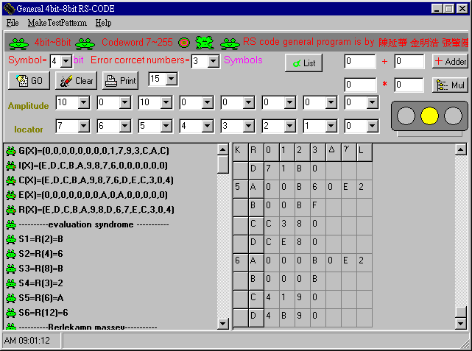
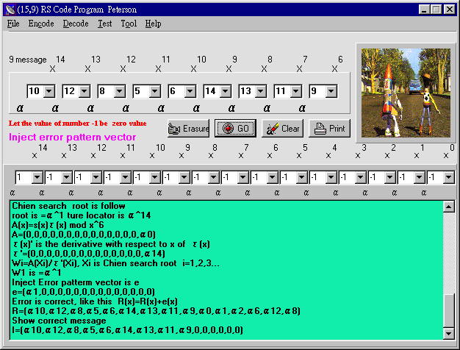
Software Simulation
Verifying RS Code algorithm step by step

Slide 13
..Software Simulation
Software to achieve hardware architecture
  Example Encode using LFSR
C5
C4
C3
C2
C1
C0
I(X)
g6
g5
g4
g3
g2
g1
g0
    NEXT_C0=IX+C5*G6*G0
    NEXT_C1=C0+C5*G6*G1
    NEXT_C2=C1+C5*G6*G2
    NEXT_C3=C2+C5*G6*G3
    NEXT_C4=C3+C5*G6*G4
    NEXT_C5=C4+C5*G6*G6
    Following statements are arouse by the colock.
    C0=NEXT_C0
    C1=NEXT_C1
    C2=NEXT_C2
    C3=NEXT_C3
    C4=NEXT_C4
    C5=NEXT_C5
    C0=IX+C5*G6*G0
    C1=C0+C5*G6*G1
    C2=C1+C5*G6*G2
    C3=C2+C5*G6*G3
    C4=C3+C5*G6*G4
    C5=C4+C5*G6*G5

Slide 14
..Software Simulation
The Functional Block Diagram
The top down design of RS decoder

Slide 15
Design of The Critical Module
The comparison of different multipliers
Serial multiplier
sequential logic
Parallel multiplier
combination logic

Slide 16
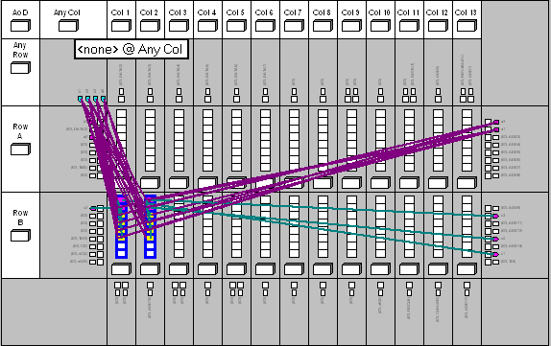
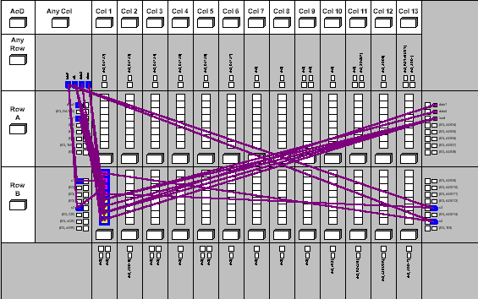
Design of The Critical Module
The FPGA Floorplan of Multipliers
Total dedicated input pins used: 4/4 (100%)
Total I/O pins used: 10/64 ( 15%)
Total logic cells used: 9/208 ( 4%)
clock 125MHZ
Total dedicated input pins used: 4/4 (100%)
Total I/O pins used: 10/64 ( 15%)
Total logic cells used: 12/208 ( 5%)
propagation 14ns
Viewing serial multiplier in the Floorplan (FLEX 8000 EPF8282ACL84-4)
Viewing parallel multiplier in the Floorplan (FLEX 8000 EPF8282ACL84-4)

Slide 17
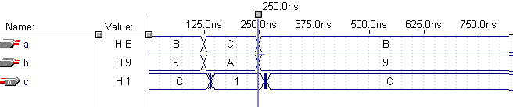
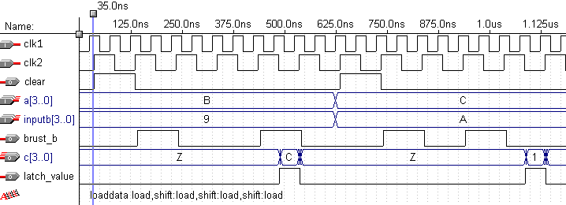
Design of The Critical Module
Timing Requirement
4bit serial multiplier waveform
4bit parallel multiplier waveforms

Slide 18
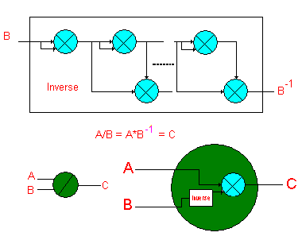
Design of The Critical Module
Inversion circuit design

Slide 19
Hardware Implementation and Test
Syndrome evaluation circuit
.
.
.

Slide 20
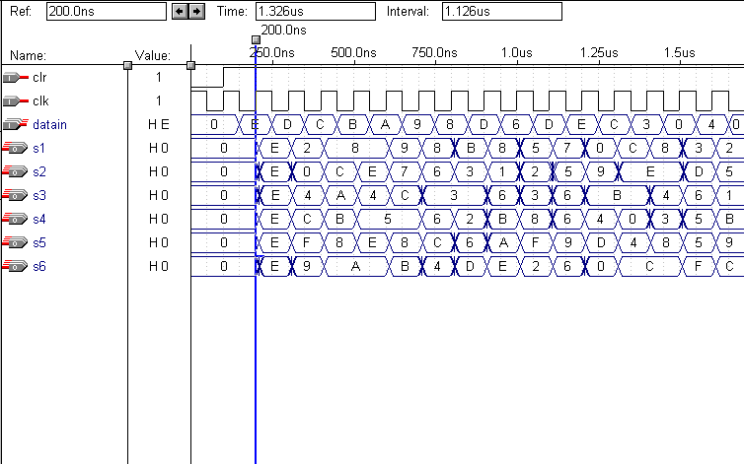
Hardware Implementation and Test
Total dedicated input pins used: 6/6 (100%)
Total I/O pins used: 24/183 ( 13%)
Total logic cells used: 24/4992 ( 0.004%)
clock 125 Mhz
15 clocks for Syndrome

Slide 21
Hardware Implementation and Test
Inversionless Berlekamp Massey circuit
Where C are the coefficients of error locator polynomial

Slide 22
Hardware Implementation and Test
SUBDESIGN BM_CTRL
(
CLKIN :INPUT;
CLEAR :INPUT;
DELETA[3..0] :INPUT;
CLK[3..1] :OUTPUT;
COUNT[3..0] :OUTPUT;
NL[3..0] :OUTPUT;
SELA :OUTPUT;
GAMAR[3..0] :OUTPUT;
)
VARIABLE
CLK1 :DFF;
COUNT[3..0] :DFF;
SELA :DFF;
NL[3..0] :DFF;
GAMAR[3..0] :DFF;
TEMP[4..0] :NODE;
BEGIN
% CLS %
CLK1.CLK = CLKIN;
CLK2 = !CLK1.Q;
CLK1.D = CLK2;
CLK3 = (!CLKIN & (clk1 # !SELA));
% CLOCK %
SELA.PRN = CLEAR;
GAMAR0.PRN = CLEAR;
COUNT[].CLRN = CLEAR;
NL[].CLRN = CLEAR;
CLK1.CLRN = CLEAR;
GAMAR[3..1].CLRN = CLEAR;
% MAKE UP %
COUNT[].CLK = CLK1.Q;
SELA.CLK = CLKIN;
NL[].CLK = CLKIN;
GAMAR[].CLK = CLKIN;
COUNT[] = COUNT[] +1;
% GAMAR && SELAIO%
TEMP[] = (NL[],0);
IF ((DELETA[] != 0) & (TEMP[]<=(0,(count[]-1)))) THEN
GAMAR[].D = DELETA[];
NL[] = COUNT[] - NL[];
ELSE
GAMAR[].D = GAMAR[].Q;
NL[].D = NL[].Q;
END IF;
IF ((DELETA[] != 0) & (TEMP[]<=(0,(count[]-1)))
& (CLK1 != 0) & (SELA != 0))THEN
SELA = GND;
ELSE
SELA = VCC;
END IF;
END;
BM Control module
Timing Analysis

Slide 23
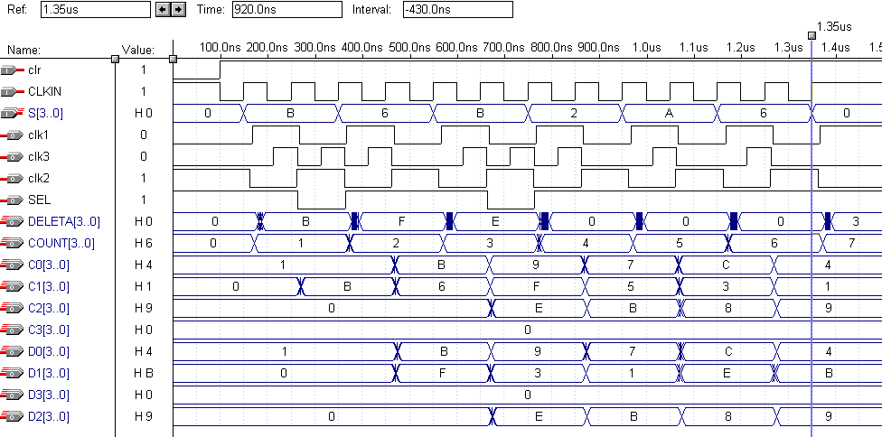
Hardware Implementation and Test
Total dedicated input pins used: 6/6 (100%)
Total I/O pins used: 52/183 ( 28%)
Total logic cells used: 361/4992 ( 7%)
13 clocks for BM

Slide 24
Hardware Implementation and Test
Polynomial Evaluation and Chien search
15 clocks for Chien search need
Forncy’s algorithm

Slide 25
Hardware Implementation and Test
Integrated and pipelined issues
  Numbers of registers for delay buffers are in system
  Timing control in system
Buffer

Slide 26
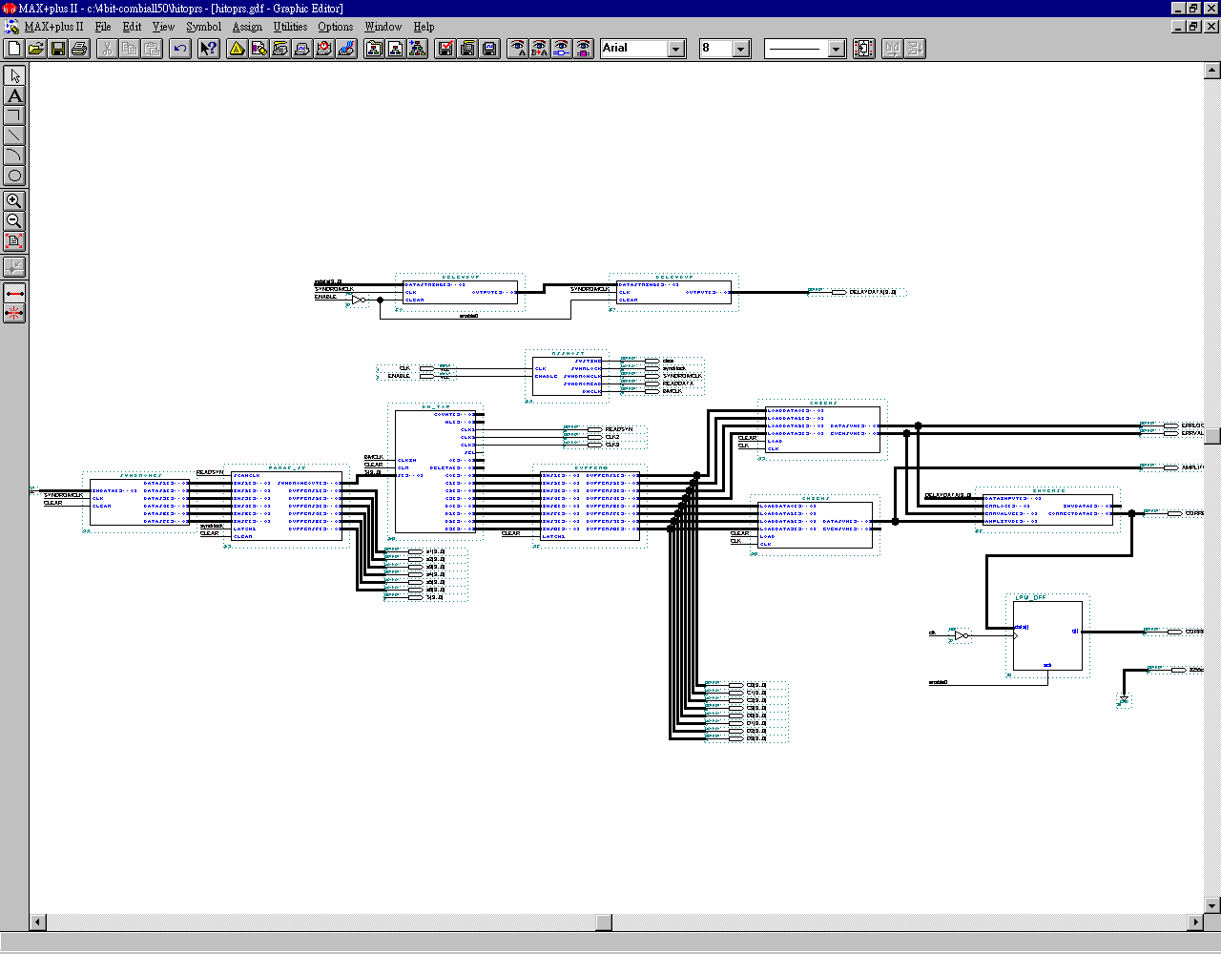
Hardware Implementation and Test

Slide 27
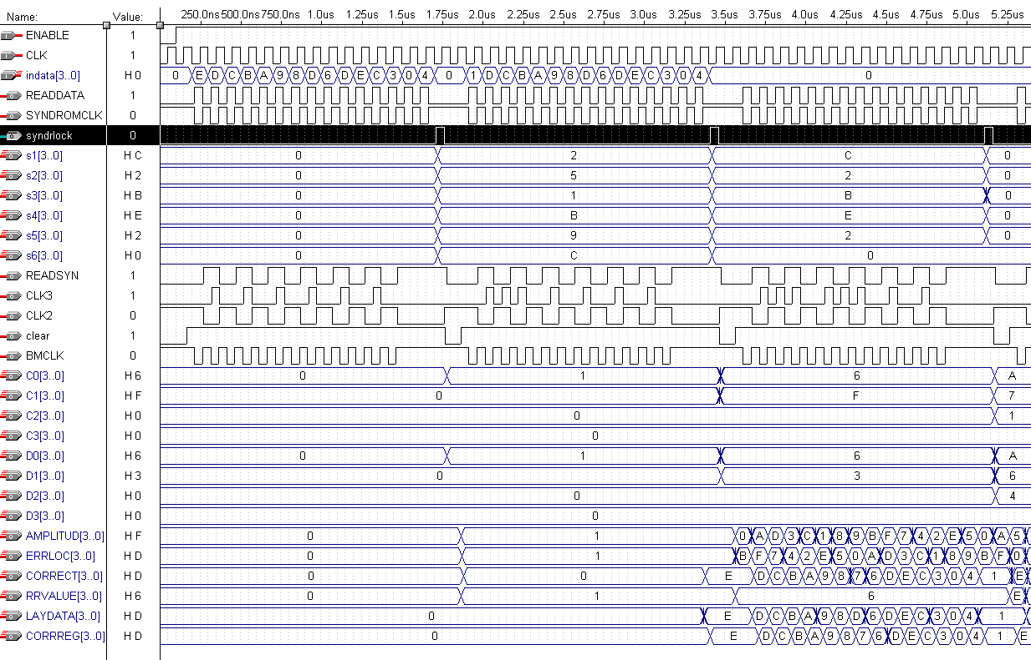
Hardware Implementation and Test
Timing requirements

Slide 28
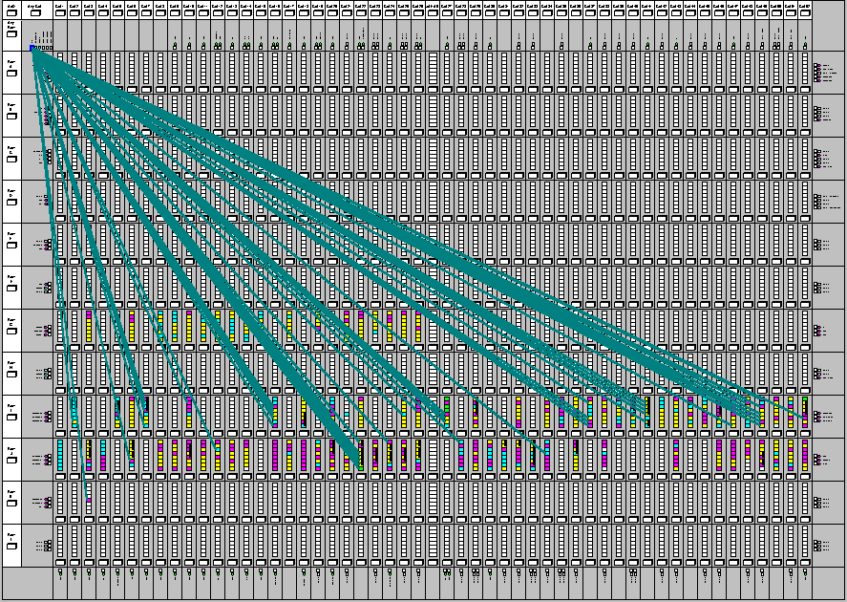
Hardware Implementation and Test
4bit decoder in the floorplan
(FELX10K EPF100KRI240-3)
Total dedicated input pins used: 2/6 (33%)
Total I/O pins used: 100/183 ( 54%)
Total logic cells used: 705/4992 ( 14%)

Slide 29
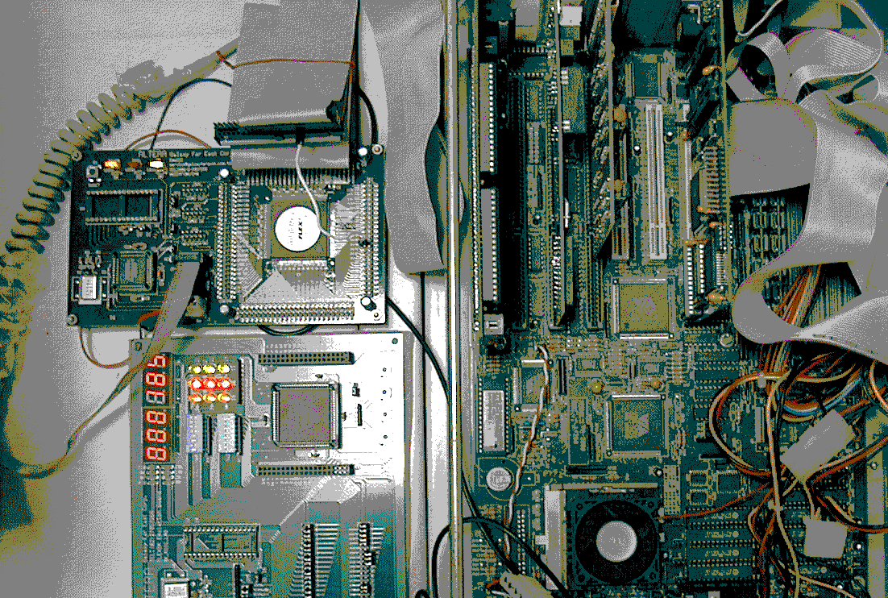
The Prototyping System

Slide 30
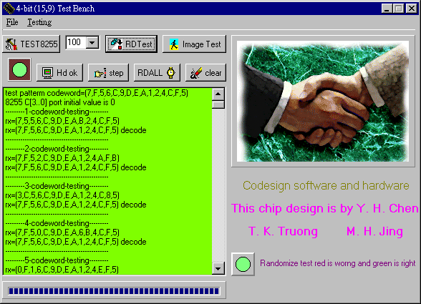
Random Testing

Slide 31
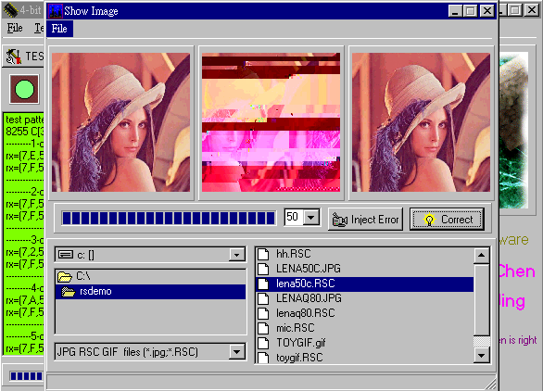
Image Testing

Slide 32
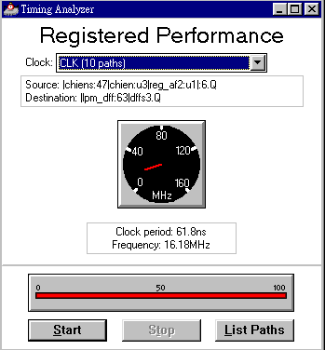
Conclusion
Improved Design Methodology Using Codesign
  Windows, Simulator, Emulator
Critical Modules Improvement
  Multiplier, Inversion
Efficient system development
  Supports of testBench promote the level of the system development

Slide 33
Decoding Binary Quadratic Residue Codes

Slide 34
Outline
Introduction
Conceptual Framework
Methodology of Study
The Algebraic Decoding of Some Quadratic Residue (QR) Codes
Conclusions

Slide 35
(1) Introduction
QR codes have two nice properties:
  Block codes.
  Algebraically decodable.
QR codes are very good codes to use for concatenated codes.
QR codes are cyclic codes.
The QR codes have large minimum distances.

Slide 36
A Concatenated Code

Slide 37
Interleaving
Codeword
Codeword

Slide 38
New Concatenated Code

Slide 39
Large Minimum Distances
(7, 4, 3)
0000 000
0001 011
0010 110
0011 101
0100 111
0101 100
0110 001
0111 010
1000 101
1001 110
1010 011
1011 000
1100 010
1101 001
1110 100
1111 111

Slide 40
Conceptual Framework
Let n be a prime number of the form n=8l±1, where l is a positive integer..
The set of quadratic residues modulo n is the set of nonzero squares modulo n; that is

Slide 41
Conceptual Framework
A binary (n, k, d) QR code is a cyclic code with the generator polynomial g(x) of the form,
Since (n-1)/2=d is the smallest positive integer so that n divide 2^{d}-1, the generator polynomial of the (n, k, d) QR code is irreducible . If the smallest positive integer m so that n|2^{m}-1 is m which is not equal to (n-1)/2, the generator polynomial for this QR code is not irreducible.

Slide 42
Conceptual Framework
A code polynomial c(x) is a multiple of g(x)
e(x) is a error polynomial has v nozero terms.
where

Slide 43
Conceptual Framework
r(x) is a received polynomial.
known syndromes is obtained by evaluating r(x) at the roots of g(x).

Slide 44
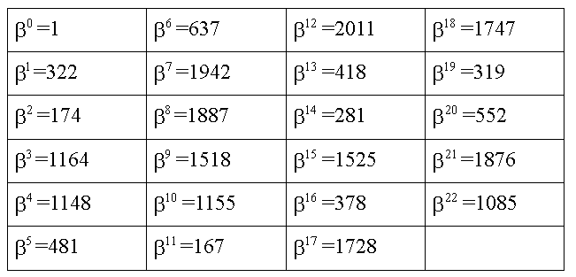
Golay Code Using Lookup Table

Slide 45
Implementation of decoder Using C Code
int De_table[2048];
int beta[23]={ 1, 322, 174, 1164, 1148, 481, 637, 1942, 1887, 1518, 1155, 167, 2011, 418, 281, 1525, 378, 1728, 1747, 319, 552, 1876, 1085 };
void Ge_talbe(){
int Temp = 1; De_table[0]=0;
for (i=0; i< 23; i++) {
De_table[Beta[i]]= (Temp <<i;)
}
for (i=0; i<21; i++)
for(j=i+1;j<22;j++){
De_table[Beta[i]^Beta[j]]=
((Temp <<i)^(Temp<<j));
}
for (i=0; i<20; i++)
for(j=i+1;j<21;j++)
for(k=j+1;k<22;k++){
De_table[Beta[i]^Beta[j] ^Beta[k]]=
((Temp <<i)^(Temp<<j) ^(Temp<<k));
}
int Find_error(int r){
int syndrome;
for(int i=0;i<23;i++)
syndrome=syndrome^De_table[i]*(r>>i)&0x01;
return syndrome;
}
main(){
int c=0; int r;
Ge_table();
r=Addtion_rand_error (c );
c=r^Find_error(r);
}

Slide 46
(4) Algebraic decoding of some QR Codes
Two QR codes use this scheme decoding of (23, 12, 7) and (47, 24, 11).
Two QR codes have lengths greater than 100.
  (103, 52, 19) QR code
  (113, 57, 15) QR code

